Slide 1

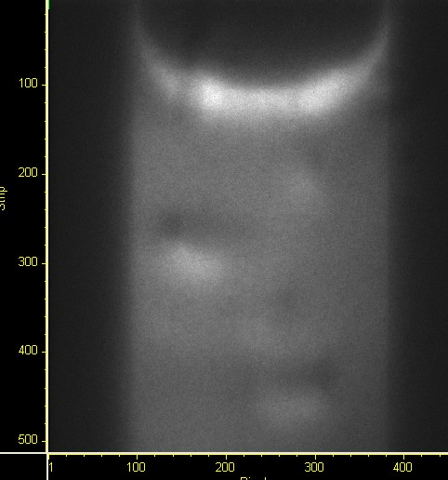
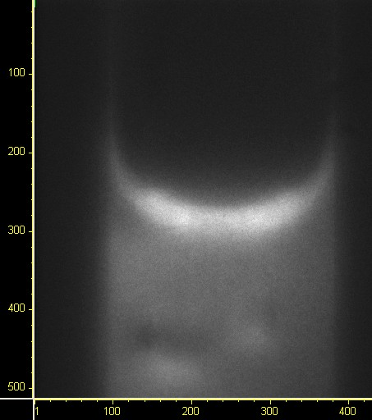
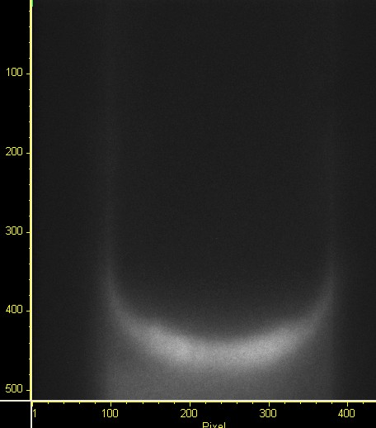
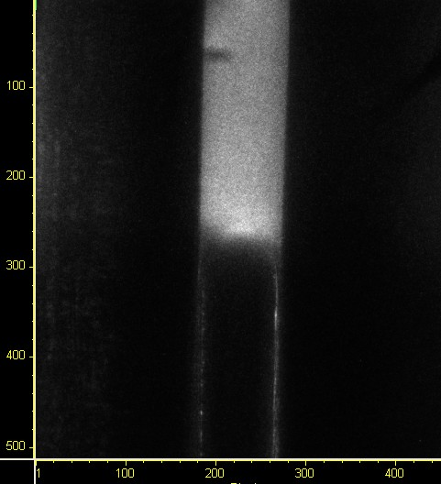
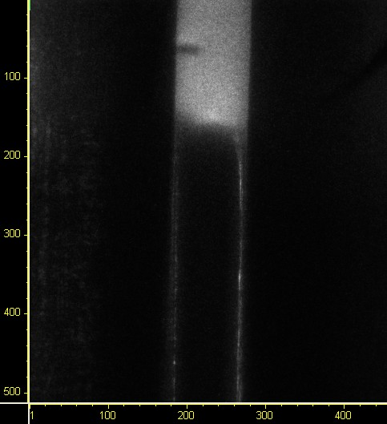
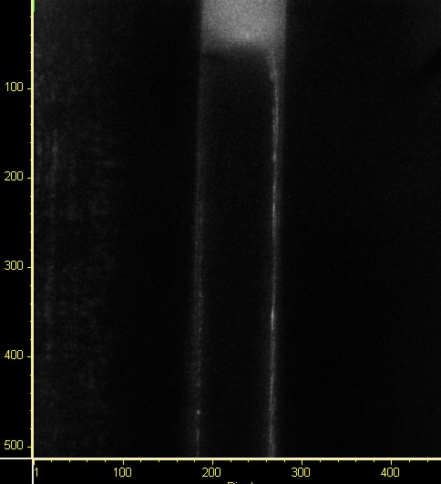
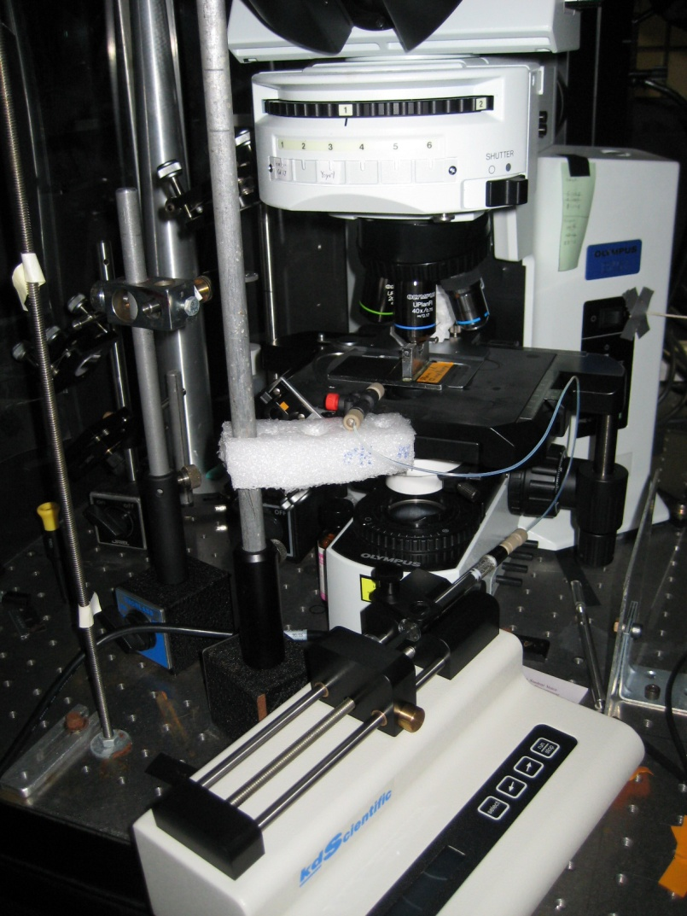
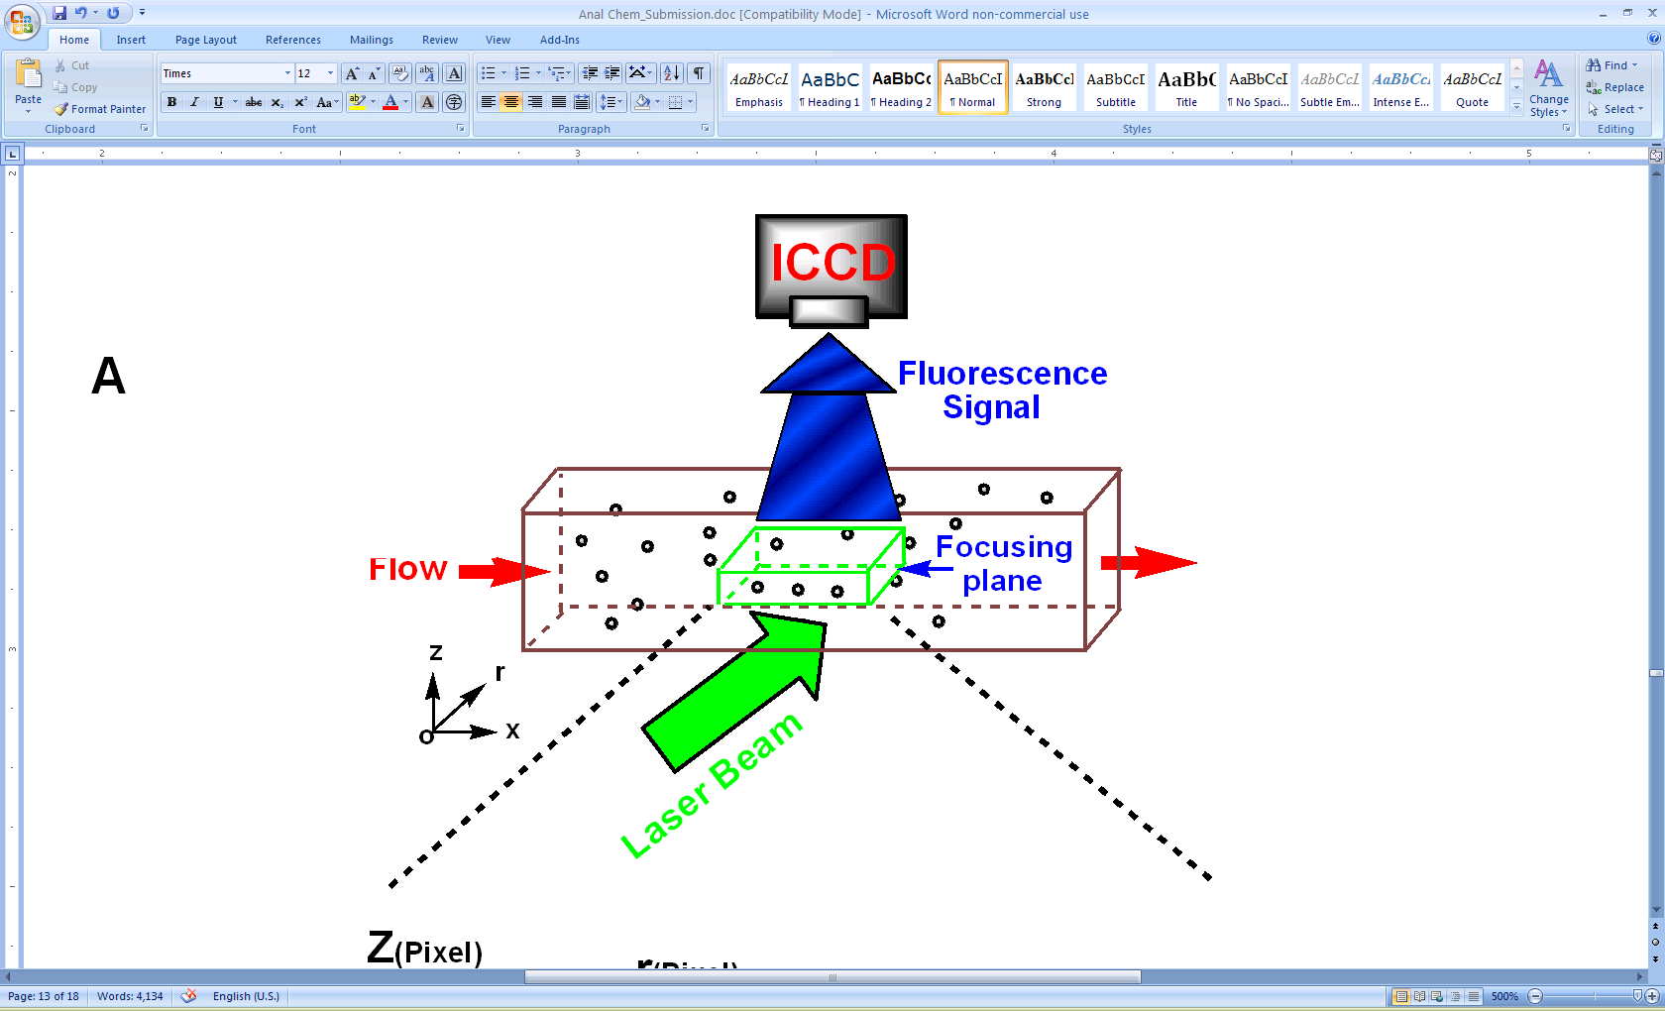
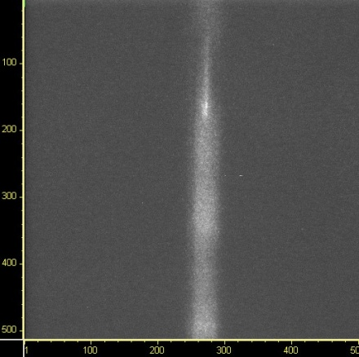
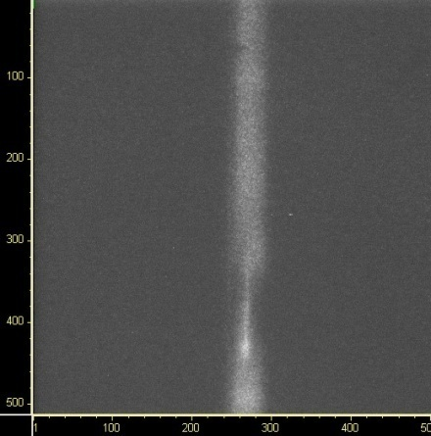
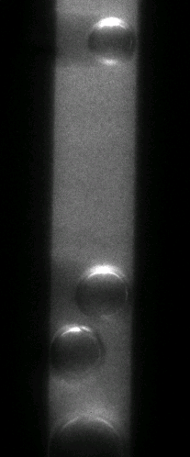
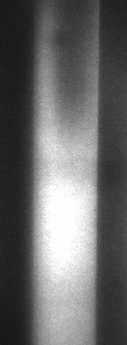
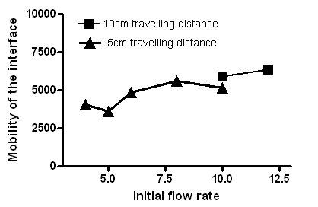
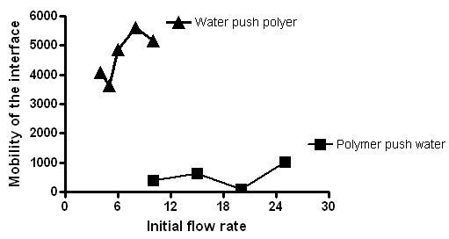
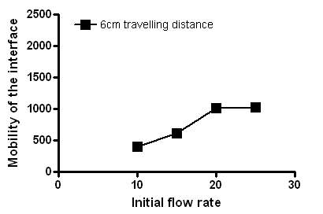
Velocity Profiling of polymer/aqueous phase interface in
microchannel using single molecule imaging system
Xiaoliang Cheng¹, Qihua Wu¹, Baojun Bai², Yinfa Ma¹
¹Environmental Research Centre and Chemistry department at Missouri University of S&T, Rolla, MO 65401
²Department of Geological sciences and Engineering at Missouri University of S&T, Rolla, MO 65401
Introduction
The retention of the injected fluids and the specially designed additives, such as friction reducers, viscosity modifiers was considered as the major cause for productivity impairment in gas wells during drilling, completion and fracturing operation. It requires a better understanding of introduced fluid flow behavior in tight gas and shale formations for gas development to select proper fluids and associated additives that have no damage to the formation. Thus, It is increasingly important to study the flow behavior of interface between polymer and aqueous phase in the microchannel which is a experimental model for porous media.
A novel single molecule dynamic imaging system has been developed. This dynamic imaging system can allow us to follow many fluorescent molecules at the same time in a micro-channel or nanochannel to study their flow behavior and flow velocity.
This work investigated the introduced fluid flow behavior by studying the velocity profile of polymer and aqueous phase interface in the microchannel using single-molecule imaging system combined with microfluidic devices. Specifically, the flow rate profile of polymer and aqueous phase in micro-channels were examined.
Methods, Results and Discussion
1. Single Molecule Imaging System.
3. Gas bubble in polymer solution.
250µm channel
50µm channel
10µm channel
4. Interface between polymer and aqueous solution.
2. Quantitative analysis method.
Quantitative information on boundary shape, migration behavior and velocity profile can be directly obtained from the images. With an in-house computer program, the coordinators of each pixel and interval time between frames can be obtained.
Setup for high-viscosity fluid
Setup for low-viscosity fluid
Polymer in H2O
Gas bubble
in H2O
Conclusions
In order to study the local behaviors of polymer and interactions between polymer and solid/liquid interface in micro-environmental, a specific in-house built single molecule imaging system with capillary as sample channel was designed and set up. Necessary adjustments on the setup and optical pathway optimization were conducted to generate the best signal/noise ratio. Quantitative analysis method was setup to calculate the position, size and flow rate of boundary and gas bubbles in micro-channel.
Authors thank the Financial support from Research Partnership to Secure Energy for America and Missouri S&T

