Slide 1
Information management in V2V networks
Sriram Chellappan
Computer Science, Missouri S&T – Rolla, USA

Slide 2
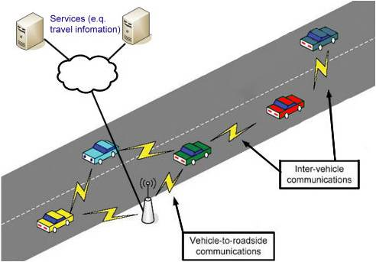
Overview
V2V Networking
V2V communications are emerging
DSRC standard has been proposed
75MHz of spectrum in the 5.9GHz
A host of applications are possible

Slide 3
Salient Features
V2V communications are different from existing mobile networks like
MANETs
Mobile Sensor Networks
Consequently existing approaches do not suffice
Future frameworks must be holistic in nature
Fundamentally new designs are needed

Slide 4
Some On-going Works
Optimization of RSU deployment for V2V support
Design of protocols at the network layer from medium access and routing
Algorithms for content management in V2V networks
Storage, Identification and Retrieval
Incentive management via economic models
Security and Privacy
Sybil attacks, Location privacy

Slide 5
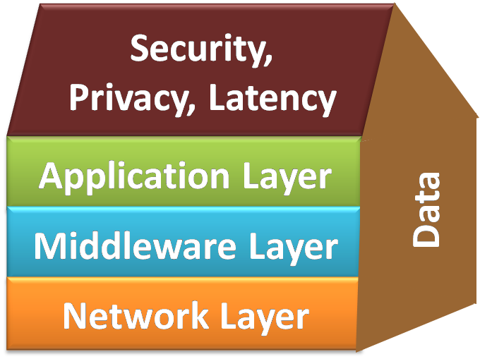
Proposed Research
An integrated cross layer approach for information management in V2V networks
Our Proposed Framework

Slide 6
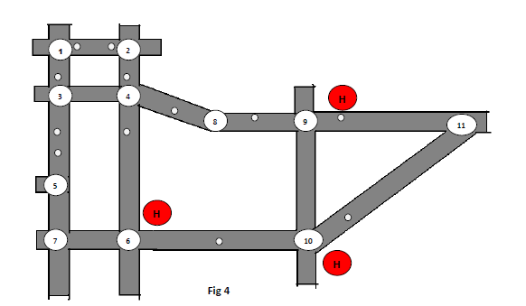
Network Layer
Tree based protocol for query/ content dissemination in VANETs

Slide 7
Network Layer Challenges
Taking road topology into consideration
How to ensure integration of wireless transmission and node mobility
Minimize overhead at the expense of latency
Key issue is to exploit controlled node mobility
Adaptive protocols for dynamic road conditions
Analyzing Physical and MAC layer issues and integrating with Routing

Slide 8
Security and Privacy
A host of attacks are possible in VANETs
Attacks can occur with multiple objectives
Application level – Sybil Attacks, False Messages, Data Integrity attacks
Network level – Packet drops, Selective forwarding
Location privacy, Non deducibility

Slide 9
Open Issues
Integrated approaches are the need of the hour
How can context and situational awareness be integrated with the network functionality
How can application layer semantics like latency and reliability integrate with various layers
How can security integrate with the layers
Solutions should rely on traditional cryptography, mobility management, infrastructure aware, and social sciences

Slide 10
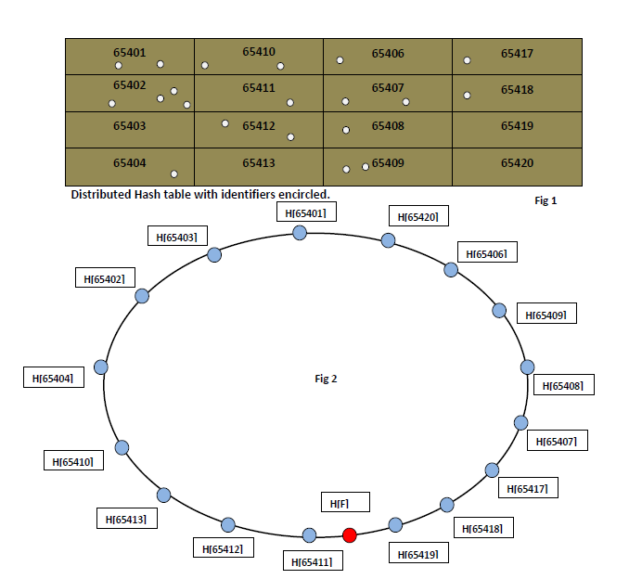
Inform loc
65401
Request file
Retrieve loc

Slide 11
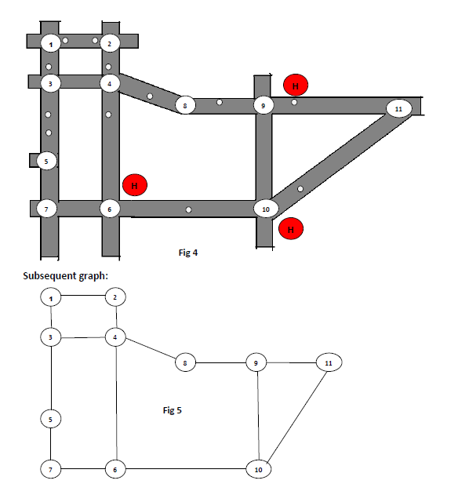
Replication Approaches:
Hotspot
Tree Based Approach (TBR).
Djiktra’s Path Forwarding Approach (DPFR)
Hybrid Approach (DPFTBR)
Hotspot (Density of vehicles are more)

Slide 12
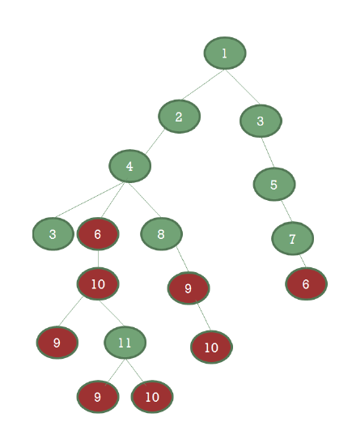
Tree Based Replication Approach:
Algorithm:
The road topology is converted to graph.
Master node ←Intersection where the inform message originates.
1. The root node is the master node and children of the root nodes are the neighbors of the root node.
2. While (true)
3. If nodes have not occurred in previous level, expand it such that, it’s one hop neighbors are its children. Mark the node as visited.
5. @expand: If a neighbor is already
a child of another node at the
same level ,don’t add it as a child.
7. Else If (All nodes in current level is visited)
break;
8. level ++;
9. End
Replicating Files and Information based on Constructed Tree:
Steps:
The originating node will construct the tree based on the algorithm, and identifies the hot spot under it.
If there are various hot spots under it, it duplicates the File/Information with respect to the number of children having hotspots and handles it to neighboring cars reaching the subsequent intersection.
The packet handled to the neighboring car contains the virtual tree and duplicated file/information.
The subsequent cars at intersections getting this duplicated packet, has the virtual tree and hence repeats the above process and performs duplication if needed and handles the packets to cars moving towards intersections below it.
This form of duplication and handling of packets to vehicles takes place until all the hotspots at leaves are reached.

Slide 13
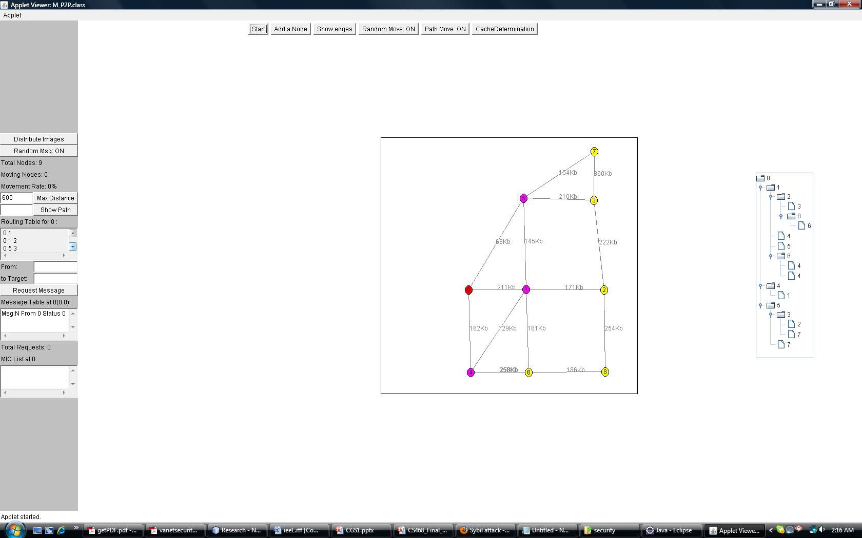
Implementation:

Slide 14
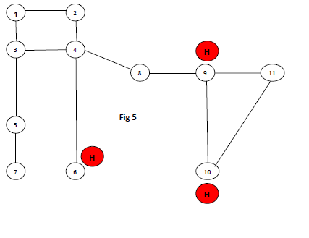
Djiktra’s Path Forwarding Approach:
Djiktra’s Path Forwarding Replication approach (DPFR):
In this approach, we are using Djiktra’s shortest path algorithm to calculate the shortest path to the appropriate hot spots and forward packets accordingly.
Steps:
1) The car at the originator intersection, where the message originated from an external zone will calculate the shortest path to the hot spots.
2) It handles the packet along with the path to the vehicle moving to the next intersection in the shortest path.
3) If an intersection lies in the shortest paths to two or more hot spots. It will handle the corresponding shortest paths.
4) The vehicle at each intersection checks the path, if the next intersection is common for both the paths it does not duplicate and just handles packet to subsequent vehicle.
5) If the next intersection is not common it duplicates two packets having same File/Information, but different shortest paths corresponding to their route.
6) This continues until the hotspots are reached.
If a car at intersection 1 gets an inform message it calculates the shortest path to hotspots as
1) To 6=1->2->4->6
2) To 9=1->2->4->8->9
3) To 10=1->2->4->6->10

Slide 15
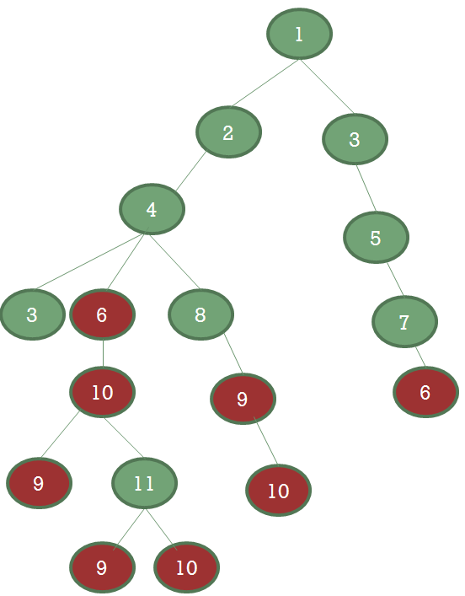
Hybrid Approach:
“In case of DPFR, while calculating the shortest path to hotspots, if the objective is to avoid unwanted duplication at early stage. Check the tree generated through TBR, if the tree provides a sub tree to reach all the hotspots. Choose path across the root of the sub tree ignoring the shortest path”
Consider in case of DPFR, if a car at intersection 1 gets an inform message, it calculates the shortest path to hotspots as
To 6 ←1->3->5->7->6
To 9←1->2->4->8->9
To 10←1->2->4->6->10
6 can be reached either through 3 or 2, though through 3 is the shortest path, if it chooses path 1->2->4->6, it avoids duplication at early stages.

Slide 16
Comparsion:
 | Advantages | Disadvantages
TBR | The overall complexity is O(nlgn) | Multiple replications occur, with increase in no of hot spots under a specific sub tree No efficient usage of shortest path to destination nodes.
DPFR | Avoids multiple replications as compared to TBR approach. | The worst case running time complexity of the algorithm is O(n²). The TBR algorithm has worst case complexity of O (nlgn), which is lesser than DPFR.
DPFTBR | 1. Effective utilization of both the approach. | Running time complexity is O(n³ lgn), which is not fair compared to the above two.

Slide 17
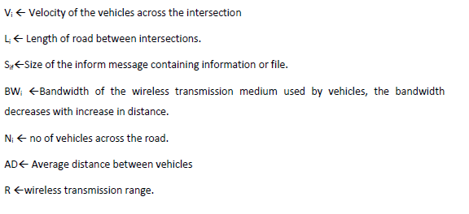
Djiktra’s Edge Weight:

Slide 18
Amazon rule:
This rule is derived with an idea used in Amazon website, when people purchase an item; the site will give suggestions as such “Frequently bought together”. We are also using a metric known as Call to Popularity ratio (CPR) to satisfy request in advance incorporating Amazon rule.
CPR_{file} = No of requests to the file from calling zone
Popularity of the file
When a request for a file F1 arrives from a zone Z, the CPR_{F1} is compared with the CPR values of files requested from Z, if there is a correlation between CPR_{F1} and CPR_{F2} derives a rule
CPR_{F1} ➔ CPR_{F2}
Which means when a request for file F1 comes from a zone other than Z, it is more advisable to attach file F2 also. The above rule is similar to Amazon’s suggestion, vehicles which have requested for file F1 has mostly requested for file F2 also.
 |  | CPR_{F1} ➔ CPR_{F2} D
Z |  | X Req F1

Slide 19
Cryptographic Solution:
Digital Signature
-Before handling the file it should check , whether it is handling file to a good vehicle.
-Malicious vehicles are those having pirated copies
All the vehicles of a zone share a common symmetric key P_{k} .
When a vehicle enters a zone, a certification authority issues a public key and certificate specific to a zone.
The certificate authority runs a remote application to scan the vehicle file data base to identify pirated copies.
If scan is successful it issues the public key and certificate specific to zone.
When a vehicle wants to send a file to another vehicle. It does the following.
V → N_{i} : Request for Certificate.
N_{i} → V : P_{k} (CERT_{ZONE})
V→ N_{i} : P_{k} (CERT_{ZONE} ,M)
V decrypts and verify the certificate, if authorized handles the file to the car.
DisAdvantages: Could not avoid middle attack. i.e.) when a malicious vehicle eavesdrops the message send from CA to good vehicles.

Slide 20
Cryptographic solutions:
To avoid middle attack, the vehicles participating in file sharing share a common hash algorithm
Including hash function, the solution will be
V → N_{i} : Request for Certificate.
N_{i} → V : P_{k} (H(CERT_{ZONE} ) )
V→ N_{i} : P_{k} (H(CERT_{ZONE} ) ,M)
But still hash collision attack can cause problem.
Moreover, practically having a common hash algorithm is difficult in this architecture.

Slide 21
Various attack models:
Examining some attack models in the above replication architecture.
Eavesdropping.
Malicious Data/Digital Signature Attack.
Denial of Service.
Sybil Attacks.

Slide 22
Malicious Data-Digital Signature Attack :
A vehicle convince other vehicle by passing in-correct data.
A malicious vehicle, which has eaves dropped CA information, send a pirated copy to a honest vehicle.
Through this the honest vehicle becomes malicious when it reaches other zone.
How this Attack will be carried out
MV₁ enters Zone “Z”.
CA_{Z} rejects CERT_{ZONE} and P_{k}.
MV₁ eavesdrops CERT_{ZONE} & P_{k} .
MV₁→ V₂ : Request for Certificate
V₂ → MV₁ : P_{k} (CERT_{ZONE} )
MV₁→ V₂ : P_{k} (CERT_{ZONE} ,Pirated(M))
Now V₂ becomes malicious, when it reaches other zone.
This kind of attack can be done single hop or multiple hop, since we are having symmetric key.

Slide 23
Denial of Service-Malicious node Attack:
Dos and an idea to avert this attack.
Can drop some of the data packets.
Can alter the path in DPFR approach and hybrid approach.
This can be averted by providing a confidence metric to cars.
The confidence metric for a vehicle increases with its participation level in file sharing.

Slide 24
Sybil Attacks:
The solution to DOS can motivate sybil
“A Sybil attack is one in which an attacker subverts the reputation system of a peer-to-peer network by creating a large number of pseudo -nymous entities, using them to gain a disproportionately large influence.”
Pseudonymous entity =Cost metric, which is a solution to prevent DOS.
A malicious vehicle compromises a good vehicle by eavesdropping CERT_{ZONE} and P_{k}.
It pretends to have the highest confidence metric.
So multiple vehicles will transfer file to this malicious vehicle.
MV₁ eavesdrops CERT_{ZONE} & P_{k} .
V₂ →MV₁ : Request for cost metric
MV₁→ V₂ : P_{k} (CERT_{ZONE} , falsified cost metric )
V₂ verifies certificate by decryption
V₂ →MV₁ : P_{k} (CERT_{ZONE} ,(M))
MV₁ overcame defense against DOS, and performs its usual peril actions.
The CA can check the speed of cars across intersections, if the mobility is less then it can do the piracy validation of those cars and detect malicious cars.
Disadvantage: The CA has to have a track on the zone periodically which increases the communication cost.

Slide 25
Solution to avoid Sybil attacks
How can the CA distinguish the mobility pattern ?
Identify the vehicle position by using Reduced signal strength indicator.
Correlate the speed limit with consistent positions of the vehicle across the intersection.
Greater deviation shows the vehicle is malicious.

Slide 26
Survey of various attacks:
Survey of additional attacks that could take place in this architecture.
No of  ← Vulneratbility level
Attacks | Description | Effect
Eavesdropping | The ultimate source of all the attacks. | 
Impersonation | A malicious vehicle pretending to be a good vehicle. | 
Denial of Service | Dropping packets | 
Digital Signature | By sending malicious data (pirated files) | 
Sybil | Solution to Dos motivates this attack. | 
Worm hole | Tunnel data to attacker at another location instead of hotspot, disrupts routing | 
Black hole | Consumes packet with out forwarding, Suppression takes place in few packets leaving others, limiting suspicion. | 

Slide 27
Survey of various attacks:
Survey of additional attacks that could take place in this architecture.
Attacks | Description | Effect
Resource consumption | An attacker attempt to consume battery life | 
Location disclosure | The attacker retrieves road map and plan for further attacks. | 
Byzantine | An extension of worm-hole, where set of nodes collaborate to form routing loops. | 
Replay | Repeating the data again and again and dumping the memory of destination. | 

Slide 28
THANK YOU ALL
Thanks to Advisor Dr.Sriram Chellapan

