Slide 1
AZF Ammonium Nitrate Explosion
By: Alexander Dobson
Tyler Gach
Sean Sullivan
Notes:
Group

Slide 2
Outline of Presentation
Introduction
Process Description
Timeline
Results
Root Causes
Lessons Learned
Summary
Notes:
Tyler

Slide 3
Introduction
Explosion occurred at the Azote Fertilisant Plant (AZF) in Toulouse, France on September 21st, 2001
The explosion caused 30 fatalities
The plant was owned by the Total Group (an oil and gas company)
The explosion occurred in a storage tank for downgraded ammonium nitrate
Notes:
Tyler

Slide 4
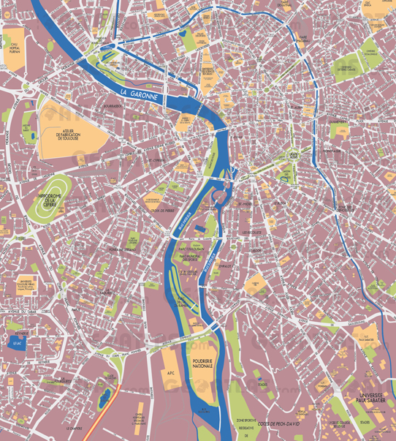
Introduction

Slide 5
Process Description
Reacting Ammonia and Nitric Acid
NH₃ + HNO₃ →NH₄NO₃
Liquid Ammonium Nitrate
Concentrated
Formed into Solids
Prilling
Granulating
Solid Screening
Recycle
Location of Explosion
Final Product
Notes:
Tyler

Slide 6
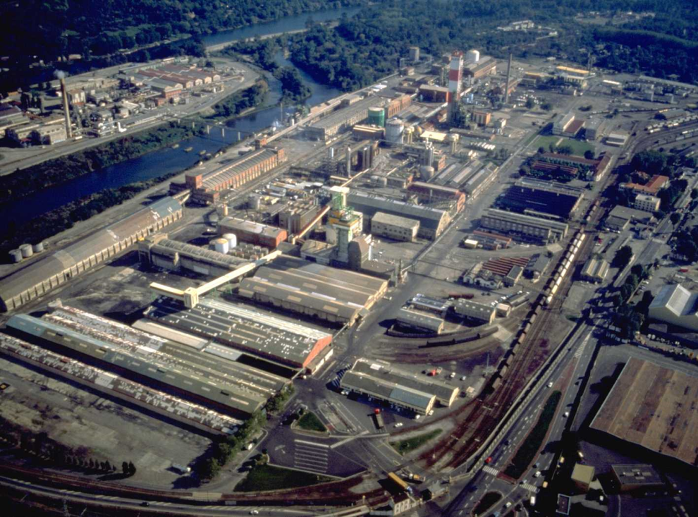
Process Description
The AZF explosion occurred in a storage tank for downgraded Ammonium Nitrate before it was recycled
At the time of the explosion, the tank contained 300 tons of Ammonium Nitrate.
Notes:
Tyler

Slide 7
Timeline
September 20th, 2001
15 to 20 metric tons of Ammonium Nitrate was moved into building 221-222
September 21st, 2001, morning
Ammonium Nitrate packing products were moved into the building
September 21st, 2001, 10:12 AM
A Grand Paroisse employee left an adjacent, sack-filling building. He reported that nothing was out of the ordinary
September 21st, 2001, 10:17 AM
An explosion occurred in building 221 when 40 to 80 metric tons of Ammonium Nitrate exploded killing 30 and injuring 2200. The explosion left a crater that was about 60 meters in diameter and 7 meters deep. A number of nearby tanks containing Ammonium Nitrate were also damaged by the explosion, but did not detonate
Notes:
Dobby

Slide 8
Timeline
September 22, 2001
The Total Group set up an emergency relief fund for accident victims
October 24th, 2001
The Inspection Générale de l’Environnement released their public report on the accident
February 2002
A parliament commission released their public report of the incident
March, 2002
The Total Group reported their investigation of the incident
Notes:
Dobby

Slide 9
Timeline
April, 2002
The Total Group closed down the AZF plant.
June 11th-14th, 2002
Several Grand Paroisse employees were taken into custody. All but one, the plant’s general manager, were eventually exonerated
June 15th, 2002
The police released a press report on the incident. Experts believed the cause of the explosion was a mixture of Chlorine and Nitrates
Notes:
Dobby

Slide 10
Results
The blast at the AZF plant resulted in the loss of 30 lives, 22 of which were employees, and 8 of which were from the public
In addition to the fatalities, 2242 people were injured and 5079 people were also treated for stress
Glass breakage up to 5 kilometers from the explosion
Crater lip up to a radius of 30 meters from the explosion
Notes:
Sean

Slide 11
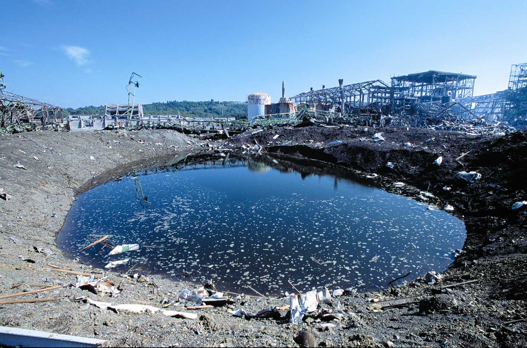
Results
Notes:
Sean

Slide 12
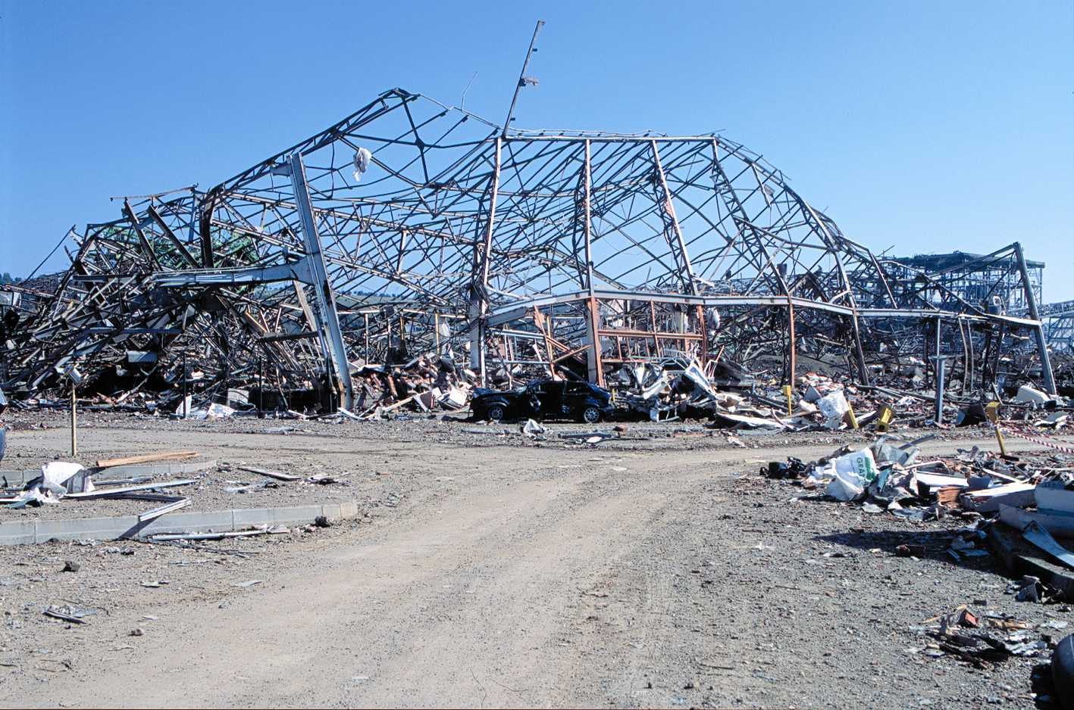
Results
Overpressure calculation
The blast was comparable to 40 tons of TNT; 80 tons of ammonium nitrate detonated
Building Destruction
Non-metal buildings made uninhabitable up to 900 meters from the explosion
Complete destruction of buildings up to 300 meters from the explosion
Notes:
Sean

Slide 13
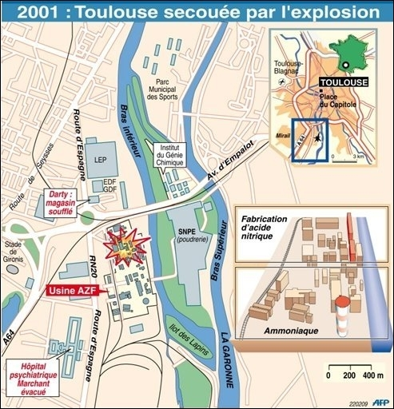
Results
Complete Building Destruction
Non-metal Building Uninhabitable
Notes:
Sean

Slide 14
Results
More than 500 homes became uninhabitable, and 85 educational buildings were damaged.
Costs:
Cost to insurers -1.5 billion Euro ($2.016 billion)
Cost to the government - 228 million Euro ($306 million)
Cost to Total - 2 billion Euro ($2.68 billion)
In April 2002, the AZF plant was closed by Total
Notes:
Sean

Slide 15
Root Causes
Terrorist attack
Ten days after the September 11th, 2001 attack
A smaller explosion before the major explosion
Dismissed due to lack of evidence
Notes:
Sean

Slide 16
Root Causes
Sodium dichloroisocyanate
Chlorine and ammonia gases released
Mistakenly stored and labeled
Added ammonium nitrate
Contact with moisture
Dormant WWII bomb explosion
Dr. Georges Guiochon of the University of Tennessee
Steam plume electrified the ground by contact with power lines
Electrified ground detonates dormant bomb resulting in the secondary explosion of the Ammonium Nitrate reject tank
Notes:
Sean/Tyler

Slide 17
Lessons Learned
Though exact cause of the explosion is still unknown some lessons can still be learned
Prevent Civilian Encroachment
Between 1975 and 1990, the area around the plant became increasingly populous
Preventing this development could have prevented the 8 civilian deaths and some of the 2000 injuries
Notes:
Dobby

Slide 18
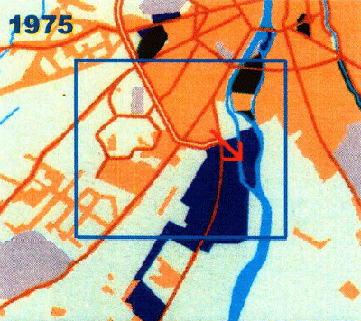
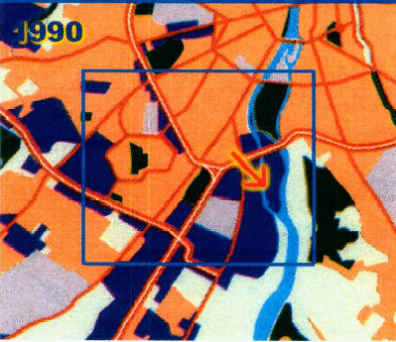
Civilian Encroachment
Notes:
Dobby

Slide 19
Lessons Learned
Monitor Storage Conditions
The area’s overall conditions were relatively poor
The conditions of the facility were largely unmonitored
If the explosion was caused by Sodium Dichloroisocyanate then maintaining low moisture levels would have prevented the explosion
Notes:
Dobby

Slide 20
Summary
The AZF explosion left many questions and 30 people dead
The root cause of the explosion is not known but a number of theories have been proposed
Sodium Dichloroisocyanate
Dormant Bomb
Brought to light the dangers of living near facilities that store large amounts of explosive chemicals and the importance of chemical monitoring.
Notes:
Tyler

Slide 21
References
1 http://www.hse.gov.uk/landuseplanning/toulouse.pdf
2 Dechy, Nicolas. Bourdeaux, Thomas. Ayrault, Nadine. Kordek, Marie-Astrid. Le Coze, Jean-Christophe. (2004). "First Lessons of the Toulouse Ammonium Nitrate Disaster, 21st September 2001, Azf Plant, France". Journal of Hazardous Materials. , 111(1-3), 131-138.
3 http://histoire.total.com/index_en.html
4 http://www.efma.org/documents/file/bat/BAT%20Production%20of%20Ammonium%20Nitrate%20and%20Calcium%20 Ammonium%20Nitrate.pdf
5 http://www.wsws.org/articles/2001/sep2001/toul-s25.shtml
6 http://aiche.confex.com/aiche/s12/webprogram/Paper241840.html
7 http://www.epa.gov/ttnchie1/ap42/ch08/final/c08s03.pdf
8 http://www.ncbi.nlm.nih.gov/pubmed/15939859
9 http://www.aristatek.com/newsletter/0709september/techspeak.aspx
10 http://www.unep.fr/scp/sp/disaster/casestudies/france/
11 http://www.chem.info/News/2009/11/Factory-Chief-Acquitted-Over-AZF-Disaster-That-Killed-31/
12 http://www.erris.org/accidents/majaccidents/toulouse.html
13 http://pedagogie.ac-toulouse.fr/histgeo/monog/azf/azf.htm

Slide 22
QUESTIONS?
Notes:
Tyler

