Slide 1
Lecture 28: Heat energy and transport
0th law of Thermodynamics
Heat and temperature change
Heat transfer

Slide 2
Zero-th Law of Thermodynamics
Two objects in thermal contact, no interaction with the environment → will reach the same temperature after sufficient time.
= Thermal equilibrium.
If two objects are in thermal equilibrium with a third object, they are in thermal equilibrium with each other.
Basis for any temperature measurement

Slide 3
Energy transfer
If two objects are in contact: Energy transfer.
Heat energy transferred because of difference in temperature.
Heat is always flowing from hot object to cold object
If heat is put into an object, its temperature rises.
$$ΔT=\frac{Q}{mc_{substance}}$$
$c_{substance}$ is called specific heat,
heat capacity

Slide 4
Heat
$$Q=mcΔT$$
$Q$ is the amount of heat energy that needs to be transferred into mass m of the substance to change its temperature by $ΔT$.
If $Q$ is positive:
$ΔT$ is positive (temperature increases)
Heat energy flows into system
If $Q$ is negative:
$ΔT$ is negative (temperature decreases)
Heat flows out of the system

Slide 5
Heat in phase changes
Phase changes (phase transitions) require (+) or release ( $−$) extra amount of heat.
solid liquid
$$Q=+mL_{f}$$
$$Q=−mL_{f}$$
$L_{f}$ latent heat of fusion
$$Q=+mL_{v}$$
liquid gas
$$Q=−mL_{v}$$
$L_{v}$ latent heat of vaporization

Slide 6
Example 1
300 g of tea at 70º C are poured into a 120g cup made of aluminum that is at a temperature of 20º C. What is the final temperature?

Slide 7
Example 2
You have 0.25 kg of water at 25 ºC and are adding ice to it that has a temperature of – 20ºC. How much ice is needed to that the final temperature of the mixture is 0ºC and all ice is melted? Neglect the container.

Slide 8
Three mechanisms of heat transfer
Conduction
Convection
Radiation

Slide 9
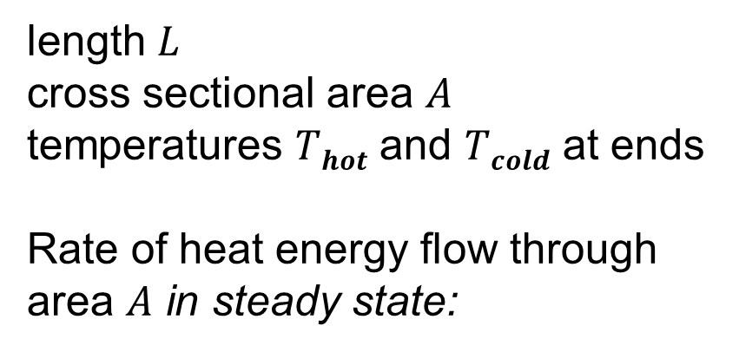
Heat conduction
length $L$
cross sectional area $A$
temperatures $Thot$ and $Tcold$ at ends
Rate of heat energy flow through area $A$ in steady state:
$$H=\frac{dQ}{dt}=kA\frac{T_{hot}−T_{cold}}{L}$$
$k$ thermal conductivity, material property

Slide 10
Material boundaries
Layers of different materials with different thermal conductivities $kn$ and thickness $Ln$:
$$H=A\frac{T_{hot}−T_{cold}}{R_{tot}}$$
$$R_{tot}=\sum{R_{n}} R_{n}=\frac{L_{n}}{k_{n}}$$

Slide 11
Example
A rod of uniform cross section has its left end placed in water of a
temperature 10ºC and its right end at 40ºC. The left half of the rod
consists of material A with a thermal conductivity of 400 W/mºC, the right half of material B with thermal conductivity of 200 W/mºC. The temperature in the middle of the rod is:
A) 20ºC B) 25º C C) 30.5º C D) 18ºC

