Slide 1
Lecture 29: 1st Law of Thermodynamics
thermodynamic work
1st law of Thermodynamics
equation of state of the ideal gas
Isochoric, isobaric, and isothermal process in ideal gas

Slide 2
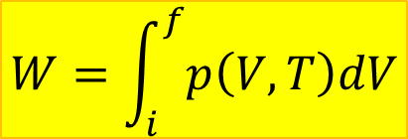
Thermodynamic work
$$W=\int_{i}^{f}{p\left(V,T\right)dV}$$
work done by the gas

Slide 3
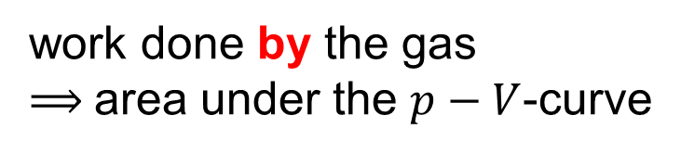
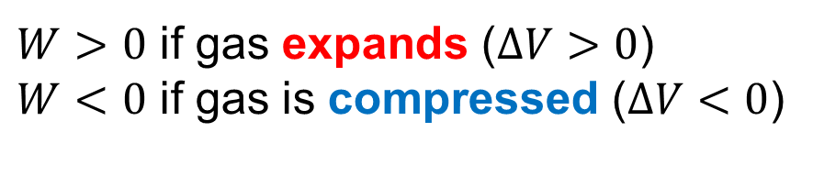
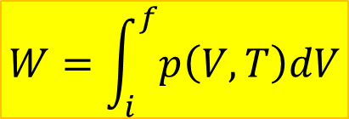
Work and p-V curve
$$W=\int_{i}^{f}{p\left(V,T\right)dV}$$
work done by the gas
⟹ area under the $p−V$-curve
$W>0$ if gas expands ($ΔV>0$)
$W<0$ if gas is compressed ($ΔV<0$)

Slide 4

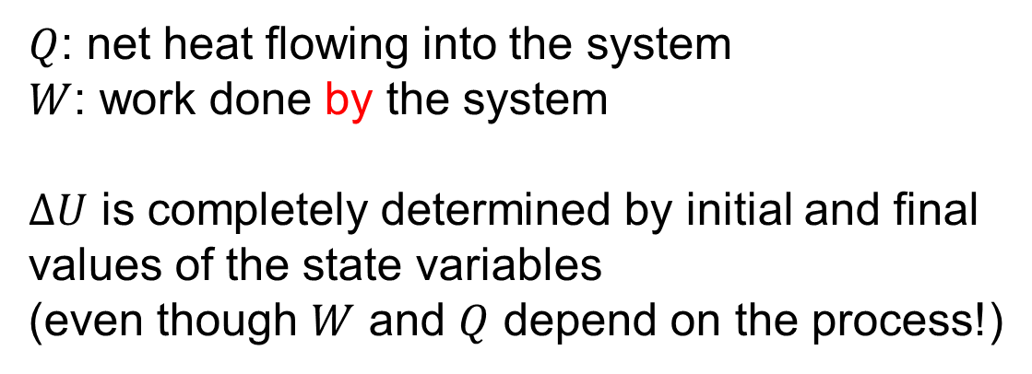
First Law of Thermodynamics
The internal energy of a system can change:
Heat flow in or out of system
Work done on or by gas
$$ΔU=Q−W$$
$Q$: net heat flowing into the system
$W$: work done by the system
$ΔU$ is completely determined by initial and final values of the state variables
(even though $W$ and $Q$ depend on the process!)

Slide 5
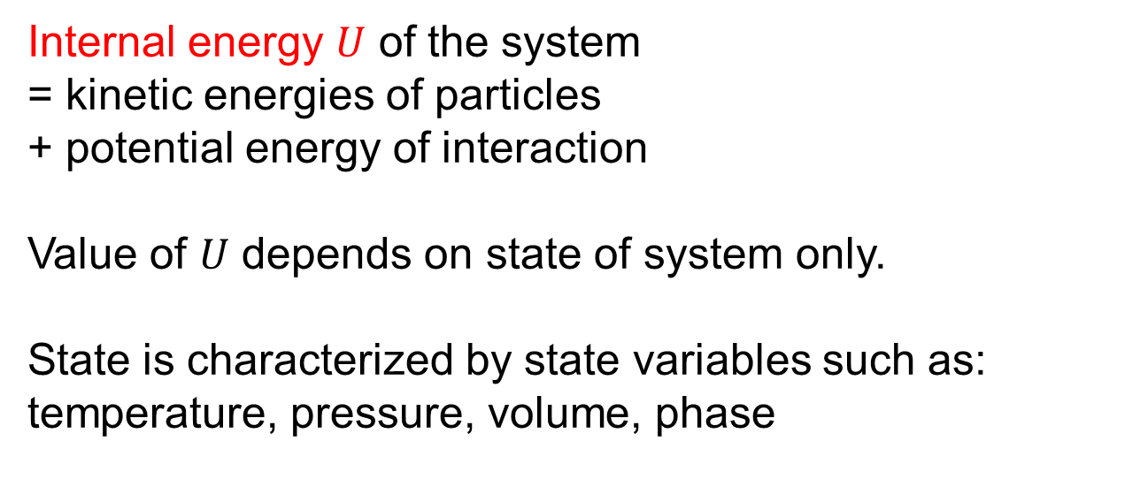
Internal energy
Internal energy $U$ of the system
= kinetic energies of particles
+ potential energy of interaction
Value of $U$ depends on state of system only.
State is characterized by state variables such as:
temperature, pressure, volume, phase

Slide 6
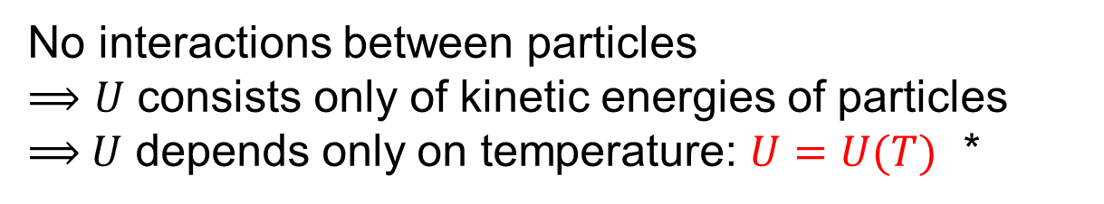
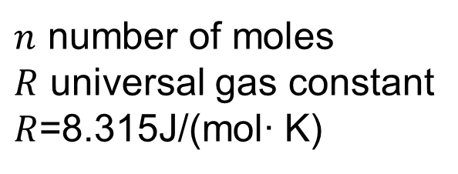

Ideal gas
particles do not interact with each other
only elastic collisions between particles and with walls
Real gas can be treated as ideal if:
low density, low pressure, high temperature
State variables are related by:
$n$ number of moles
$R$ universal gas constant
$R$=8.315J/(mol∙ K)
$$pV=nRT$$
No interactions between particles
⟹ $U$ consists only of kinetic energies of particles
⟹ $U$ depends only on temperature: $U=U(T)$ *
* Only true
for ideal gas!

Slide 7
Important processes for the ideal gas

Slide 8
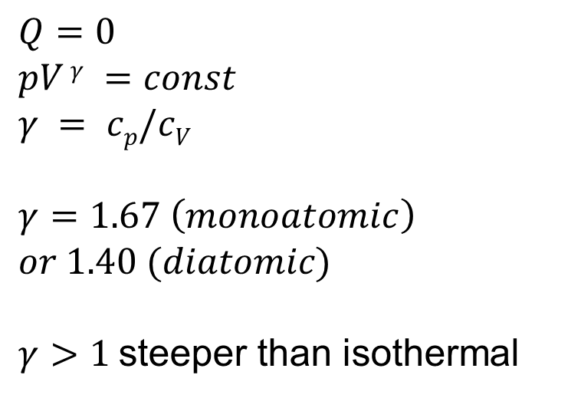
Adiabatic Process
$$Q=0$$
$$pV γ =const$$
$$γ = cp/cV$$
$$γ=1.67 \left(monoatomic\right)$$
$$or 1.40 (diatomic)$$
$γ>1$steeper than isothermal

Slide 9
Isochoric process for the ideal gas

Slide 10
Isobaric process for the ideal gas

Slide 11
Isothermal process for the ideal gas

Slide 12
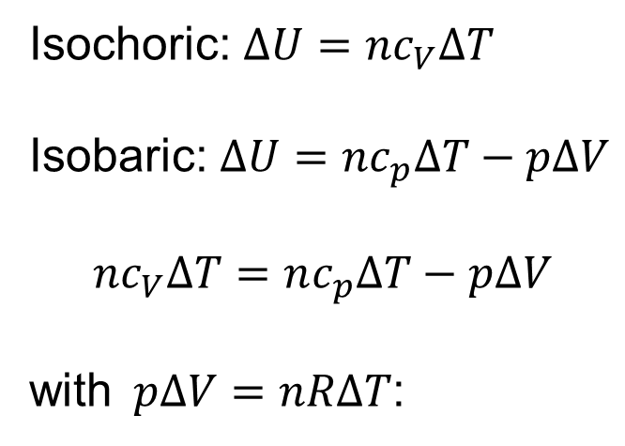

Isobaric vs isochoric process
Consider two process between same two temperatures:
Isochoric: $ΔU=nc_{V}ΔT$
Isobaric: $ΔU=nc_{p}ΔT−pΔV$
$$nc_{V}ΔT=nc_{p}ΔT−pΔV$$
with$pΔV=nRΔT$:
V
$$c_{p}−c_{V}=R$$
To increase U by same amount as in isochoric process,
more Q needed for isobaric process because gas is doing work

Slide 13


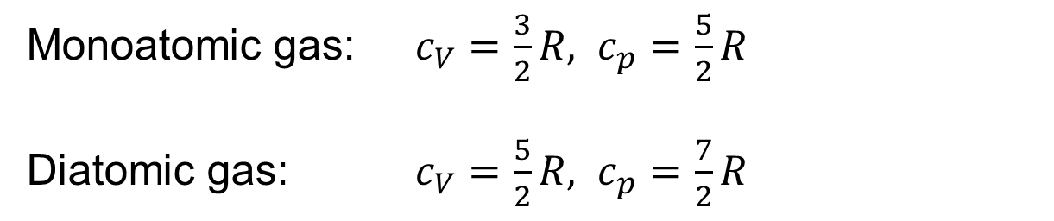
Difference between $cV$ and $cp$
$$c_{p}−c_{V}=R$$
Monoatomic gas: $c_{V}=\frac{3}{2}R, c_{p}=\frac{5}{2}R$
Diatomic gas: $c_{V}=\frac{5}{2}R, c_{p}=\frac{7}{2}R$

Slide 14
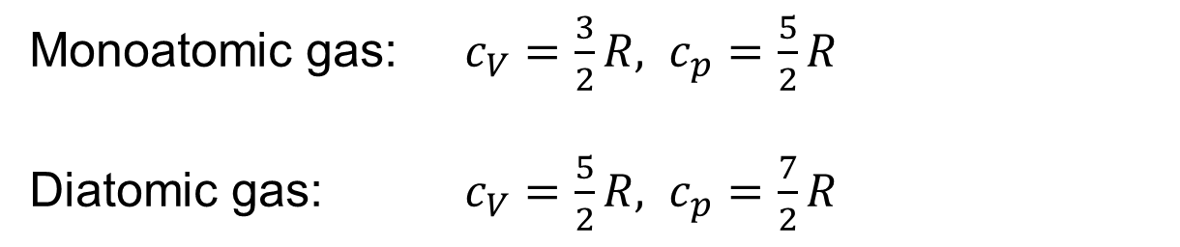
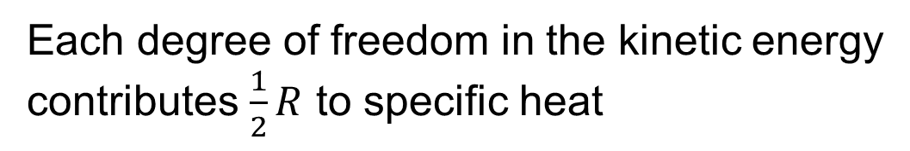
Mono- vs diatomic gas
Monoatomic gas: $c_{V}=\frac{3}{2}R, c_{p}=\frac{5}{2}R$
Diatomic gas: $c_{V}=\frac{5}{2}R, c_{p}=\frac{7}{2}R$
Each degree of freedom in the kinetic energy
contributes $\frac{1}{2}R$ to specific heat
Monoatomic gas: 3 directions for translation
Diatomic gas: 3 translations, 3 rotations,
but very small moment of inertia about one axis,
this rotation does not contribute

Slide 15

Adiabatic Process
$$Q=0 →∆U=−W$$

