Slide 1
Design of Secure and Energy-Efficient Wireless Ad-Hoc Sensor Networks
Mukesh Singhal
Laboratory For Advanced Networking
Department of Computer Science
University of Kentucky

Slide 2
Wireless Ad Hoc Networks
Security Threats
  Selective forwarding
  Wormholes
  Sinkholes
  HELLO floods
  Bogus routing information
  Sybil attacks
  Byzantine attacks
    Black hole attack
    Flood rushing attack
    Overlay wormhole attack
2

Slide 3
Wireless Ad Hoc Networks
Security: Design Challenges
  Lack of infrastructure
    Lack of a backbone to support security measures
    No trustable entities to support network security
  Node mobility
    Any node can join the network
    Elude detection by changing position
    Network topology changes rapidly and unpredictably
    Causes communication breakages
  Scarcity of resources
    Battery power/CPU speed/Main memory
  Device heterogeneity
3

Slide 4
Wireless Ad Hoc Networks
“Design and analysis of efficient, secure, and robust wireless mobile ad hoc networks (MANETs).”
(supported by three NSF grants)
Research Focus
Secure route discovery and maintenance
  Complicated due to node mobility and lack of any fixed infrastructure
    Efficiency
    Scalability
    Robustness (Path healing)
Cooperation is critical in ad hoc networks
    No centralized service
    Limited radio range (need of relaying)
    Nodes attempt to save limited resources, such as battery
    Relaying of packets is energy consuming
Trust management
4

Slide 5
Main Research contributions:
Secure position-based protocols:
  Position-based protocols are vulnerable to a new attack: “the position spoofing” attack – a node declares a fake position and uses it to launch other attacks.
  Developed a secure position-based protocol framework that guards against.
  Consist of a secure hello protocol and a secure greedy forwarding protocol (SecFwd).
  The secure hello protocol helps nodes establish a neighbor table free of malicious nodes, defends against IP-spoofing, position-spoofing, and black lists malicious nodes.
  To detect position-spoofing, nodes use a new distributed position verification algorithm that uses a position-bounding technique. SecFwd mitigates forwarding misbehaviors and insures proper execution of greedy forwarding.
5

Slide 6
Main Research contributions:
Authenticating DSR Using a Novel Multisignature Scheme
  The problem of secure routing in mobile ad hoc networks is long-standing
  We developed an efficient, single-round multisignature scheme, constructed using cubic linear feedback shift register (LFSR) sequences and a variant of the generalized ElGamal signature scheme.
  The multisignature engineered to produce an efficient technique to authenticate route discovery in the dynamic source routing (DSR) protocol.

Slide 7
Main Research contributions:
Efficient trust collection: Used the concept of “encounter age” to develop a protocol for efficient collection of trust values of nodes. (Significantly reduces the overhead compared to pure flooding-based protocols)
A low-overhead truthful route discovery protocol by applying the mechanism design: Finds a least cost route with a much lower routing overhead (O(n²) vs. O(n³)).

Slide 8
Authentication in Large Networks
Authentication in large-scale systems: Issues
  Need to handle a large number of users
  Need to handle large amount of data
  Heterogeneous environments
  Often lack of a central trusted-authority.
Construction of novel authentication schemes
  Bridging gap between theoretical cryptography and real- world security problems

Slide 9
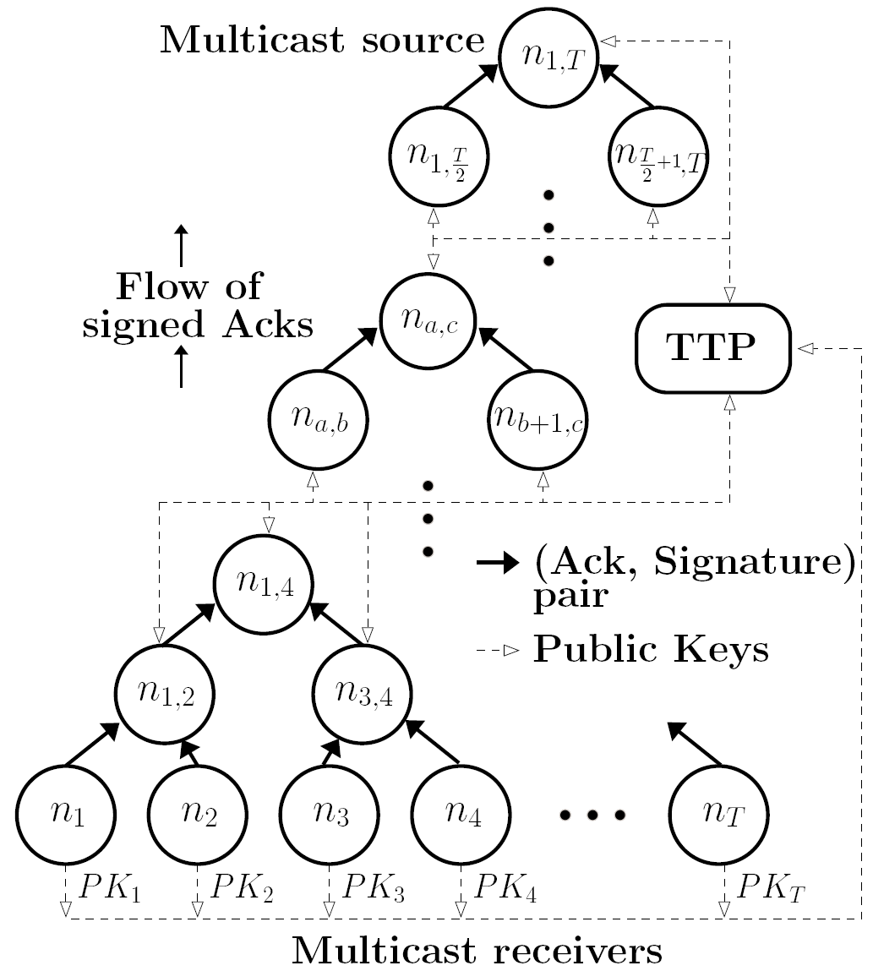
Authenticating Multicast Acks
Leaves:
  Register PKs with TTP
  Send (Ack, Sig) pair toward source
Internal nodes:
  Verify incoming signatures
  Aggregate PKs of children
  Aggregate sigs
  Register Aggregate PKs
  Send (Ack, Sig) pair
Multicast/Feedback Delivery Tree

Slide 10
Adaptive Content Distribution
Original Content
(Creator)
Modifications
(Modifier)
Modified Content
(Receiver)
Need for adaptive content has accelerated
  Personalized user experience
  Transcoding of multimedia content
  Open source “custom” built applications
Steps in adaptive content distribution
  Content creator (tier-1 provider) publishes original content
  Authorized third parties (tier-2 providers) modify content within restrictions agreed upon with original creator
  Modified content distributed to end user based on his/her preference

Slide 11
Problem: End-to-End Authentication for Adaptive Content Distribution
Original Content
Content creator authorized to create and modify content
Modifications
Limited number of trusted members (content modifiers)
Modified Content
Large number of caches and content receivers
Modifications compliant to agreement with creator
Must be able to verify authenticity and integrity of modified content
Examples:
Open source “custom-built” applications
Multimedia
Traditional solutions cannot handle content adaptation while preserving end-to-end authenticity, integrity.
Issues – Availability, Scalability, Communication overhead.

Slide 12
Our Approach: Proxy Signatures
Delegator
Transfers signing rights and capabilities to proxy
Proxy
Sign messages on behalf of delegator
Verifier
Verify authenticity w.r.t. delegator and proxy
Delegation-by-warrant: agreements between delegator and proxy
Messages should conform to warrant
Verify delegator authorized proxy
Modifications conform to agreements (warrant)
We developed a simple, efficient, secure trapdoor hash-based proxy signatures – first of its kind in the literature.

Slide 13
Authentication based on Trapdoor Hash
Features
  Associated with a private (trapdoor) key, a public (hash) key
  Collisions difficult to find without knowledge of private key
  Given private key along with trapdoor hash on message, feasible to find collisions
  Collisions in a trapdoor hash function can be used to implement authentication.
An Example (DL-based)
  Trapdoor key – TK. Hash key – HK = g^{(TK)}
  Trapdoor hash of message m under hash key HK
  TH_{HK}(m,r) = g^{(m)}HK^{(r)}
  Given (m,r), another message w, and trapdoor key TK find collision c such that TH_{HK}(m,r) = TH_{HK}(w,c) as
  c = TK⁻¹(m-w) + r

Slide 14
Basic Idea
(warrant, signature)
Generates trapdoor hash of warrant using hash key of proxy
Signs hashed warrant
Proxy signature
Does not generate signature in traditional sense
Uses its trapdoor key to find collision between hash of warrant and message
Check message conforms to warrant
Check that hash values match
Proxy signature = (collision result) + (signature on warrant)
Verify signature on warrant
DELEGATOR
PROXY
VERIFIER
Features
  Non transferable - only proxy knows trapdoor key
  Highly efficient – fast generation, verification and small signatures
  Provably secure - using well-known security model (Boldyreva model)
  Guarantees verifiability, strong undeniability and prevention of misuse.

Slide 15
Summary
Security is a major concern in wireless ad hoc networks.
State of infancy and much more work needs to be done.
At U of Kentucky, we are bridging the gap between theory and practice.
Questions?
15

