Slide 1
Context-based Information Sharing and Authorization in Mobile Ad Hoc Networks Incorporating QoS Constraints
Sanjay Madria, Missouri University of Science and Technology, Rolla, MO
&
Mark Linderman, AFRL, Rome, NY

Slide 2
OBJECTIVE and MOTIVATION
Developing a mobile agent (MA) based distributed computing framework for network centric information processing and collaboration in a wireless computing environment.
Challenge : Satisfying multiple constraints of application as well as of the environment, this includes spatial and temporal constraints, security, privacy, context dependency (i.e., QoS)
Internal collaborative processing over a distributed network of heterogeneous platform is adapted in many DOD and civil applications.
The wireless network continually under goes reconfiguration and application programs must constantly adapt to the changes in the network and process requirements while maintaining operational efficiency.
Software mobile agents (MA) can be used to overcome this problem.
MAs adapt to a dynamic environment and gives much flexibility in operations processing and collaboration.

Slide 3
BACKGROUND
Systems with process migration were supported for distributed computing but this mechanism did not allow returning data back without entire process return as well.
Client Server Model ( RMI and CORBA) assume high bandwidth between the systems to pass the data and are not fault tolerant as it involves lots of low level interactions in the form of request and replies making overall computation distributed. Any of the low level interactions can fail and the task of recovering from fault is heavily complicated.
Preserving state information improve processing time of computation.
Since C/S model lacks the ability to encapsulate state information in the executable program at the remote system there is need to develop new model which addresses this problem.

Slide 4
Why Mobile Agents…?
Inbuilt with distributed computing capability. Extend the client server mechanism for accessing and analyzing information to distributed systems.
Move with their code and computation execution state from one system to another system in network.
Support disconnected operations and remote interaction.
Communicate asynchronously with other mobile agents.
Operate independently and move autonomously.
Facilitates parallel processing that help increase efficiency and reduce processing time.
Available Platforms : IBM Aglets, Grasshopper, Voyage, Odyssey, Concordia, KYMA Atalntis.

Slide 5
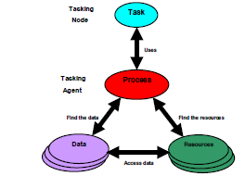
Approach
If a system in the network does not have
the resources to accomplish the tasks or if
it does not have the data residing at its
location to process or if it has no privileges
to access information the proposed framework should provide a mechanism to find another system in the network which can access the data and make computations.
System should find a viable machine in the
network, which can compute the task taking
into account the data access cost and transfer the job to that system and get the results back.
The aim of mobile agents is to provide
a mechanism to bridge the resource
and data gaps in a distributed environment.

Slide 6
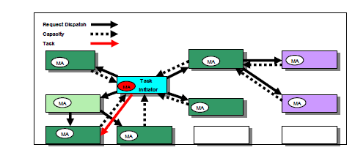
MA Communication Mechanism
Step1: Origin system sends mobile agents with task info to its neighbor systems for the processing capacity estimation. Mobile agents does the estimation on the remote machine and send a message to the origin with the result.
Step2: Origin decides what is the viable system for computation and sends another MA for actual job processing to the viable system and get the result back.

Slide 7
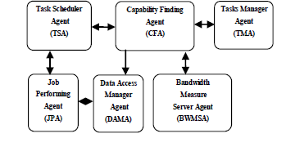
Proposed Architecture

Slide 8
Application to Military Scenario
Soldier in a battle field wants to move from point A to point B on his HAMVEE.
For a safe move, system on his HAMVEE should be able to provide him guidance and feasible route indicating the possible obstacles while moving.
System should take the start and destination information and analyze the route.
It need to access other systems that provide the information directly or those that contain data about the route and have the capability to process the data for needed.

Slide 9
Application scenario where the proposed framework can be used
Start
A
System: Terrain analysis shows obstacles. Get latest data to move between ambush area and obstacle
System: Look ahead for enemy for obstacles and road conditions
Travel restricted terrain
O
Primary route
O
System: Get reports west of bridge 1 and hydrology south of bridge 2
Suspected ambush area
O
Suspected enemy staging area
(heavily forested)
O
#1
High flow
rate in Spring
#2
Minefield
Destination
B

Slide 10
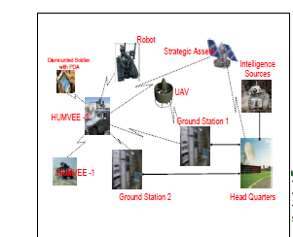
DOD Application in a Distributed Fashion

Slide 11
DISCUSSION
If system on HAMVEE1 wants to know the landmine locations in its path, it creates a MA specifying the task type and dispatches them to the first set of neighbor systems which it believes can have the capability to perform the given task type.
MAs land at the respective systems they utilize the resources on that system and compute the system idle processing time , network band width with the origin , and the projected task processing cost . These three values combined generates the capability value of the system and this value is sent to the origin as a remote message.
If any system need to access the data remotely, it send agents to its neighbor hood systems enquiring which can serve the data. Among the available systems it will access the data from a high band width system to reduce the overhead of low bandwidth.
System on HAMVEE1 keep receiving the incoming messages with the capability value of the systems and compares with a viable capability value it created for that task. Once any systems capability value satisfies viable value of origin, it sends an MA passing the necessary input for computation and gets the locations of the mines as the result reply.

Slide 12
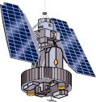
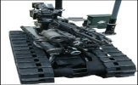
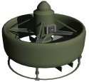
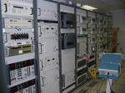
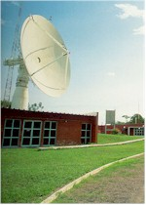
CONCLUDING REMARKS
In the heterogeneous network environment of software and hardware, mobile agent computing model effectively reduces the network loading, enhances communication efficiency, and adapt dynamically to the changing network environment in distributed computing.
In a complete wireless environment this MA based distributed computing model becomes most suitable choice for computation.
It has to deal with time, space, and constantly changing environment
ROBOT
Satellite
Dismounted Soldier
with PDA
UAV
Intelligent Sources
HAMVEE-2
Ground Station 1
Head quarters
HAMVEE-1
Ground Station 2

