Slide 1

Decentralized Coordination in Emergency Management Situations
Silvia Nittel
Spatial Information Science & Engineering
University of Maine, USA

Slide 2
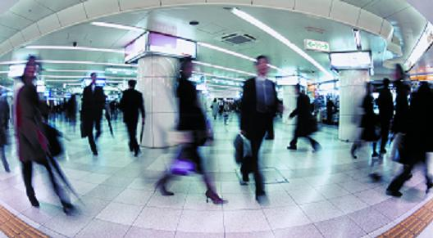
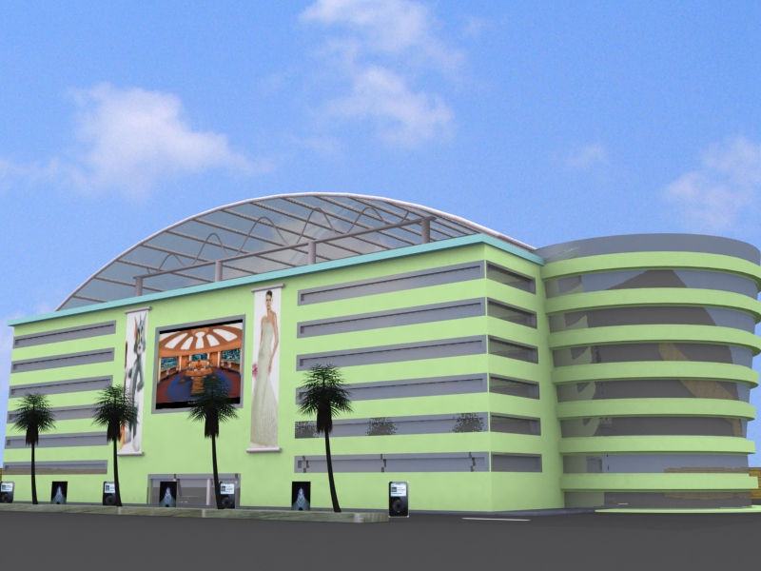
Motivation
Event
→Emergency Rescue

Slide 3
Traditional Approach
Centralized information gathering and coordination
  911 call
  Coordination by fire department, police and ambulances
  Locally coordinated rescue efforts by authorities are:
    Contain ‘event’
    Rescue injured people
    Coordinate evacuation
Bottleneck:
    Centralized information collection and centralized coordination
    Leaves people in proximity to the event without necessary information, which leads to panic and confusion
    Critical delays in response and information

Slide 4
‘Future’ Approach
Leveraging ubiquitous technology such as smart phones (e.g. Iphone, android, etc)
  Cellular and short range communication capabilities
  Applications, including social network apps, etc.
Decentralized coordination between people near event
  Immediate event notification to everyone close to the event
  Ad-hoc coordination of self evacuation
  Eventually, include rescue personnel as participants
Benefits:
  Immediate response
  Detailed and up-to-date information due to proximity to event

Slide 5
Decentralized Coordination
Problem is similar to decentralized spatial computing in wireless sensor networks, with the characteristics of:
  Each sensor node makes (independent) local decisions based on its own information, its goals and information from neighboring nodes
  Nodes are location-based and see only a snapshot of the global event
  Still, global objectives can be accomplished (e.g. boundary detection)
Decentralized coordination:
  People are the ‘sensor nodes’, and communicate ad-hoc with other ‘nodes’ in the proximity about a local event

Slide 6
Caveats
Technical challenges
  Fine grained indoor localization?
  ‘Uniform’ wireless short-range communication with sufficient radiues
  Software platform for ad-hoc coordination
Other issues
  Trust and privacy issues
  Interference with public emergency

Slide 7


