Slide 1
Uncertainty in Wireless Sensor Networks
Wang-Chien Lee
Pennsylvania State University
wlee@cse.psu.edu

Slide 2
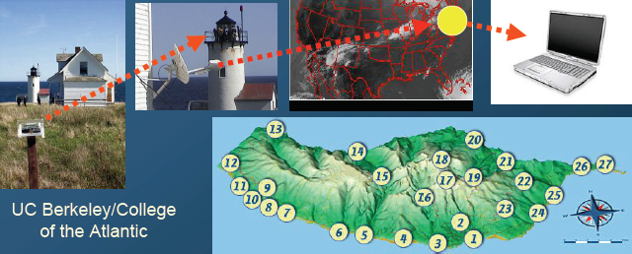
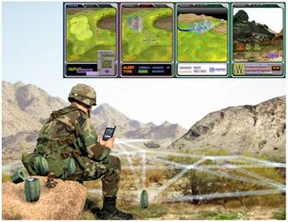
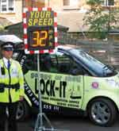
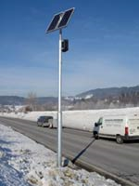
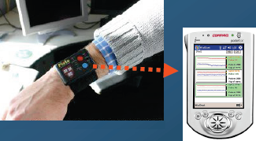
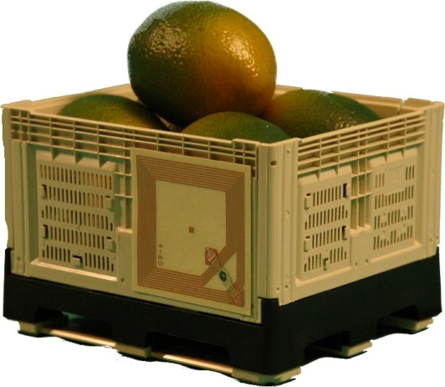
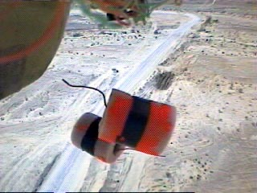
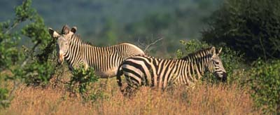
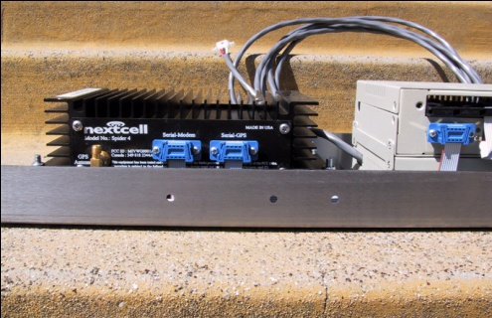
Motivating WSN Applications
Habitat monitoring
Military surveillance
Intelligent transportation system
Human healthcare system
Food quality monitoring
…

Slide 3
Uncertainty in WSN Applications
Uncertainty is a major issue in WSN applications
  Uncertainty is inherent from nature – difficult to predict
  Uncertainty is often caused by our limited ability in capturing the reality
Three Aspects of Uncertainty in WSN
  Communication uncertainty
  Sensing uncertainty
  Data uncertainty

Slide 4
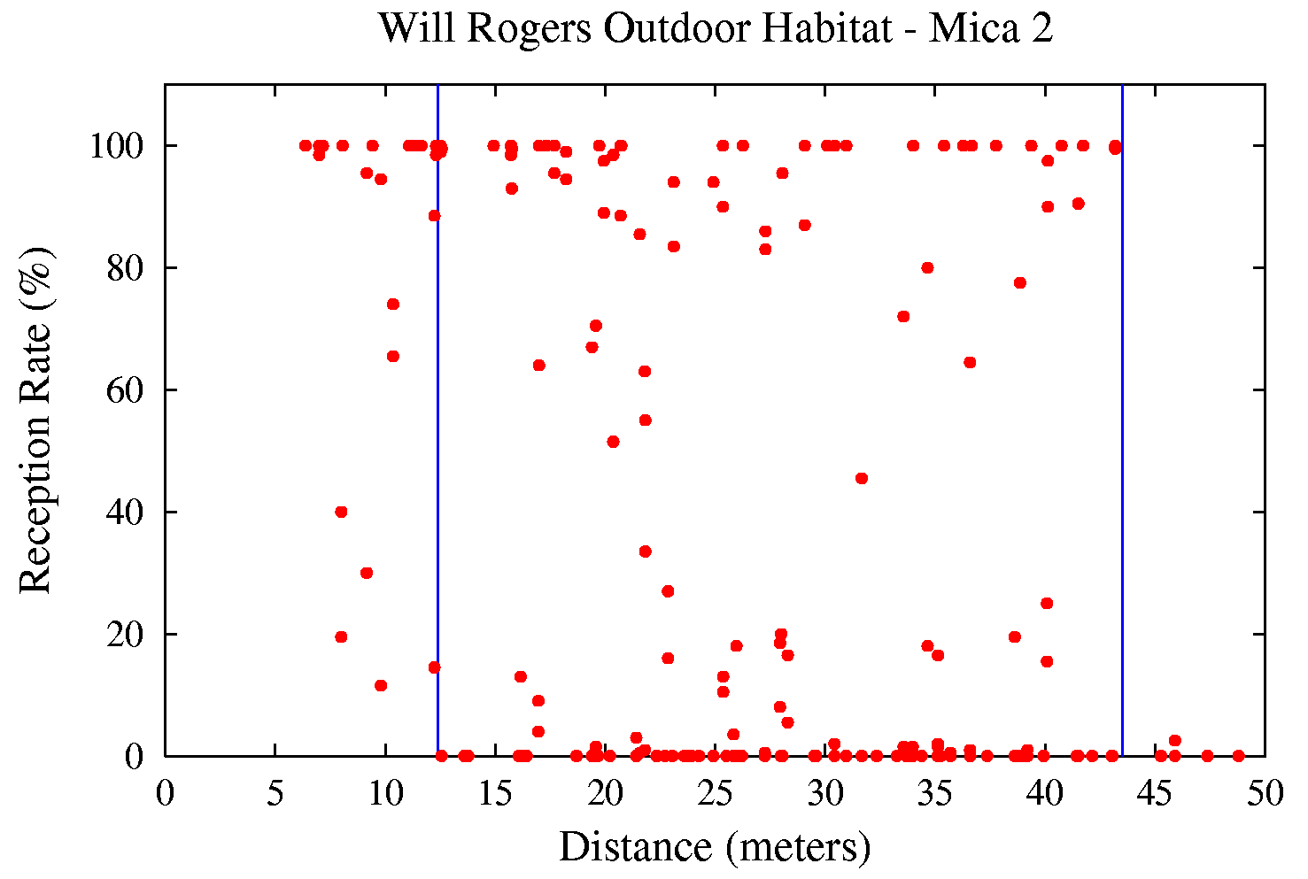
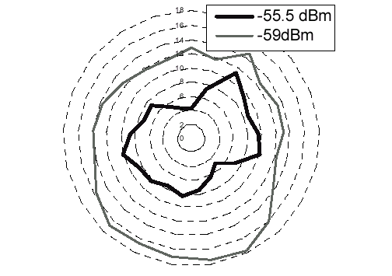


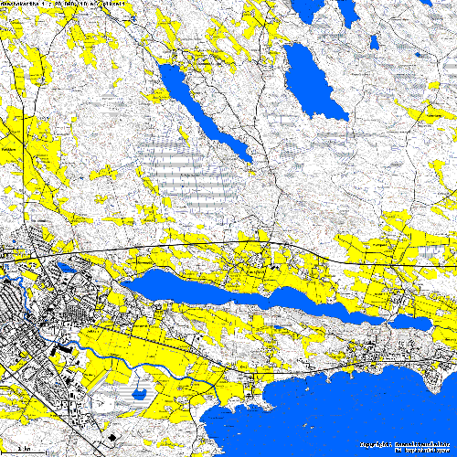

Communication Uncertainty
Asymmetric wireless links
Unreliable link quality
Intermittent connections

Slide 5
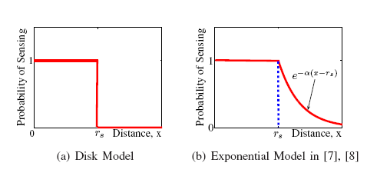
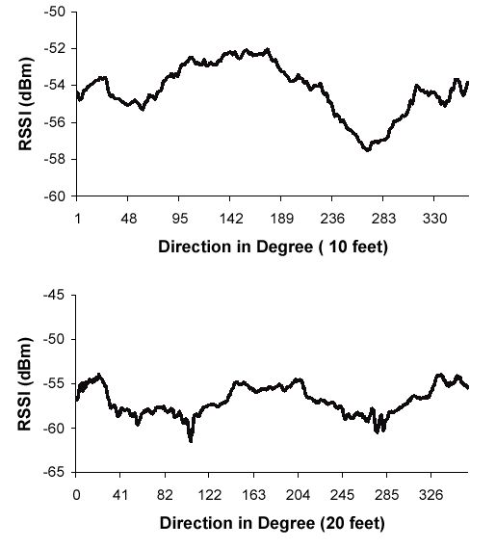
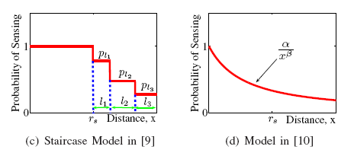
Sensing Uncertainty

Slide 6

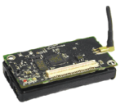


Data Uncertainty
Sensor | Time per sample(ms) | Error rate
Solar Radiation | 500 | 35%
Barometric Pressure | 35 | 1.5mbar
Barometric Pressure Temp | 35 | 0.8K
Humidity | 333 | 2%
Accelerometer | 0.9 | 200 µg
    Limits in sensing devices
p
0.4
0.3
0.3
60
65
70
temp
    Limits in information
    extraction techniques
It is about 60 – 70 F
Possible values

Slide 7
Challenges
Uncertainty modeling in link quality
Uncertainty modeling in network connectivity
Probabilistic routing
Sensing coverage
Uncertain data management
In-network probabilistic query processing

