Slide 1
Development of a Diaphragm less firing system for a Compressed Air Shock Tube

Slide 2
Background:
Used to generate a pressure gradient shock wave traveling down a closed tube

Slide 3
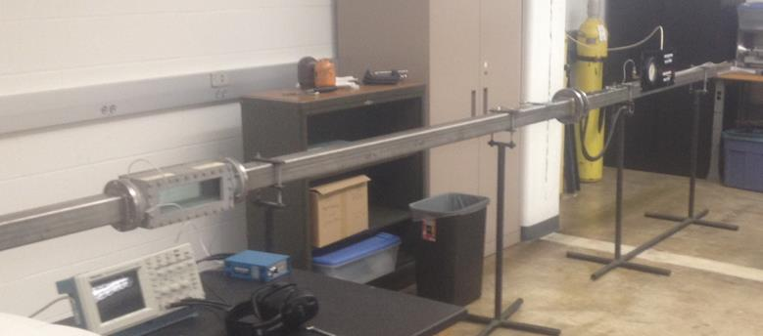
Physical system

Slide 4
Current Process
Insert a disposable diaphragm
Made of thin plastic material (.003” thick)
Charge the pressure chamber with compressed air
Rupture the diaphragm to create the shock wave
Repeat (over and over and over)

Slide 5
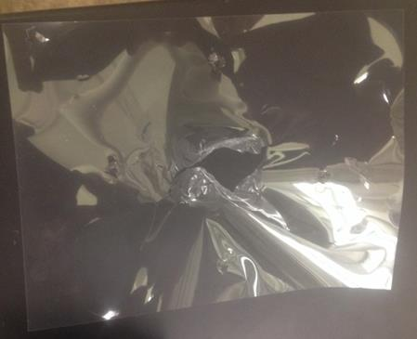
Expended diaphragm

Slide 6
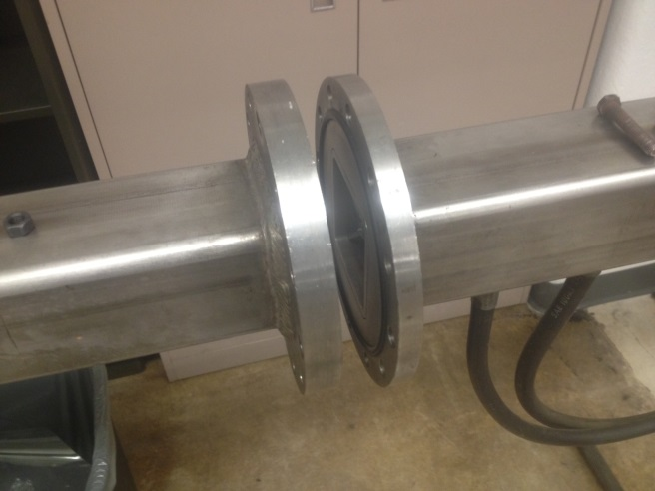
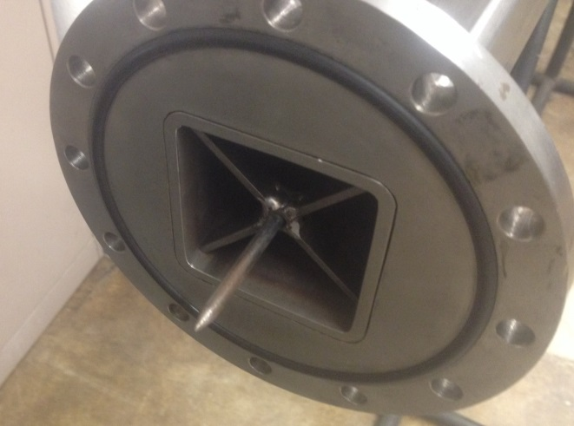
Current diaphragm mount
Inserted between two flanges either bolted or clamped together.

Slide 7
Project purpose:
Develop a new method to charge and fire the shock tube
Easy and convenient to use
Allow for quick and simple recharges
Must create a pressure profile similar to or faster than the existing system.
MUST NOT damage or modify the existing system

Slide 8
Project purpose:
Must be able to withstand pressures up to 300 PSI
Be able to operate as low as 50 PSI
Failure modes must be considered to ensure operator safety!

Slide 9
Expectations and final deliverable
Full shop drawings ready for manufacturing of a finished product.
Low pressure prototypes are a considered a plus, but are not required.

