Slide 1
Shear-wave splitting measurements for Asia
Meeting slides for
Nov. 1, 2012

Slide 2
Pay attention to “N” measurements
Only give “N” to ones with very clear XKS signal on the original R (first seismogram on the first window and second window when doing 4c), but definitely no XKS energy on the original T (second seismogram on the windows).
For noisy ones that are not “A” or “B”, change “N” to “C”

Slide 3
About “S” ranking
This is for the situation when the XKS energy on the corrected transverse component (4th seismogram in the second window) cannot be removed.
The energy can usually be removed if you adjust “a” and especially “f”
You should try your best to eliminate “S” ranking ones.

Slide 4
Adjusting “a” and “f”
This is very important and is an indication of your carefulness and your proficiency of your seismological knowledge.
The final “a” and “f” values are recorded in the *.out files under 4c*/Out.
You need to adjust them for the following cases (next slides)

Slide 5
When STD of PHI is 22.5 or larger than 15.0, or when STD of DT is larger than 1.0 s
If you see XKS signal on both Ro and To (original R and original T), but the resulting parameters have very large STDs (which can be found on the screen between the display of the first and second windows, see the line in boldface below), “f” and/or “a” need to be changed to avoid non-XKS arrivals.
**194 G24Axx i SKS 72.0 6.5 0.95 0.20 317.7
In the line above, 72 is the resultant PHI, 6.5 is its STD, 0.95 is the resultant Dt, and 0.20 is its STD. 317.7 is the back-azimuth.

Slide 6
When Dist is less than about 88º
The epicentral distance (Dist) is shown at the top of the first and second window.
For these events, the direct S wave is likely in the XKS window. It must be excluded by moving “f” toward the left.

Slide 7
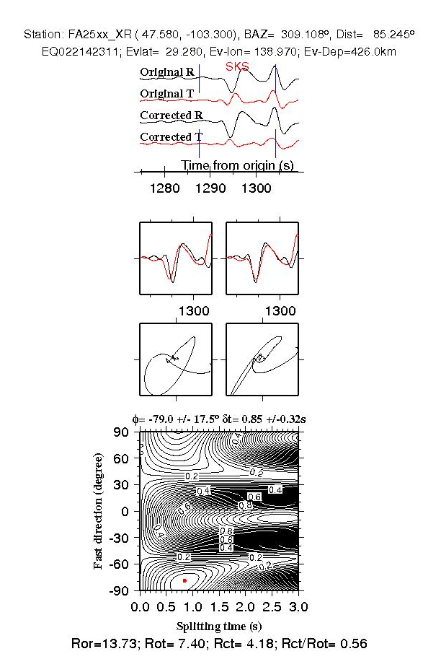
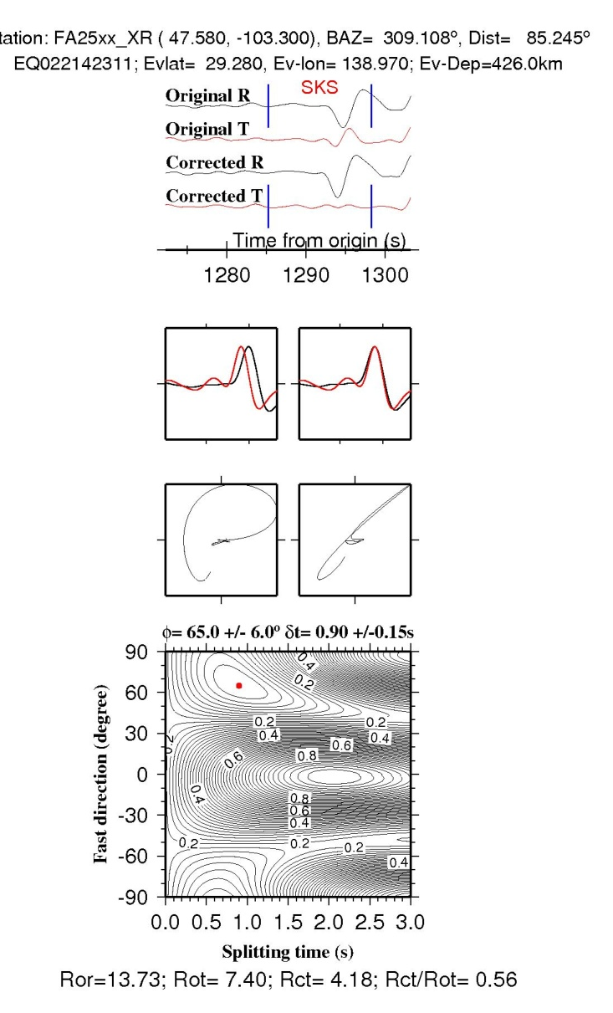
Good example: After “f” is changed
Bad example: S wave included

Slide 8
Do I need to re-filter the data (the “f” option)
For most cases, it is not necessary.
So do not over-use it.
Sometimes you have very low frequency noise. If this is the case, change the corner frequencies to (0.1, 0.4) will help a lot.
Again, the criterion is the STDs. After re-filtering, the STDs should be lowered.

