Slide 1
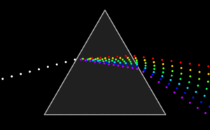
ATOMIC SPECTRA
Objectives
1. Determine the emission spectrum of Hydrogen and other elements.
2. Calculate the expected wavelengths of H using the Rydberg equation.
3. Determine the composition of unknown solutions using flame tests.
Animation of the dispersion of white light as it travels through a triangular prism.

Slide 2
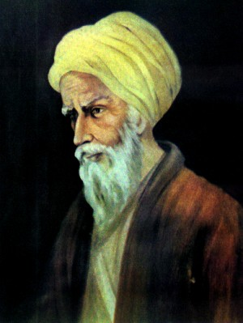
History of Optics & Light Studies
Ibn Alhazen is considered the “Father of Optics” He wrote the “Book of Optics”, which correctly explained and proved the modern theory of vision. His experiments on optics greatly influenced later scientists.
His experiments included ones on lenses, mirrors, refraction, reflection, and the dispersion of light into its constituent colors. He studied the electromagnetic aspects of light, and argued that rays of light are streams of energy particles traveling in straight lines.
Ibn Alhazen
(965 – 1039)
Arab Muslim Scientist
“Father of Optics”
http://www.hulu.com/watch/135530/milestones-in-science-and-engineering-joseph-fraunhofer-and-the-spectral-lines
Notes:
http://en.wikipedia.org/wiki/Ibn_al-Haytham

Slide 3
Atomic Spectra Experiment
PART A: Hydrogen emission spectrum.
PART B: Emission spectrum of other elements.
PART C: Flame Tests (organic & inorganic).

Slide 4
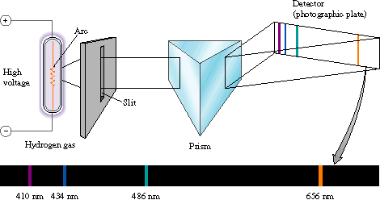
PART A: Calculate the wavelengths for Hydrogen and compare them to the Hydrogen line spectrum from a Scanning Spectrophotometer.
The hydrogen line spectrum contains only a few discrete wavelengths.
In the visible region, there are only four wavelengths.

Slide 5
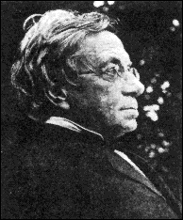
Hydrogen Spectrum – The Balmer Series
In 1885, Johann Jakob Balmer
analyzed the hydrogen spectrum and found that hydrogen emitted four bands of light within the visible spectrum. His empirical formula for the visible spectral lines of the hydrogen atom was later found to be a special case of the Rydberg formula, devised by Johannes Rydberg.
Wavelength (nm) | Color
656.2 | red
486.1 | blue
434.0 | blue-violet
410.1 | violet
Johann Jakob Balmer
(May 1, 1825 – March 12, 1898)
Swiss Mathematician &
Honorary Physicist

Slide 6
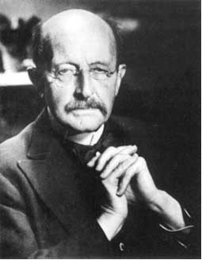
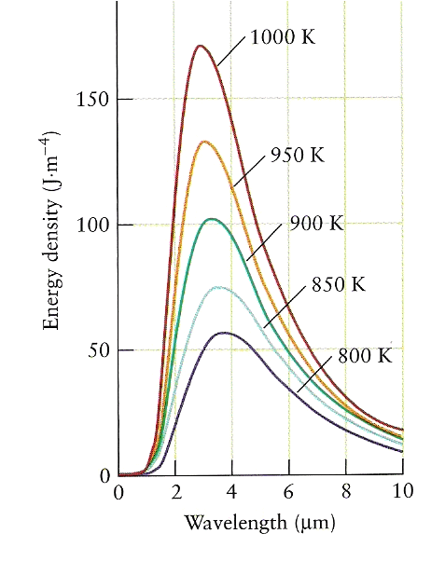
Quantum Properties of Light
ΔE = nhν
ΔE – the change
in Energy
n= 1, 2, 3, …
h – (Planck’s
constant)
h = 6.626×10⁻³⁴ Js
ν = frequency
Max Karl Ernst Ludwig Planck
(April 23, 1858 – October 4, 1947)
German Physicist
The Nobel Prize in Physics 1918 for
The discovery of energy quanta.
The profile of radiation
emitted from a black body
In 1900, Planck hypothesized that energy was quantized (i.e. energy can be gained or lost only in whole-number multiples of the quantity hν.) This hypothesis was later extended by Albert Einstein to include light. Einstein envisioned light as small discrete particles of energy which he called photons.

Slide 7
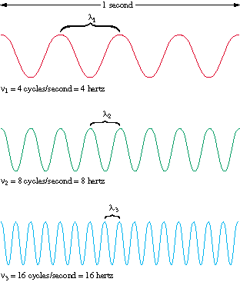
To calculate the wavelengths (p 65) –
Recall that Frequency and Wavelength are related where
frequency times wavelength equals the speed of light.
Wavelength (λ): Distance between two consecutive peaks [unit: nm]
Frequency (ν): Number of waves per second that pass a given point in space [unit: s⁻¹ (Hertz)]
λ ν = c
Where C is the speed of light
&
C = 2.9979×10⁸ m/s
λ = c / ν
Since the speed of light is a constant, as wavelength decreases,
then frequency must increase.

Slide 8
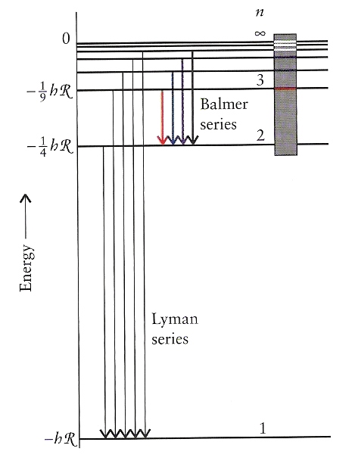
Calculating the Balmer & Lyman Series
As noted earlier, the four bands of light calculated by Balmer could be simply calculated using the Rydberg equation:
*
Where v = frequency
n = the quantum number
R = (Rydberg constant)
R = 3.29 ×10¹⁵ Hz
1 Hz = 1 s⁻¹
The permitted energy levels of a hydrogen atom.
*This equation will be used on page 65.

Slide 9
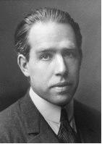
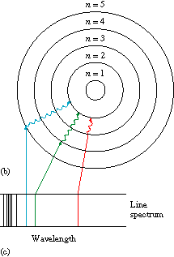
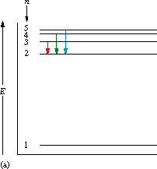
In 1913, Bohr developed a quantum model
for the hydrogen atom.
Proposed the Solar System model of the atom
where the electron in a hydrogen atom
moves around the nucleus only in certain
allowed circular orbits.
Niels Henrik David Bohr
Oct. 7, 1885 – Nov. 18, 1962
Danish Physicist
The Nobel Prize in Physics 1922
for the investigation of the structure
of atoms and of the radiation
emanating from them.
These orbits then correspond to the energy levels seen in the Balmer series. (p 71)
Notes:
http://en.wikipedia.org/wiki/Bohr_model
In atomic physics, the Bohr model depicts the atom as a small, positively charged nucleus surrounded by electrons that travel in circular orbits around the nucleus — similar in structure to the solar system, but with electrostatic forces providing attraction, rather than gravity. This was an improvement on the earlier cubic model (1902), the plum-pudding model (1904), the Saturnian model (1904), and the Rutherford model (1911). Since the Bohr model is a quantum-physics based modification of the Rutherford model, many sources combine the two, referring to the Rutherford-Bohr model.

Slide 10
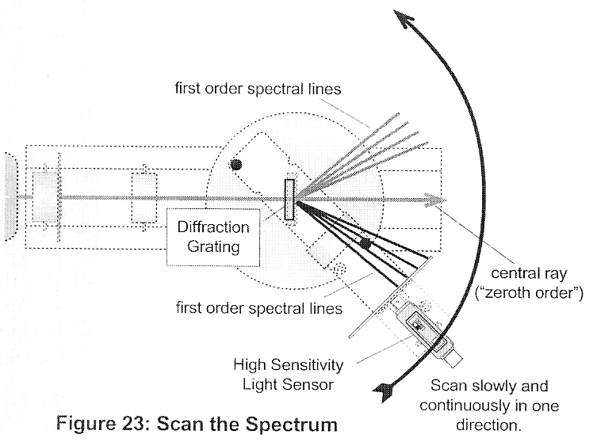
Scanning Spectrophotometer (top view)
A hydrogen light source will be viewed using a scanning spectrophotometer. The wavelengths will be calculated for the Balmer and Lyman series and then compared to those generated by the computer attached to the scanning spectrophotometer.
Notes:
http://loke.as.arizona.edu/~ckulesa/camp/how_it_works.html

Slide 11
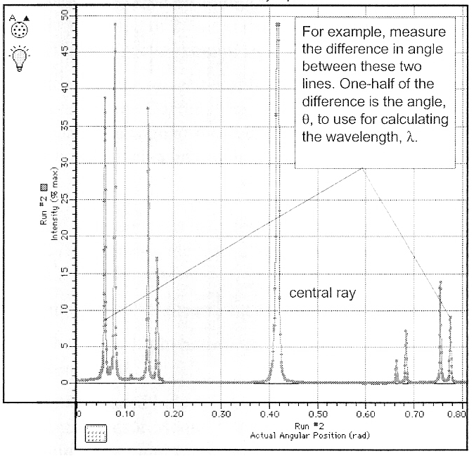
Computer Output from a Scanning Spectrophotometer
The peaks on the spectrograph correspond to the energy changes of the electrons for the Hydrogen atom.

Slide 12
PART B: Emission spectrum of other compounds using
The STAR Spectrophotometer.
View the line spectrum through the STAR Spectrophotometer
- point arrow towards the light and view to the left.
2. Verify that the scale is lined-up accurately by looking at the fluorescent light. In addition to other lines, you should see a green doublet for mercury at ~570 nm (the scale on the bottom).
3. Measure the line spectrum of the gas tubes set up in Room 201.
4. Compare your results with literature values.
http://physics.nist.gov/PhysRefData/ASD/lines_form.html

Slide 13
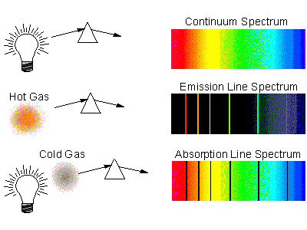
Emission Spectra Complement Absorption Spectra
The emission spectrum we see is the complement to the mysterious dark lines (Fraunhofer lines) in the sun's spectrum. It is now possible to identify the chemical composition of elements and distant objects like the sun and other stars. This is because the Fraunhofer lines in the solar spectrum were due to the absorption of light by the atoms of various elements in the sun's atmosphere.

Slide 14
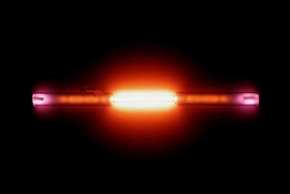
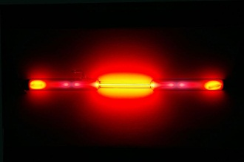
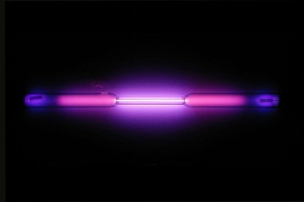
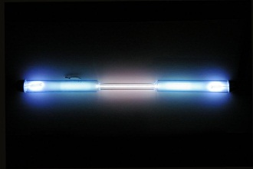
Atomic Spectra of Noble Gases
Helium
Neon
Argon
Krypton
The Atomic Spectra will be determined for the Noble Gases by looking at the gas discharge tubes.

Slide 15
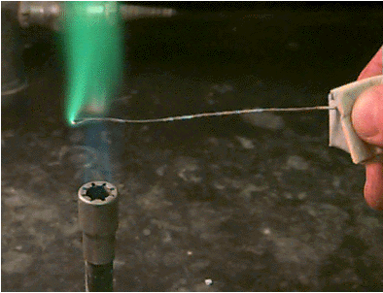
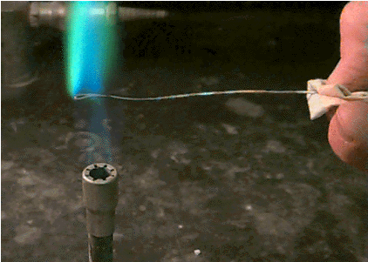
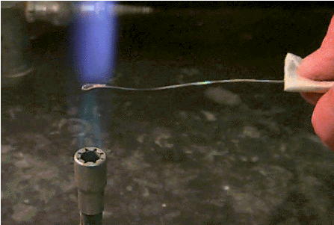
PART C: Flame Test (Organic Compounds)
Beilstein test
If a clean copper wire is coated with a halogen-containing compound and placed in a flame, the presence of the halogen is revealed by a green to blue color.
It is often possible to distinguish between chlorine, bromine and iodine based on the color of the flame.

Slide 16
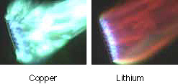
Flame Tests
Flame Test: A test used in the identification of certain elements.
It is based on the observation that light emitted by any element gives a unique spectrum when passed through a spectroscope.
Flame spectrum for lithium

Slide 17
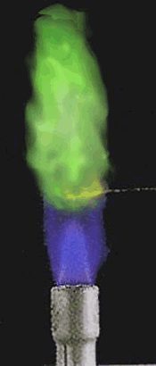
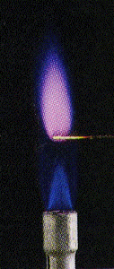
Flame tests and identification of unknown metal solutions.
Observe and record the color of the flame for each known sample. Then determine the unknown compound based on the comparison between its flame color and those of the known samples.

Slide 18
Checkout – (All items checked out should be returned)
1-STAR Spectroscope
1-nichrome flame test loop
1-copper Beilstein test loop
5 test tubes with unknowns for Flame Test
& 1 with 6M HCl for cleaning loops
In Lab
Flame test knowns – in hoods (look for signs)
Beilstein test for Part C (page 69) – in hoods
6M HCl for cleaning Beilstein loops – in hoods
Gas discharge tubes (for viewing by STAR spectroscope) – in 201
Computerized spectrophotometer – 1 setup in 201
All students
View Scanning Spectrophotometer for Part A (page 65) in Room 201.
You will need to get page 65 signed by presenter.
View Gas Discharge tubes for Part B (page 67) in Room 201.
You may do flame tests on unknowns using your own
Bunsen burner at your desk.

Slide 19
Hazards
6M HCl – strong acid, corrosive
(use solid NaHCO₃ on spills)
CH₂Cl₂ - halogenated volatile organic solvent
Bunsen Burner – open flames
Waste
Liquid waste-all waste, heavy metals, acid, rinses
This Week:
Turn In Atomic Spectra Handout (pp 65-67).
Review Session – Wednesday, Apr. 18, 6-8 pm in G3.
Evaluation Forms:
To evaluate Chem 2, you should be receiving an email
from the CET committee with the following link:
https://itweb.mst.edu/auth-cgi-bin/cgiwrap/distanceed/evals/survey.pl

Slide 20
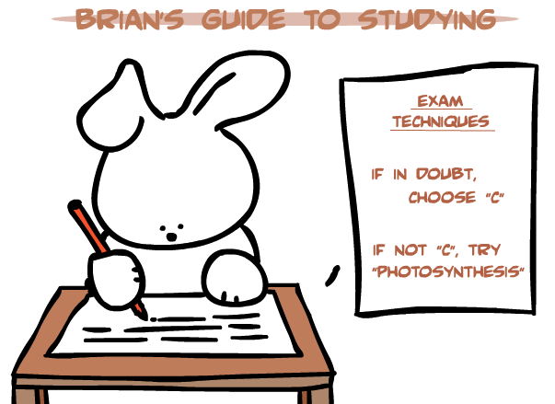
Next Week (April 26-29)
*Final Exam – 1 Hour Exam during regularly
scheduled class time*.
You will need a calculator.
**Checkout after exam. $35 fine for not checking out.
(This means NO Chem 2 Final during Finals Week.)
*If you need to take the test on a different day, email Dr. Bolon.
*************************************************
Don’t be a Dumb Bunny! - Study!
*
*It’s a biology joke! ☺

