Slide 1
Colorimetry
&
Spectrophotometry

Slide 2
Useful Terminology
Colorimetry is the use of the human eye
to determine the concentration of colored species.
Spectrophotometry is the use of instruments
  to make the same measurements. It extends
  the range of possible measurements beyond
  those that can be determined by the eye alone.
Note: This experiment will demonstrate
both techniques on the same set of dyes.

Slide 3
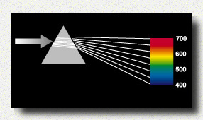
Colorimetry
Visual Observations – Because colorimetry is based on
inspection of materials with the human eye, it is
necessary to review aspects of visible light.
Visible light is the narrow range of electromagnetic
  waves with the wavelength of 400-700 nm.
ROY G. BIV
= the mnemonic used to remember the colors of the visible spectrum.

Slide 4
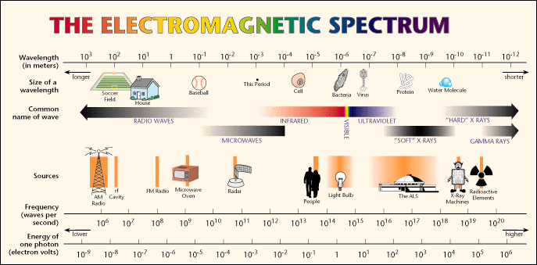
Visible light is only a very small portion
of the electromagnetic spectrum.
Note: Frequency (υ) and Energy (E) are directly proportional
whereas Frequency (υ) and Wavelength (λ) are inversely proportional.

Slide 5
Electromagnetic Spectrum
Type of Radiation | Frequency Range (Hz) | Wavelength Range | Type of Transition
gamma-rays | 10²⁰-10²⁴ | <1 pm | nuclear
X-rays | 10¹⁷-10²⁰ | 1 nm-1 pm | inner electron
ultraviolet | 10¹⁵-10¹⁷ | 400 nm-1 nm | outer electron
visible | 4-7.5x10¹⁴ | 750 nm-400 nm | outer electron
near-infrared | 1x10¹⁴-4x10¹⁴ | 2.5 µm-750 nm | outer electron molecular vibrations
infrared | 10¹³-10¹⁴ | 25 µm-2.5 µm | molecular vibrations
microwaves | 3x10¹¹-10¹³ | 1 mm-25 µm | molecular rotations, electron spin flips*
radio waves | <3x10¹¹ | >1 mm | nuclear spin flips*

Slide 6
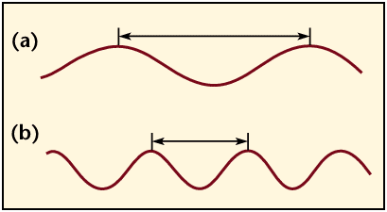
Electromagnetic radiation is characterized by its
wavelength, λ, Frequency, ν and energy, E:
E = hν = hc / λ c = ν λ
Where h = Planck’s constant & c = speed of light in a vacuum.
longer wavelength, lower energy;
shorter wavelength, higher energy.

Slide 7
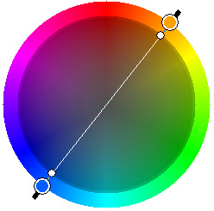
Color Wheel
(ROYGBIV)
Complementary colors lie across the diameter on the color wheel and combine to form “white light”, so the color of a compound seen by the eye is the complement of the
color of light absorbed by a colored compound; thus it
completes the color.

Slide 8
Observed Color of Compound | Color of Light Absorbed | Approximate Wavelength of Light Absorbed
Green |  | 700 nm
Blue-green |  | 600 nm
Violet |  | 550 nm
Red-violet |  | 530 nm
Red |  | 500 nm
Orange |  | 450 nm
Yellow |  | 400 nm

Slide 9
Observed Color of Compound | Color of Light Absorbed | Approximate Wavelength of Light Absorbed
Green | Red | 700 nm
Blue-green | Orange-red | 600 nm
Violet | Yellow | 550 nm
Red-violet | Yellow-green | 530 nm
Red | Green | 500 nm
Orange | Blue | 450 nm
Yellow | Violet | 400 nm

Slide 10
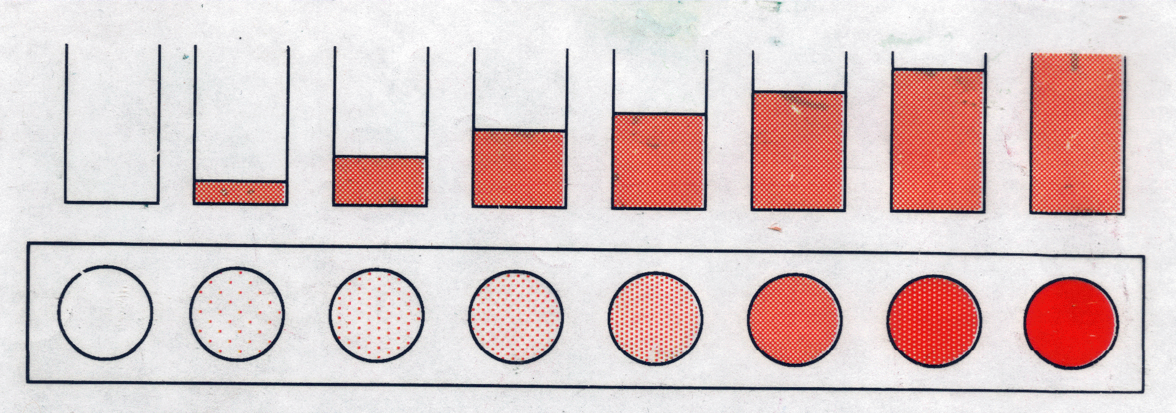
Visual Colorimetry
Intensity: For light shining through a colored solution,the observed intensity of the color is found to be dependent on both the thickness of the absorbing layer (pathlength) and the concentration of the colored species.
←Side view
←Top view
(a.k.a. Bird’s eye view)
For One Color: A series of solutions of a single color demonstrates the effect of either concentration or pathlength, depending on how it is viewed.

Slide 11
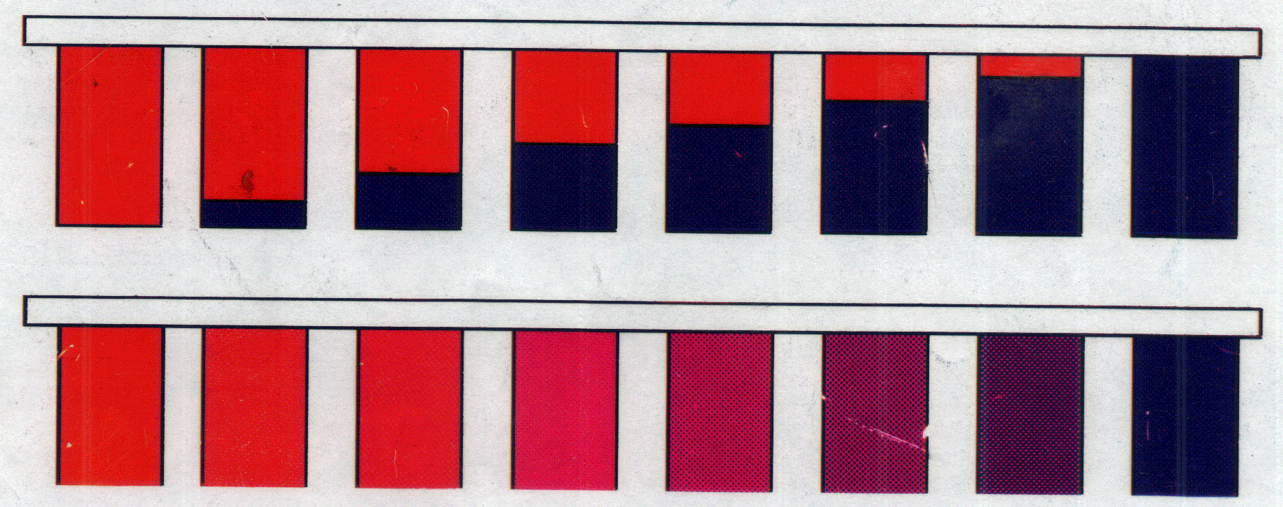
Visual Colorimetry
←Ratio used
←Purple produced
For more than one color: the ratio of an unknown mixture can also be determined by matching the shade of the color to those produced from known ratios.
In this example, the ratio of a mixture of red and blue can be determined visibly by comparing the mixture to purples produced from known ratios of red and blue.

Slide 12
Dilution Factor (constant pathlength)
Recall: C₁V₁= C₂V₂
Then for the dilution,
C_{diluted} x V_{diluted}= C_{std} x V_{std}
C_{diluted} = C_{std} x (V_{std} / V_{diluted})
Since V_{diluted} = V_{total}
C_{diluted} = C_{std} x (V_{std} / V_{total})
Substituting the volumes:
C_{diluted} = C_{std} x (3 drops / 8 drops)
If the original concentration is 5.88 ppm,
then:
C _{diluted} = 5.88 ppm x (3 / 8)
C _{diluted} = 2.21 ppm
3 drops of dye std
+ 5 drops water
8 drops total volume

Slide 13
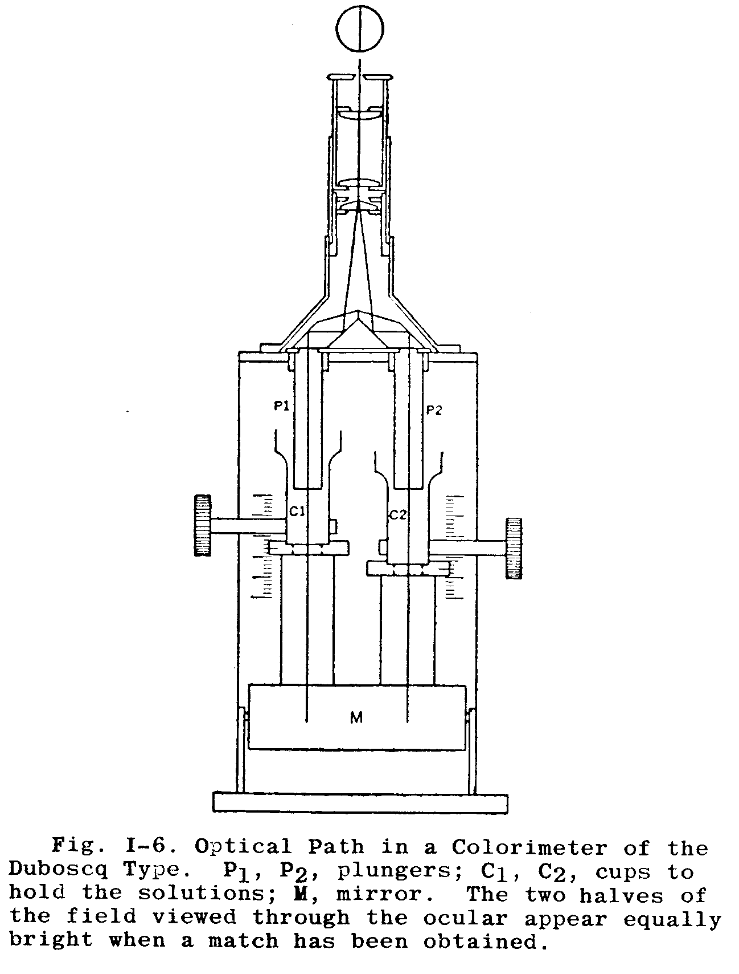
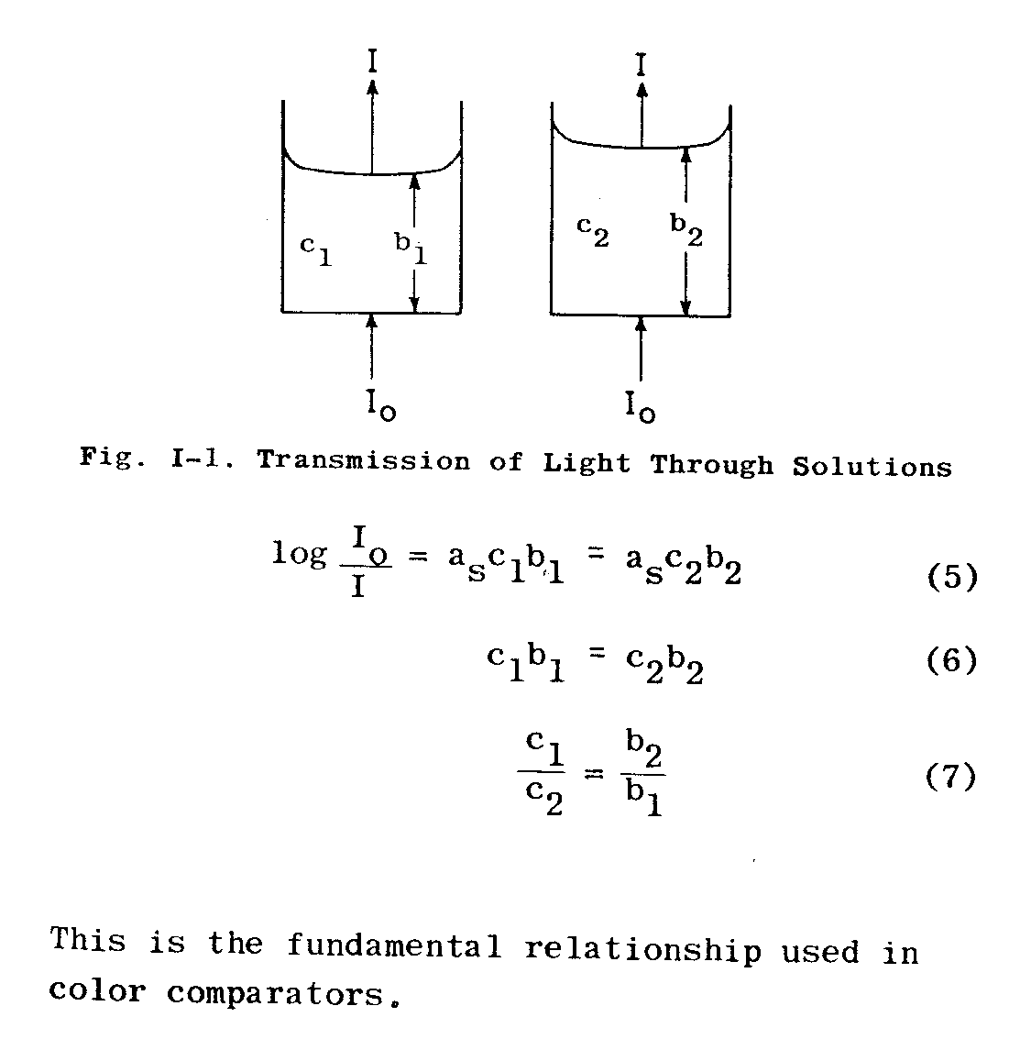
Intensity: When the product of the concentration and the pathlength of any two solutions of a colored compound are the same, the same intensity or darkness of color is observed.
Duboscq visual
colorimeter
Adjustable
Path Lengths

Slide 14
Spectrophotometry
Spectrophotometer - an instrument that measures the amount
of light absorbed, or the intensity of color at a given
wavelength.
The intensity of color can be given a numerical value by
comparing the amount of light prior to passing it through
the sample and after passing through the sample.
These quantitative measurements of light absorbed are the
Transmittance and the Absorbance.

Slide 15
Absorbance
Beer-Lambert Law (a.k.a. Beer's law) - the linear relationship between absorbance and concentration of an absorbing species.
A = abc
A is the absorbance
“a” is molar absorptivity in L/[(mole)(cm)]
Also called “extinction coefficient” or “ε”;
it is dependent on the material being studied.
“b” is the path length in cm
The diameter of the cuvette or sample holder which is the distance
the light travels through the absorbing sample. “b” is a constant
when the same size cuvette is used for all samples.
“c” is the concentration of the sample in (mol/L)
Main use of Beer’s Law is to determine the concentration
of various solutions.

Slide 16
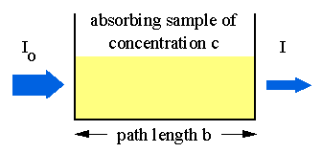
Transmittance is Related to Absorbance
Transmittance is given by the equation:
T = I/I_{o}
where I is the intensity of the light after it has gone
through the sample & I_{o} is the initial light intensity.
Absorbance is related to the %T:
A = -logT = -log(I/ I_{o})

Slide 17
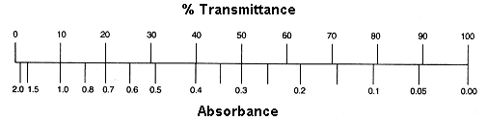
Equation Summary
T= (I/I_{o}) = 10^{-A} %T = (I/I_{o}) x 100 A = -logT = log(1/T)
Sample Calculation
If %T = 95%, then A = log(100/95) = log(1/.95) = -log(.95)
A = 0.02227
Note the scale for Absorbance: 9/10th of the scale is from 0-1 and 1/10th is from 1-2.
For this reason, the spectrometers have been calibrated in % Transmittance and
all readings will be taken in %Transmittance.

Slide 18
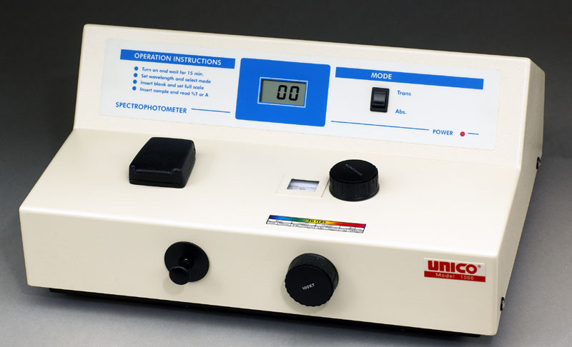
Spectronic 20 (a.k.a. Spec-20)
Spec-20 - A single-beam visible light spectrophotometer.
Tungsten filament lamp emits visible wavelengths of light.
Blank is inserted to adjust 100%Transmittance at each wavelength.

Slide 19
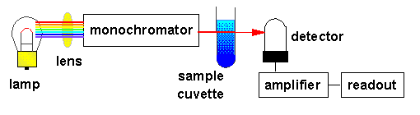
Simple Spectrophotometer Schematic
The lamp emits all colors of light (i.e., white light).
The monochromator selects one wavelength and that wavelength is sent through the sample.
The detector detects the wavelength of light that has passed through the sample.
The amplifier increases the signal so that it is easier to
  read against the background noise.

Slide 20
Spectronic 20 Instructions
(Directions below will be available next to each instrument)
Digital Display
Mode Knob
(set to Trans)
Sample Chamber
1. With sample chamber empty, set desired wavelength then adjust to 0%T with right knob on front panel.
2. Insert blank solution, close lid and adjust 100%T
with right knob on front panel.
3. Insert dye solutions, read and record %T values.
4. Change wavelength*, repeat steps 2-4.
Filter Lever
Wavelength Knob
0-100%T Knob
*NOTE: The filter must be changed periodically to coordinate with the wavelength range studied: blue (400-449), green (450-549) and orange (550-749).

Slide 21
Post Lab: 4 Plots of Absorption Data
Plots similar to the 3 below will need to be generated using a computer program such as Excel.
You will also need to make a plot of your unknown blue or red which will look similar to #1 or #2.
#1
#2
#3

Slide 22
Checkout
Visual Portion Spec-20s
1 - 12 well plate 5 - cuvettes in a 3 - 12 well strips* test tube rack 5 - Beral pipets**
*2 of which need to be at least 9 wells long.
**Don’t have to be returned.
There aren’t enough Spec-20s for all groups.
So 1/2 will start with the Spec-20s
and 1/2 will start with the visual portion.
Dyes - Located in Lab: Record Concentrations
Blue std. = _____ ppm
Red std. = _____ ppm
Waste
We are using FDA food dyes and distilled water.

Slide 23

For April 9-12
Turn In:
Colorimetry & Spectrophotometry pp 51-58
+ 4 Graphs
Read Over:
Antacid Analysis (pp 33-34) in Green Book
& Dimensional Analysis #4-5
(pp 28-34 in the first book).

