Slide 1
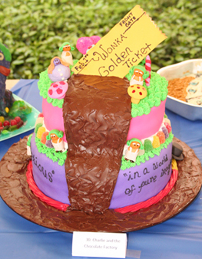
Miner League Players Present: Willy Wonka
*************************
Thursday – Saturday
April 12 -14, 7:30 pm ****************************************
Sunday, April 15, 2012 2 pm
************************
Adults $12 Youth (7-18) - $10 Child (1-6) - $5 Students with valid ID - $10
************************
Call the box office for tickets
Call 573-341-4219
************************
Come Win A Golden Ticket!

Slide 2
Antacid Analysis Lab
Purpose of the Experiment
To determine the effectiveness
of antacid tablets.

Slide 3
Dissociation of Water
O
H
H
O
H
H
2 H₂O <-> H₃O⁺ + OH⁻
Water dissociates to form the hydronium and hydroxide ions.

Slide 4
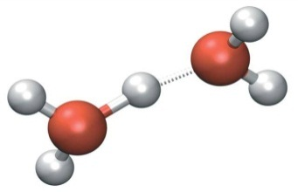
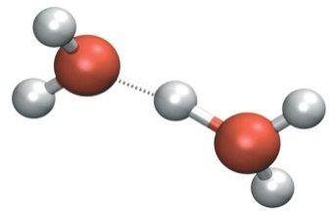
What are Acids & Bases?
An Arrhenius acid is a substance that, when dissolved in water, increases the amount of
hydronium ion over that present in pure water.
Likewise, an Arrhenius base increases the amount
of hydroxide ion over that present in pure water.
A Bronsted-Lowry acid is a substance that can
donate a hydrogen ion; and,
a Bronsted-Lowry base is a substance that can
accept a hydrogen ion.
A Lewis acid is any species that accepts electrons
through coordination to its lone pairs; and,
A Lewis base is any species that donates electrons.

Slide 5
pH 0
[H₃O⁺] 10⁰
[OH] 10⁻¹⁴
pOH 14
What is pH?
1
10⁻¹
10⁻¹³
13
2
10⁻²
10⁻¹²
12
pH = -log [H₃O⁺]
pOH = -log[OH⁻]
pH + pOH = 14
3
10⁻³
10⁻¹¹
11
4
10⁻⁴
10⁻¹⁰
10
5
10⁻⁵
10⁻⁹
9
6
10⁻⁶
10⁻⁸
8
7
10⁻⁷
10⁻⁷
7
8
10⁻⁸
10⁻⁶
6
9
10⁻⁹
10⁻⁵
5
10
10⁻¹⁰
10⁻⁴
4
11
10⁻¹¹
10⁻³
3
12
10⁻¹²
10⁻²
2
13
10⁻¹³
10⁻¹
1
14
10⁻¹⁴
10⁰
0

Slide 6
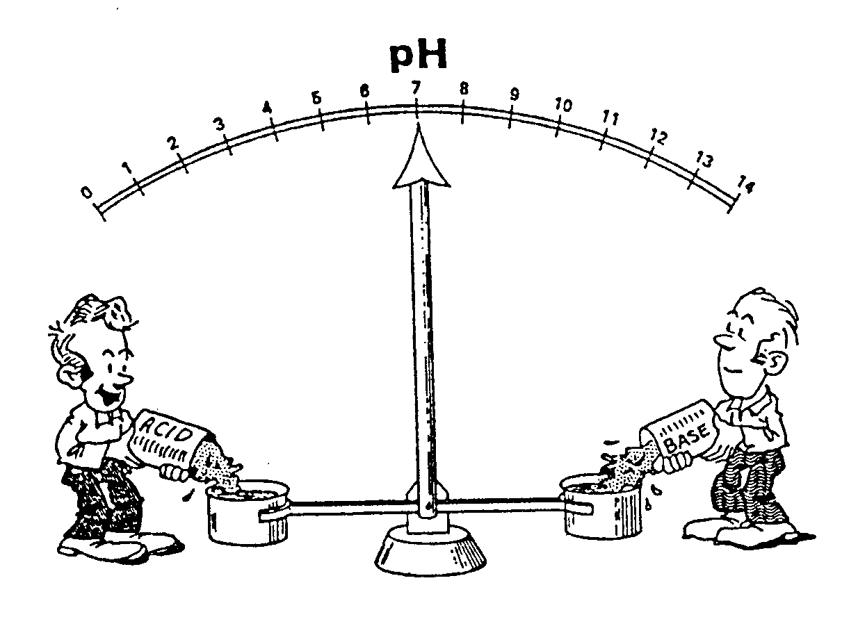
The pH Scale

Slide 7
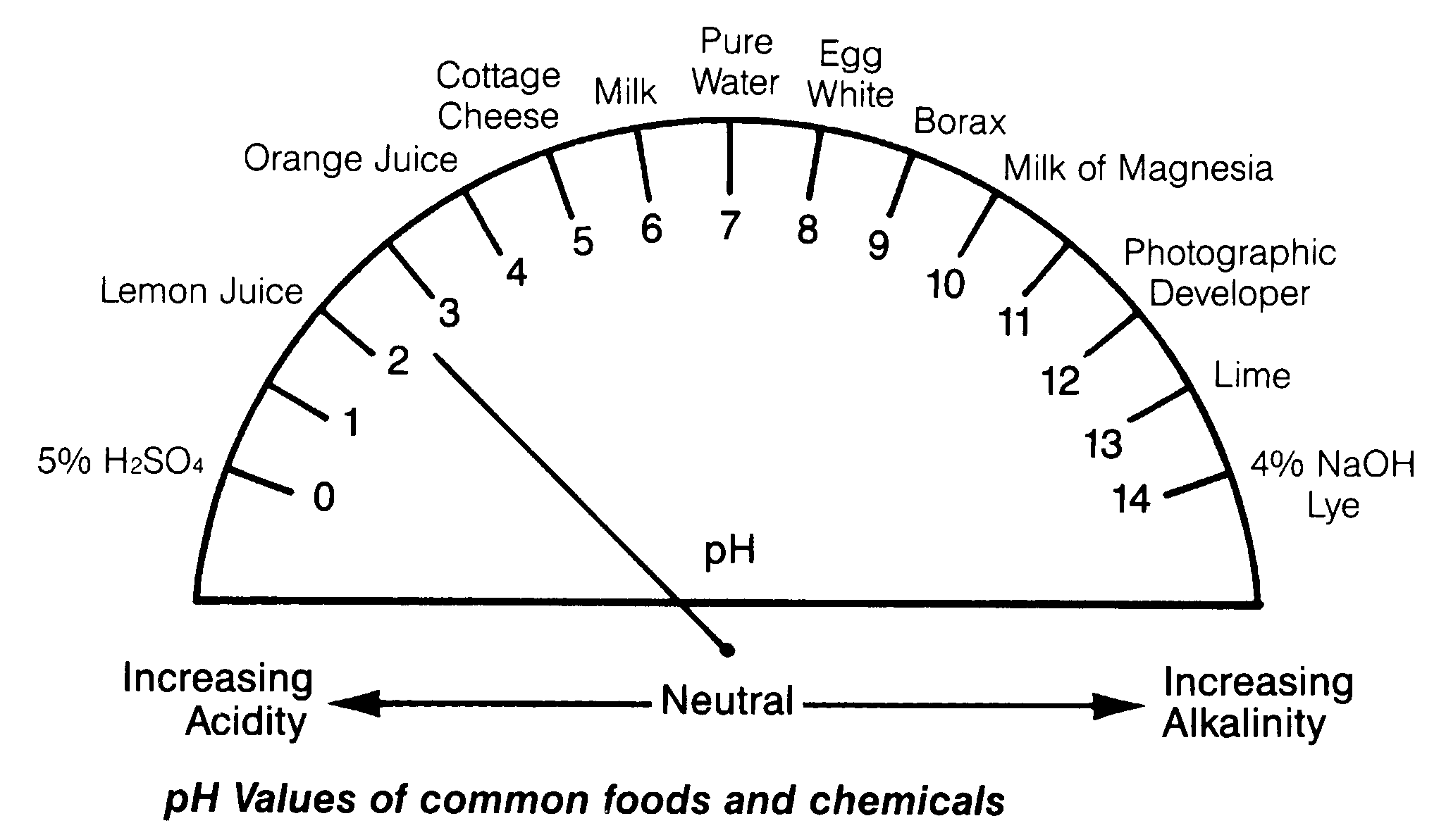
pH Values for Common Foods & Chemicals

Slide 8
Antacids
Stomach cells secrete hydrochloric acid
(0.155 M HCl) to digest the food.
Generation of too much acid → “heartburn”.
Antacids neutralize the excess HCl.
This reaction then is an Acid/Base reaction.

Slide 9
Would a little bit of NaOH be equally effective???
HCl + NaOH → H₂O + NaCl
Antacids are formulated to reduce acidity while
avoiding physiological side-effects.

Slide 10
Commercial Antacids Use A Variety of Chemicals
Calcium-based antacids: Tums, Rennies
CaCO₃ + __HCl →
Magnesium-based antacids: Mylanta, Milk of Magnesia
Mg(OH)₂ + __HCl →
Aluminum-based antacids: Maalox, Mylanta
Al(OH)₃ + __HCl →
Bicarbonate-based antacids: Alka Seltzer
NaHCO₃ + __HCl →

Slide 11
Commercial Antacids Use A Variety of Chemicals
Calcium-based antacids: Tums, Rennies
CaCO₃ + 2HCl → CaCl₂ + H₂CO₃
H₂CO₃ → H₂O + CO₂
Magnesium-based antacids: Mylanta, Milk of Magnesia
Mg(OH)₂ + 2HCl → MgCl₂ + 2H₂O
Aluminum-based antacids: Maalox, Mylanta
Al(OH)₃ + 3HCl → AlCl₃ + 3H₂O
Bicarbonate-based antacids: Alka Seltzer
NaHCO₃ + 1HCl → NaCl + H₂CO₃

Slide 12
What are Indicators?
A molecule whose conjugate acid or
conjugate base has a different color.
Used to mark a certain pH level.
Used to detect the endpoint of a titration.

Slide 13
HIn + H₂O H₃O⁺ + In⁻
Acid-base indicators are weak acids or bases.
The molecular form has a different color
than the ionic form.
Increase the concentration of H₃O⁺
Decrease the concentration of H₃O⁺
HIn + H₂O H₃O⁺ + In⁻
HIn + H₂O H₃O⁺ + In⁻
Or
HIn + H₂O H₃O⁺ + In⁻
HIn + H₂O H₃O⁺ + In⁻

Slide 14
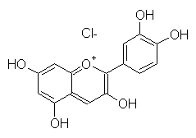
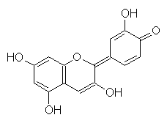
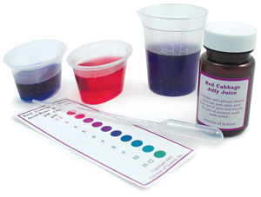
Cyanidin chloride
in acidic solution
gives a red color.
Cabbage Juice
Indicator
*
*
Cyanidin
in basic solution
gives a blue color.

Slide 15
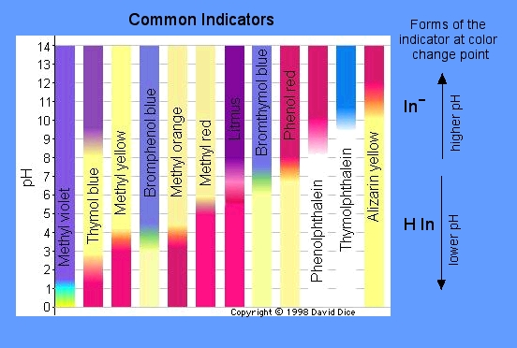
We’ll be using phenolphthalein and bromocresol green.

Slide 16
What is Titration?
An experiment where
a known volume of an unknown concentration
of acid or base is
neutralized with
a known volume and known concentration
of base or acid, respectively,
to determine the concentration
of the unknown.

Slide 17
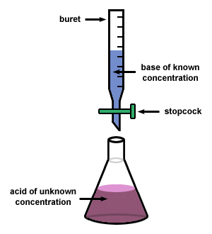
Typical Titration Set-up
Since:
mole _{acid} = mole _{base}
M_{acid} ×V_{acid} = M_{base} ×V_{base}
known
Determine
Read from buret
Then:
M_{acid} = M_{base} ×(V_{base} / V_{acid} )

Slide 18
Back or Indirect Titration
Dissolve a measured amount of tablet in a simulated stomach environment (known quantity of an HCl solution).
N_{Acid} = The number of moles for the initial quantity of HCl.
N_{antacid} = The number of moles of HCl
neutralized by Antacid Tablet.
N_{Base} = The number of moles of NaOH
used to neutralize the remaining
HCl (that which was not
neutralized by the antacid).
N_{Acid} = N_{antacid} + N_{Base}
N_{antacid} = N_{Acid} - N_{Base}
HCl
HCl
HCl
HCl
HCl
HCl
HCl
*NOTE: A grad cylinder is NOT accurate enough to measure HCl.

Slide 19
Forward or Direct Titration
HCl with known conc.
mole HCl = mole Antacid
Antacid dissolved in water
M_{HCl} × V_{HCl}

Slide 20
Buret Checkout
1. Check tip and top of buret for chips.
(If there are any chips, return buret to Stockroom.)
2. Fill buret with distilled water to check
that the valve does not leak.
(If there are any leaks, return buret to Stockroom.)
3. Determine if your buret is clean.
(If it is not clean, clean it.
There are buret brushes near the sinks.)

Slide 21
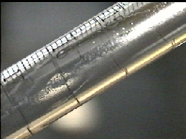
How to determine if you have a dirty buret?
There will be liquid clinging to the sides.
Clean the buret with soapy water & a buret brush.
Do NOT add concentrated soap to buret.

Slide 22
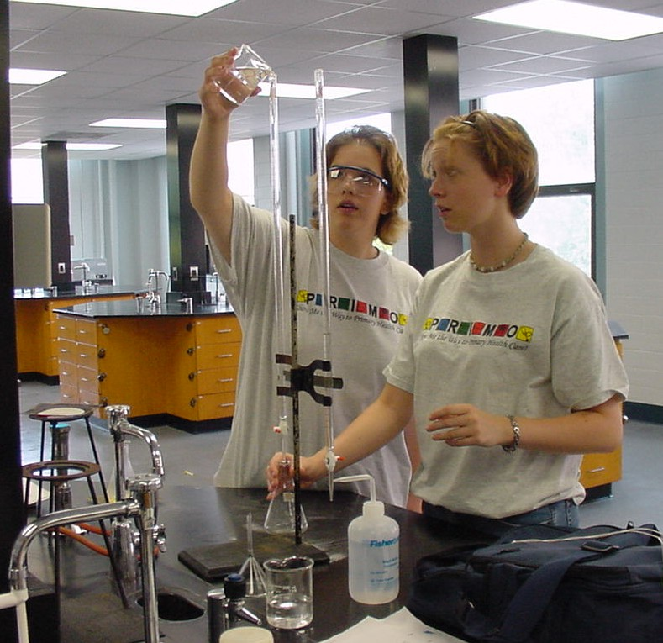
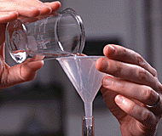
Filling the Buret
To fill a buret, close the stopcock at the bottom & use a funnel.
You may need to lift the funnel slightly to allow the solution to flow freely into the buret.

Slide 23
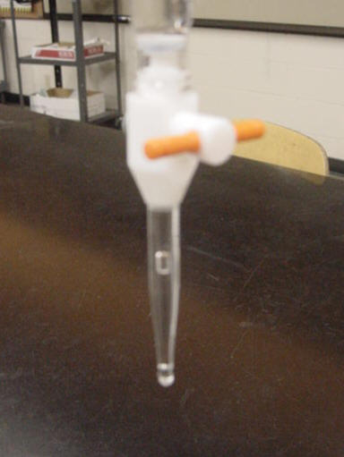
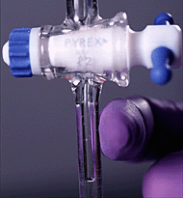
Air Bubbles in the Buret Tip
Check the tip of the buret for an air bubble.
To remove an air bubble, tap the side of the buret tip while solution is flowing.

Slide 24
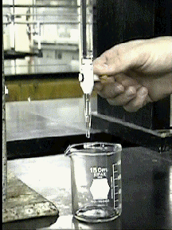
Rinse & drain buret twice with 1-2 ml of standardized solution before filling completely with standard to avoid dilution.
Open the valve & let a few mL of solution flow through until all air bubbles are purged from the tip.

Slide 25
Differences in Glassware
zero
zero
Graduated Cylinder
Buret

Slide 26
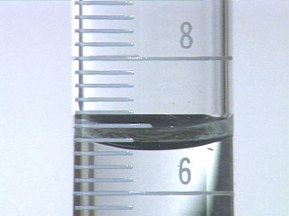
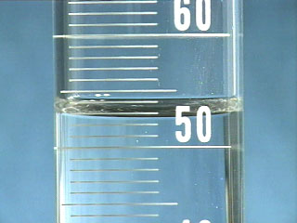
Determination of Certain Digits
When Using a Graduated Cylinder
10 mL graduated cylinder
volume is 6.65 mL
100 mL graduated cylinder
volume is 52.7 mL
Because 0, ¼, ½, & ¾ are about the best one can determine visually,
it is common practice to estimate the last digit as 0, 2, 5, 7 or 0, 3, 5, 8.

Slide 27
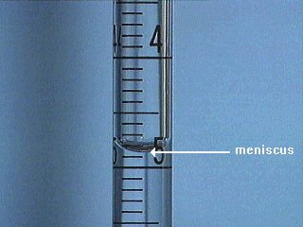
Determination of Certain Digits
When Using a Buret
To determine the volume contained in a buret, read the bottom of the meniscus at eye level.
This buret
reads
4.85 mL.
Determine the volume using all certain digits plus one uncertain digit. Certain digits are determined from the calibration marks on the cylinder. The uncertain digit, the last digit of the volume, is then estimated.

Slide 28
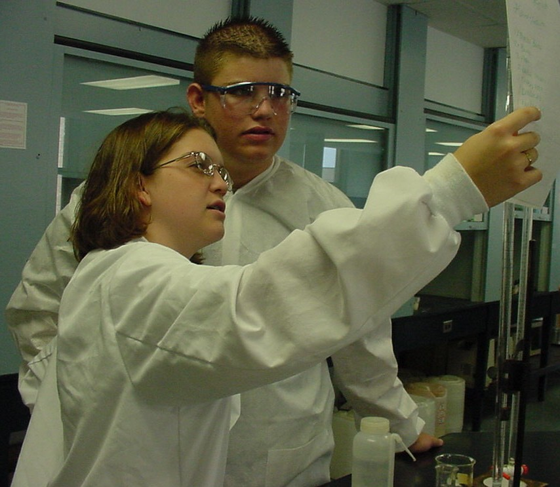
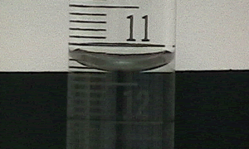
Reading the Buret
1. Hold a buret reading card behind the buret.
2. Move the card until you can easily see the meniscus.
3. Read the buret from top to bottom.
This buret reads 11.33 mL

Slide 29
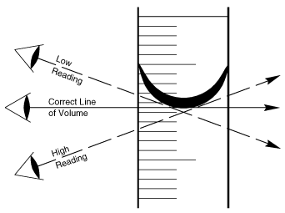
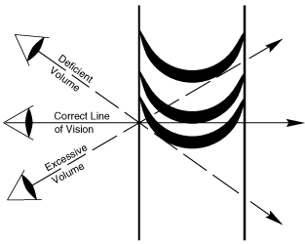
Viewing the Meniscus
Viewing the meniscus from an angle can lead to false readings of the volume.

Slide 30
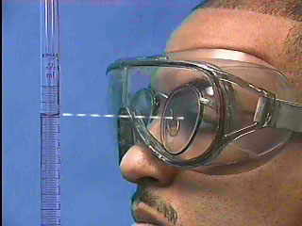
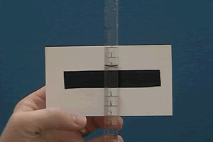
Proper Viewing of the Meniscus
Take the initial buret reading to the nearest 0.00 ml with your eye level with the bottom of the meniscus to avoid parallax error, using a dark surface placed below and behind the meniscus for ease of reading.

Slide 31
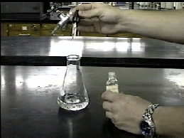
Proper Recording of the Data
All readings should be read and recorded to the nearest 0.00 ml, even if they land exactly on a line.
(e.g. Record 1.00 ml instead of just 1 ml)
Add drops of indicator before starting the titration.
Note: Use a sheet of white paper under the flask
to improve visibility of color change.

Slide 32
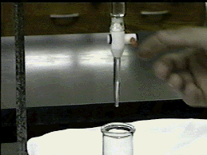
By carefully manipulating the valve you can carefully control how much NaOH solution drains into the flask at a time, from several mL to just a single drop.
*Practice adding a single drop at a time to an empty
beaker, before you begin your titrations.

Slide 33
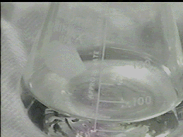
At the start of the titration one can add a few mL of NaOH solution at a time and the pink color that appears where the NaOH hits will fade quickly as the flask is swirled.

Slide 34
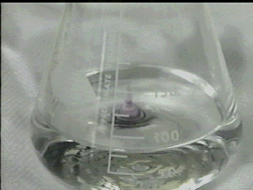
You will know when you are getting close to the endpoint because addition of a small amount of NaOH (as little as a drop) will produce a pink color that will take a long time to fade as the flask is swirled.

Slide 35
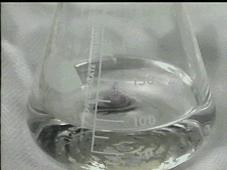
You have reached the endpoint of the titration when addition of one drop or less of solution causes the solution in the flask to turn pink and stay pink for 30 seconds or longer.

Slide 36
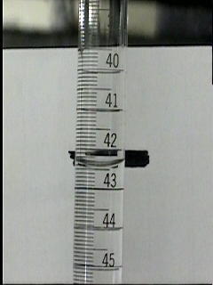
Once the endpoint has been reached,
read the final volume off of the buret.
If in doubt about endpoint, record buret reading.
Add 1 more drop and observe color again.
Record new reading if applicable.

Slide 37
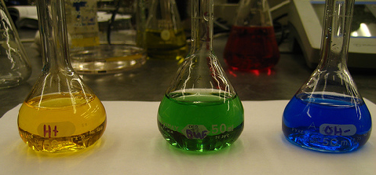
*
Bromcresol Green (yellow in acid, blue in base,
green at transition).
*NOTE: you may need 5-10 drops of bromcresol green
to get adequate color change for the Tums.

Slide 38
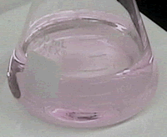
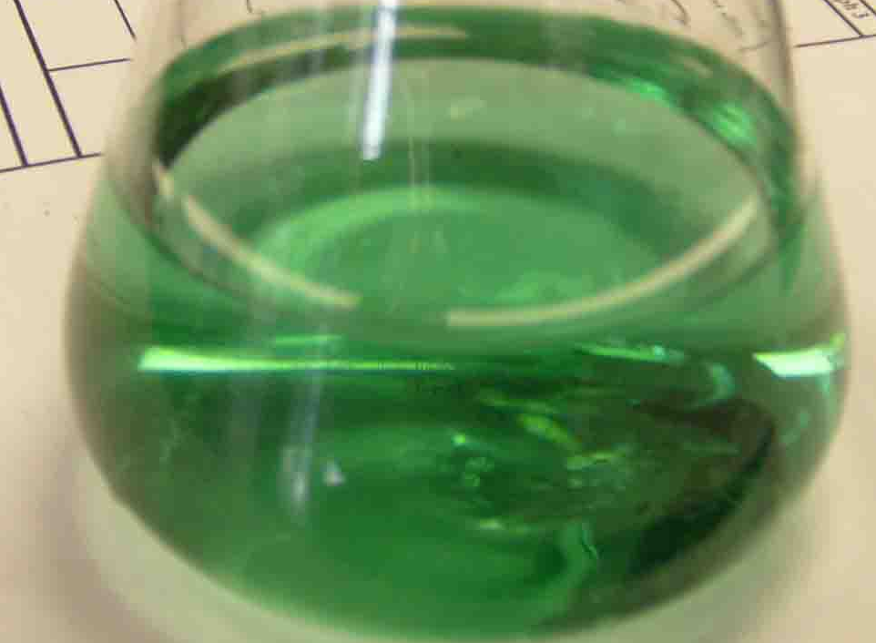
Indicators
Phenolphthalein (colorless in acid, pink in base);
Bromcresol Green (yellow in acid, blue in neutral/base,
green at transition).
*NOTE: you may need 5-10 drops of bromcresol green
to get adequate color change for the Tums.

Slide 39
Antacids - In bottles near the chalkboard.
Note: use 1 tablet only for each titration.
No need to weigh tablets.
Don’t use chipped tablets.
Baking soda, NaHCO₃ - In boxes near the balances.
Record actual weight in milligrams to nearest 0.001 gm.
For example, if you have 1.235g record as 1,235mg)
Indicators – Check out from the stockroom.
Phenolphthalein (colorless in acid, pink at endpoint);
Bromcresol Green (yellow in acid, green at endpoint).
*NOTE: may need 5-10 drops of bromcresol green
for the TUMS to get adequate color change.

Slide 40
Required Titrations
Indirect (back) titration – Equate, Tums & Baking Soda
Direct titration – Tums & Baking Soda (only)
For all titrations, dispense standard acid and base via buret.
*A grad cylinder is NOT accurate enough for measuring HCl.
All data is to be recorded on the Antacid Data Sheet in INK.
(Columns 1, 2, 5, 6, 14 & 15.)
You may use a pencil to record calculated data.
(All other columns.)
A Table of Antacid Cost and Composition Data
(Use WS/2012 data) is on the chem 2 web page http://web.mst.edu/~tbone/Subjects/TBone/antacidtable.html

Slide 41
Datasheets:
Antacid Data Table: Record all volumes to 0.00 ml, even if they land exactly on a line, for example
you would record 12.00 ml not 12 ml.
Data needs to be recorded in pen.
Calculated results:
You will need a separate calculations page to show how you calculated starred items on pp 36-38: 4, 8, 9, 11, 13, 25, 27, 28, 29, & 31.
Calculations may be done in pencil.

Slide 42
Checkout
2 - 50 ml Burets
You should have* in your desk a mortar & pestle set,
and 2 short-stemmed funnels.
*If not, get the missing items from the stockroom.
Indicators – one each phenolphthalein & bromcresol green
Reagents (carboys in the hoods)
_____M HCl (take ~100 ml in a beaker)
_____M NaOH (take ~50 ml in a beaker)
Hazards
HCl - strong acid, pH < 0
NaOH - strong Base, pH > 14
Wash off skin with large amounts of water.
Use baking soda for acid spills and
acetic acid then baking soda for base spills.
Waste
All titration waste - 5 gal waste carboy labeled “Antacid Waste”.

Slide 43
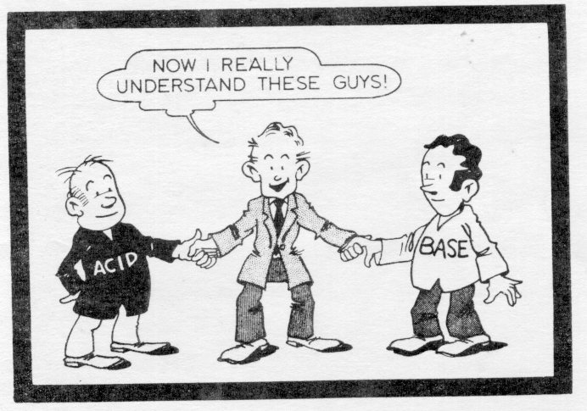
April 16-19 Turn In:
Antacid Datasheets pages 39-41
(including Post Lab p 43 & 3 Graphs)
& Dimensional Analysis #4-5 (First Book pp. 28-34)*
*Lost your 1st book? Go to http://web.mst.edu/~tbone/Subjects/TBone/Chem2.html
Read: Atomic Spectra (Green book pp 59-69)

