Slide 1
Determining the Empirical Formula
of Copper Chloride
Purpose of the Experiment
To determine the empirical formula
of a compound containing only copper and chlorine.

Slide 2
Molar Mass (Molecular Weight)
The mass in grams of 1 mole of a compound is equal to the mass in grams of the components.
H₂O MW = 2(1.008) + 15.999 g
AlCl₃ MW = 26.98 + 3(35.45) g
(Note: The Significant Figures.)
So the mass in grams of 1 mole of each compound is…

Slide 3
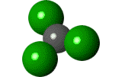
Molar Mass (Molecular Weight)
The mass in grams of 1 mole of each compound is…
H₂O MW = 18.015 g
AlCl₃ MW= 133.33 g

Slide 4
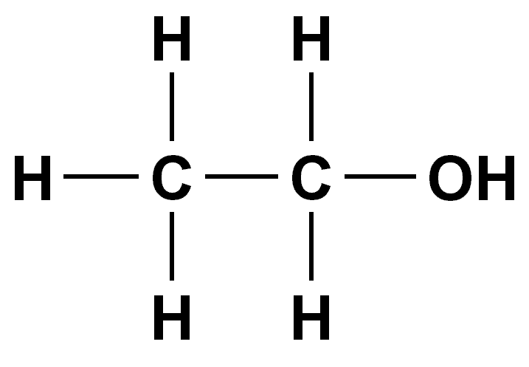
Percent Composition
Defn: The percentages of a compound’s mass that are due to each of the component elements.
Mass of C = 2 x 12.011g
Mass of H = 6 x 1.008 g
Mass of O = 1 x 15.999 g
Mass of 1 mole of C₂H₅OH = ??
C₂H₅OH

Slide 5
Percent Composition
Defn: The percentages of a compound’s mass that are due to each of the component elements.
Mass of C = 24.022 g
Mass of H = 6.048 g
Mass of O = 15.999 g
Mass of 1 mole of C₂H₅OH = 24.022 + 6.048 + 15.999 = 46.069g
C₂H₅OH
Mass percent of C = ??

Slide 6
Percent Composition
Defn: The percentages of a compound’s mass that are due to each of the component elements.
Mass of C = 24.022 g
Mass of H = 6.048 g
Mass of O = 15.999 g
Mass of 1 mole of C₂H₅OH = 24.022 + 6.048 + 15.999 = 46.069g
C₂H₅OH

Slide 7
Empirical Formula
Represents the simplest whole-number ratio
of the various types of atoms in a compound.
Examples
What is the Empirical Formula for the following compounds?
Isoamyl Acetate Scent of Bananas
Drying Agent
Caffeine
P₄O₁₀
C₁₄H₂₈O₄
C₈H₁₀N₄O₂

Slide 8
Empirical Formula
Represents the simplest whole-number ratio
of the various types of atoms in a compound.
Examples
What is the Empirical Formula for the following compounds?
Isoamyl Acetate Scent of Bananas
Drying Agent
Caffeine
P₄O₁₀
C₁₄H₂₈O₄
C₈H₁₀N₄O₂
P₂O₅
C₇H₁₄O₂
C₄H₅N₂O

Slide 9
Empirical Formula Example 1
A white compound is analyzed and found to contain
43.64% phosphorous and 56.36% oxygen by mass.
What is the empirical formula?
1st Step:

Slide 10
Empirical Formula Example 1
A white compound is analyzed and found to contain
43.64% phosphorous and 56.36% oxygen by mass.
What is the empirical formula?
1st Step: Because it is a percent we can choose any mass we want and multiply that mass by the percents of the components.
What is the easiest mass to choose?

Slide 11
Empirical Formula Example 1
A white compound is analyzed and found to contain
43.64% phosphorous and 56.36% oxygen by mass.
What is the empirical formula?
1st Step: Because it is a percent we can choose any mass we want and multiply that mass by the percents of the components.
What is the easiest mass to choose?
100.00 grams

Slide 12
Empirical Formula Example 1
A white compound is analyzed and found to contain
43.64% phosphorous and 56.36% oxygen by mass.
So since we chose 100.00 g of compound we have 43.64g P & 56.36 g O.
Can we compare grams directly?
2nd Step:

Slide 13
Empirical Formula Example 1
A white compound is analyzed and found to contain
43.64% phosphorous and 56.36% oxygen by mass.
So since we chose 100.00 g of compound we have 43.64g P & 56.36 g O.
Can we compare grams directly?
2nd Step: Convert grams to moles.
43.64g P x ???
56.36 g O x ???

Slide 14
Empirical Formula Example 1
A white compound is analyzed and found to contain
43.64% phosphorous and 56.36% oxygen by mass.
So since we chose 100.00 g of compound we have 43.64g P & 56.36 g O.
Can we compare grams directly?
2nd Step: Convert grams to moles.
43.64g P x (1 mol P / 30.974g P) = 1.409 mol P
56.36 g O x (1 mol O / 15.999g O) = 3.523 mol O

Slide 15
Empirical Formula Example 1
A white compound is analyzed and found to contain
43.64% phosphorous and 56.36% oxygen by mass.
So we now have 1.409 moles of P &
3.523 moles of O.
What can we do to compare the moles?
3rd Step:

Slide 16
Empirical Formula Example 1
A white compound is analyzed and found to contain
43.64% phosphorous and 56.36% oxygen by mass.
So we now have 1.409 moles of P &
3.523 moles of O.
What can we do to compare the moles?
3rd Step: Convert the smaller number to one.
Do this by dividing both mole values by the smaller one.
1.409
3.523
=
?
P
and
=
?
O
1.409
1.409

Slide 17
Empirical Formula Example 1
A white compound is analyzed and found to contain
43.64% phosphorous and 56.36% oxygen by mass.
So we now have 1.409 moles of P &
3.523 moles of O.
What can we do to compare the moles?
3rd Step: Convert the smaller number to one.
Do this by dividing both mole values by the smaller one.
1.409
3.523
=
1
P
and
=
2.5
O
1.409
1.409

Slide 18
Empirical Formula Example 1
A white compound is analyzed and found to contain
43.64% phosphorous and 56.36% oxygen by mass.
So by dividing both mole values by the smaller one we deduced:
1.409
3.523
=
1
P
and
=
2.5
O
1.409
1.409
This yields the formula PO_{2.5}
Is this an acceptable empirical formula?

Slide 19
Empirical Formula Example 1
A white compound is analyzed and found to contain
43.64% phosphorous and 56.36% oxygen by mass.
So by dividing both mole values by the smaller one we deduced:
1.409
3.523
=
1
P
and
=
2.5
O
1.409
1.409
This yields the formula PO_{2.5}
Is this an acceptable empirical formula?
No.

Slide 20
Empirical Formula Example 1
A white compound is analyzed and found to contain
43.64% phosphorous and 56.36% oxygen by mass.
Since compounds must contain whole numbers of atoms,
the empirical formula should contain only whole numbers.
What must we do to fix the formula PO_{2.5}?

Slide 21
Empirical Formula Example 1
A white compound is analyzed and found to contain
43.64% phosphorous and 56.36% oxygen by mass.
Since compounds must contain whole numbers of atoms,
the empirical formula should contain only whole numbers.
What must we do to fix the formula PO_{2.5}?
4th Step: Convert to whole numbers.
Do this by multiplying both mole values to get whole numbers.

Slide 22
Empirical Formula Example 1
A white compound is analyzed and found to contain
43.64% phosphorous and 56.36% oxygen by mass.
Since compounds must contain whole numbers of atoms,
the empirical formula should contain only whole numbers.
What must we do to fix the formula PO_{2.5}?
4th Step: Convert to whole numbers.
Do this by multiplying both mole values to get whole numbers.
1 P x 2 = 2 P
2.5 O x 2 = 5 O
Empirical Formula = P₂O₅

Slide 23
Empirical Formula Example 2
A student burns 0.353 g of magnesium ribbon in an open crucible. A white powder forms and is found to weigh 0.585 g. What is the empirical formula?
Atmospheric oxygen is in excess
heat
Mg _{(solid – silvery white)} + O₂ _{(gas)} → Mg_{x}O_{y} _{(solid – white)}
(0.353g)
limiting reagent
(0.585g)
resulting mass
How do we determine the empirical formula?

Slide 24
Empirical Formula Example 2
A student burns 0.353 g of magnesium ribbon in an open crucible. A white powder forms and is found to weigh 0.585 g. What is the empirical formula?
Atmospheric oxygen is in excess
heat
Mg _{(solid – silvery white)} + O₂ _{(gas)} → Mg_{x}O_{y} _{(solid – white)}
(0.353g)
limiting reagent
(0.585g)
resulting mass
How do we determine the empirical formula?
1st Step: Calculate mass percents.

Slide 25
Empirical Formula Example 2
1st Step: Calculate mass percents.
Mass of O = total mass of compound – mass of Mg = 0.232 g
Mg = 60.3% and O = 39.7%

Slide 26
Empirical Formula Example 2
2nd Step: Formula Masses and their Percent Composition.
Formula masses and percent composition
of three theoretical compounds of Mg and O
Mg = 24.31 g/mole
O = 15.999 g/mole
Formula of Oxide Mg_{x}O_{y} | Formula Weight |  | %Mg | %O
MgO | 24.31+15.999 =
MgO₂ | 24.31 + 2(15.999) =
Mg₂O | 2(24.31) + 15.999 =
Mg = 60.3% and O = 39.7%

Slide 27
Empirical Formula Example 2
2nd Step: Formula Masses and their Percent Composition.
Formula masses and percent composition
of three theoretical compounds of Mg and O
Mg = 24.31 g/mole
O = 15.999 g/mole
Formula of Oxide Mg_{x}O_{y} | Formula Weight |  | %Mg | %O
MgO | 24.31+15.999 = | 40.309
MgO₂ | 24.31 + 2(15.999) = | 56.308
Mg₂O | 2(24.31) + 15.999 = | 64.619
Mg = 60.3% and O = 39.7%

Slide 28
Empirical Formula Example 2
2nd Step: Formula Masses and their Percent Composition.
Formula masses and percent composition
of three theoretical compounds of Mg and O
Mg = 24.31 g/mole
O = 15.999 g/mole
Formula of Oxide Mg_{x}O_{y} | Formula Weight |  | %Mg | %O
MgO | 24.31+15.999 = | 40.309 | 24.31/ 40.309 | 15.999/ 40.309
MgO₂ | 24.31 + 2(15.999) = | 56.308 | 24.31/ 56.308 | 2 x 15.999/ 56.308
Mg₂O | 2(24.31) + 15.999 = | 64.619 | 2 x 24.31/ 64.619 | 15.999/ 64.619
Mg = 60.3% and O = 39.7%

Slide 29
Empirical Formula Example 2
2nd Step: Formula Masses and their Percent Composition.
Formula masses and percent composition
of three theoretical compounds of Mg and O
Mg = 24.31 g/mole
O = 15.999 g/mole
Formula of Oxide Mg_{x}O_{y} | Formula Weight |  | %Mg | %O
MgO | 24.31+15.999 = | 40.309 | 60.3 | 39.7
MgO₂ | 24.31 + 2(15.999) = | 56.308 | 43.2 | 56.8
Mg₂O | 2(24.31) + 15.999 = | 64.619 | 75.2 | 24.8
Mg = 60.3% and O = 39.7%

Slide 30
Empirical Formula Example 2
2nd Step: Formula Masses and their Percent Composition.
Formula masses and percent composition
of three theoretical compounds of Mg and O
Mg = 24.31 g/mole
O = 15.999 g/mole
Formula of Oxide Mg_{x}O_{y} | Formula Weight |  | %Mg | %O
**MgO | 24.31+15.999 = | 40.309 | 60.3 | 39.7
MgO₂ | 24.31 + 2(15.999) = | 56.308 | 43.2 | 56.8
Mg₂O | 2(24.31) + 15.999 = | 64.619 | 75.2 | 24.8
Mg = 60.3% and O = 39.7%

Slide 31
Today’s Experiment
Al(s) + Cu_{x}Cl_{y}(aq)
AlCl₃(aq) + Cu(s)
(silvery white)
(blue soln)
(gray soln)
(reddish)
known mass
of ~25 ml
(excess)
known mass
of product
Limiting reagent

Slide 32
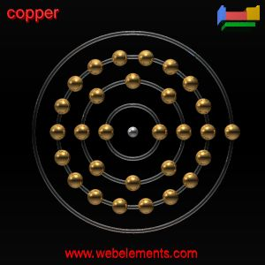
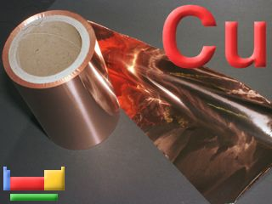
Copper is a Transition Metal.
Ground state electron configuration: [Ar].3d10.4s1
Shell structure: 2.8.18.1
Transition metals may exhibit multiple oxidation states
(+1, +2, +3, etc…). These are not easily predicted
by position in the periodic table.
Transition metal ions in aqueous solutions are frequently brightly colored, this is also due to transitions of electrons in the d orbitals (e.g. Cu ions tend to be blue).

Slide 33
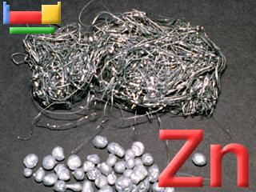
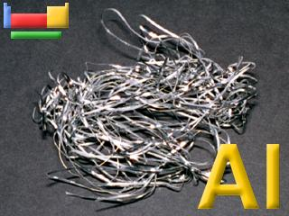
Last time we worked with Zinc. Zn and Al are both stronger reducing agents than copper. (Note the redox potentials on next slide.)
Because of this either one would work to produce metallic copper from a solution of a copper salt. We chose aluminum to work with because the reaction between Zinc and Copper Chloride is quite exothermic and extreme caution would have had to have been observed to avoid burns.

Slide 34
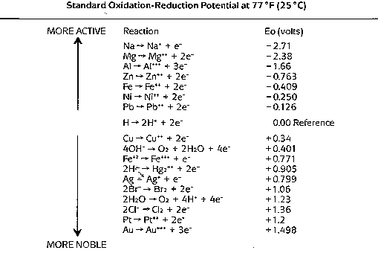
The oxidation of aluminum is more likely than the oxidation of zinc.
*
*
*
These potentials indicate the relative thermodynamic
tendency for the indicated half-reaction to occur.
Al <--> Al⁺³ + 3 e– E = -1.66 volts
Zn <--> Zn⁺² + 2 e– E = -0.763 volts Cu <--> Cu⁺² + 2 e– E = +0.34 volts

Slide 35
Removal of Excess Reducing Agent
2Al(s) + 6HCl(aq) --> 2AlCl₃(aq) + 3H₂(g)
Cu(s) + n HCl(aq) -x-> No Reaction
Once you have ensured that the aluminum is in excess (some aluminum will be floating on the surface), then it is time to proceed with the next step: removal of the aluminum.
This is accomplished by adding HCl in excess.
The HCl reacts with the aluminum and not the copper.

Slide 36
Checkout
3 pc Al foil – Add small pieces. Do not fold. Add in excess.
If there is any remaining unused Al, give to TA.
1 - pair of Beaker Tongs
Return to stockroom when you are done.
Reagents in Lab
Cu_{x}Cl_{y} solution in 4L spigot jugs
- Take ~25 ml for each run (using 100 ml Grad Cylinder)
Record data: (0.08067g Cu_{x}Cl_{y} /ml, d=1.074 g/ml)
10% HCl in 1L wash bottles
- Take 5-10 ml for each run (using 10 ml Grad Cylinder)
(N.B. solid NaHCO₃ is to be used for acid spills.)

Slide 37
Flow Chart for Procedure
Casserole 1 – Weigh to the nearest 0.001g. Record mass [3].
100 ml Graduated Cylinder - Acquire ~25 ml Cu_{x}Cl_{y} solution.
Pour Cu_{x}Cl_{y} soln into casserole
Casserole 1 with ~25 ml Cu_{x}Cl_{y} soln –
Weigh to the nearest 0.001g. Record mass [4].
Obtain Al foil. Tear Al foil into ~1 cm² pieces.
Casserole 1 with ~25 ml Cu_{x}Cl_{y} soln
Add Al foil to Cu_{x}Cl_{y} soln.
Submerge foil with glass stirring rod. Do NOT stir.
When solution turns green – start adding ~¹/₄ cm² pieces.
When solution is grey stop.
Are there small pieces of Al floating on the surface?
No.
Yes.
Add more Al.
Decant AlCl₃ soln into waste beaker.

Slide 38
Flow Chart for Procedure
Yes.
Decant AlCl₃ soln into waste beaker.
Obtain ~10 ml of HCl.
Casserole 1 with solid Cu.
Beaker 1 - Have TA verify that all Cu has been removed from solution.
Yes.
No.
Pour HCl over Cu in casserole.
Stir gently.
Are there small pieces of Al visible on the surface?
Are there bubbles still forming on the surface?
Pour in proper
waste container.
Add more Al.
Yes.
No.
Add more HCl.
Decant AlCl₃ soln into waste beaker.
Rinse twice with distilled water.
Decant rinsings into waste beaker.
Casserole 1 with damp solid Cu.
Beaker 1 with waste AlCl₃ solution.
Pour in proper
waste container.

Slide 39
Flow Chart for Procedure
Casserole 1 with damp solid Cu.
Place on hotplate (~100 ºC) for 5 min.*
Take off hotplate. Cool to room temp.
Weigh to the nearest 0.001g.
Record mass [8] under 1st heating.
*Repeat until 2 successive readings are within 0.010g.
(Note: Decrease heating time each successive heating and
break apart solid each time with a microspatula to increase surface area.)
Is the mass within 0.010g of the previous mass?
No.
Yes.
Continue with next heating.
Stop. Pour solid Cu into “used solids” container.

Slide 40
Highlights of Procedure Notes
Record all weights to 0.001g.
Weigh ~25 ml of Cu_{x}Cl_{y} solution, use exact density to calculate exact
volume, then calculate the mass of Cu_{x}Cl_{y.}
Do not use the metal microspatulas when stirring solution.
Add Al foil until blue color is gone, allow excess foil to dissolve also.
Allow container to cool before weighing.
Speed up cooling by placing under hoods.
Break apart solid Cu between weighing with microspatula.

Slide 41
Hazards
10% HCl - strong acid, corrosive
Cu_{x}Cl_{y} solution - heavy metal, irritant
Hot surfaces - hotplates, glassware
(Be Careful: Hot glassware looks just like cold glassware.)
Waste
Liquid Waste: Al⁺³ / HCl
Used Solids: Cu

Slide 42
Homework Assignment – Due Feb. 6-9
Read: Dimensional Analysis (pp. 24-28)
Do: Problem Set #2 (p.25) 2.1-2.4 & Set #3 (28) 3.1-3.2
(On a separate sheet of paper, show your calculations.)
For Feb. 6-9
Read: Ternary Mixture pp 95-111.
Turn-In: EF pp. 87-93; Calculations Page
(explained on p.87*) & DA Homework.
*Note that on the bottom of page 87 it states that the calculations which need to be shown on a separate sheet of paper are indicated by asterisks (*).

