Slide 1
*Gas Laws*
Purpose of the Experiment
To demonstrate the complexities involved in measuring properties of gases related to:
1.) Complications in weighing due to the buoyancy of air;
2.) Problems in pressure measurements over water; and,
3.) Non-ideality of Gases.

Slide 2
Physical Characteristics of Gases
Physical Characteristics | Typical Units
Volume, V | liters (L)
Pressure, P | atmosphere (1 atm = 1.015x10⁵ N/m²)
Temperature, T | Kelvin (K)
Number of atoms or molecules, n | mole (1 mol = 6.022x10²³ atoms or molecules)

Slide 3
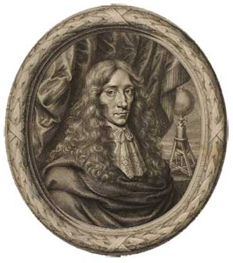
Boyle’s Law
Pressure and volume are inversely related at constant temperature.
PV = K
As one goes up, the other goes down.
P₁V₁ = P₂V₂
“Father of Modern Chemistry”
Robert Boyle
Chemist & Natural Philosopher
Listmore, Ireland
January 25, 1627 – December 30, 1690

Slide 4
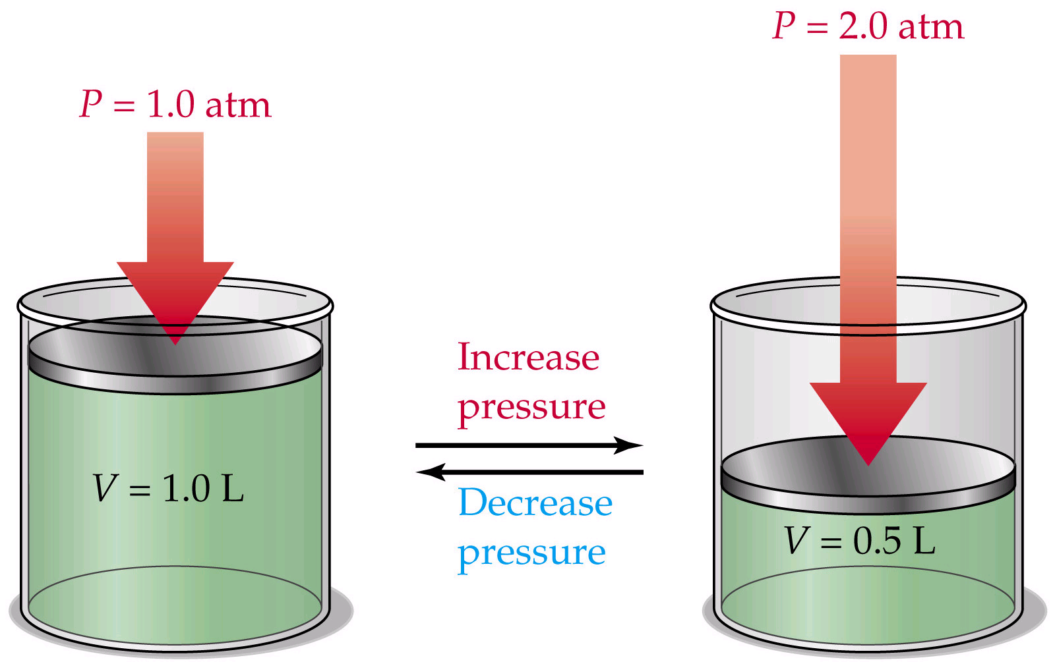
Boyle’s Law: P₁V₁ = P₂V₂

Slide 5
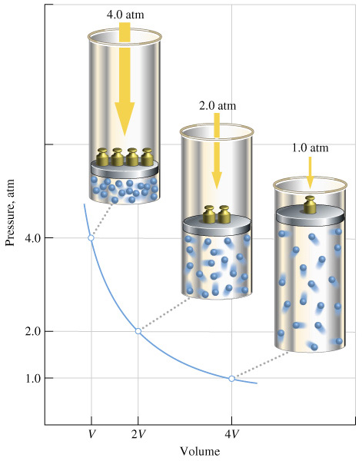
Boyle’s Law: P₁V₁ = P₂V₂

Slide 6
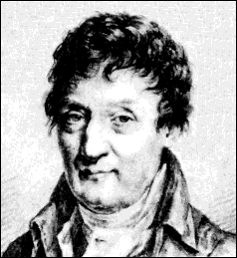
Charles’ Law
Volume of a gas varies directly with the absolute temperature at constant pressure.
V = KT
V₁ / T₁ = V₂ / T₂
Jacques-Alexandre Charles
Mathematician, Physicist, Inventor
Beaugency, France
November 12, 1746 – April 7, 1823

Slide 7
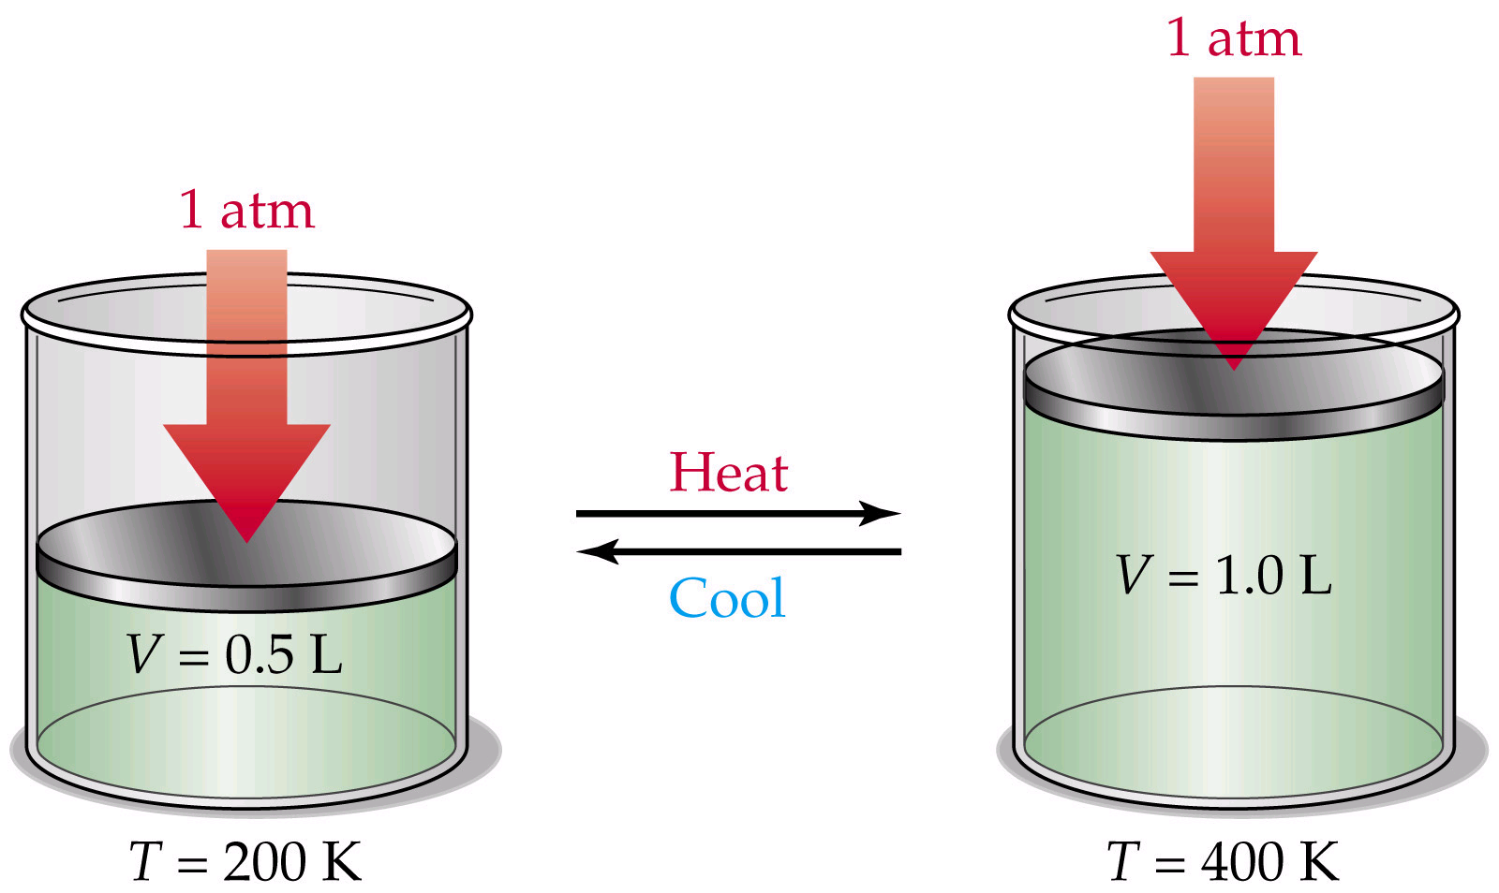
Charles’ Law: V₁/T₁ = V₂/T₂

Slide 8
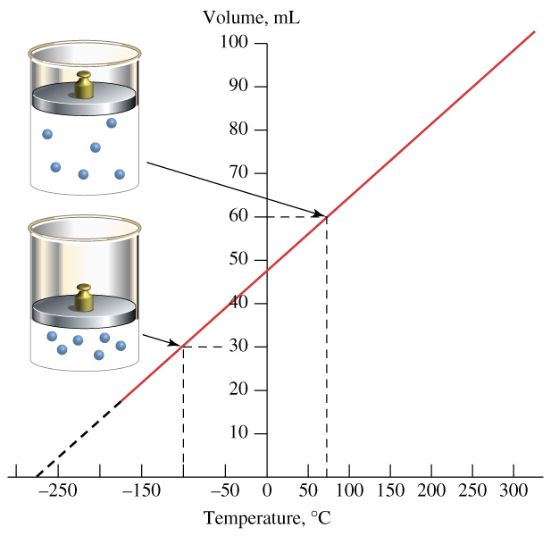
Charles’ Law: V₁/T₁ = V₂/T₂

Slide 9
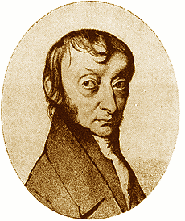
Avogadro’s Law
At constant temperature and pressure, the volume of a gas is directly related to the number of moles.
V = K n
V₁ / n₁ = V₂ / n₂
Amedeo Avogadro
Physicist
Turin, Italy
August 9, 1776 – July 9, 1856

Slide 10
Avogadro’s Law: V₁/n₁=V₂/n₂

Slide 11
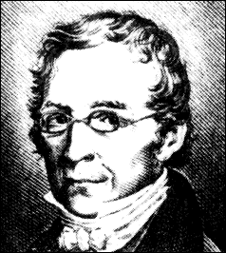
Gay-Lussac Law
At constant volume, pressure and absolute temperature are directly related.
P = k T
P₁ / T₁ = P₂ / T₂
Joseph-Louis Gay-Lussac
Experimentalist
Limoges, France
December 6, 1778 – May 9, 1850

Slide 12
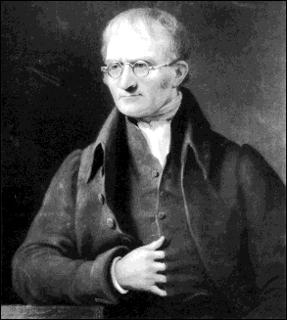
Dalton’s Law
The total pressure in a container is the sum of the pressure each gas would exert if it were alone in the container.
The total pressure is the sum of the partial pressures.
P_{Total} = P₁ + P₂ + P₃ + P₄ + P₅ ...
(For each P = nRT/V)
John Dalton
Chemist & Physicist
Eaglesfield, Cumberland, England
September 6, 1766 – July 27, 1844

Slide 13
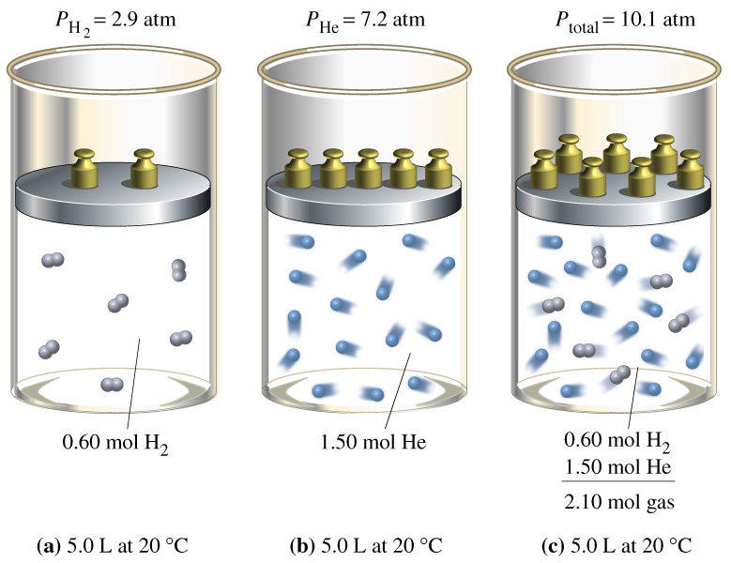
Dalton’s Law

Slide 14
Vapor Pressure
Water evaporates!
When that water evaporates, the vapor has a pressure.
Gases are often collected over water so the vapor pressure of water must be subtracted from the total pressure.

Slide 15
Differences Between Ideal and Real Gases
Ideal Gas
Real Gas
Obey PV=nRT | Always | Only at very low P and high T
Molecular volume | Zero | Small but nonzero
Molecular attractions | Zero | Small
Molecular repulsions | Zero | Small

Slide 16
Real Gases
Real molecules do take up space and do interact with each other (especially polar molecules).
Need to add correction factors to the ideal gas law to account for these.

Slide 17
Ideally, the VOLUME of the molecules was neglected:
at 1 Atmosphere Pressure
at 10 Atmospheres Pressure
at 30 Atmospheres Pressure
Ar gas, ~to scale, in a box 3nm x 3nm x3nm

Slide 18
But since real gases do have volume, we need:
Volume Correction
The actual volume free to move in is less because of particle size.
More molecules will have more effect.
Corrected volume V’ = V – nb
“b” is a constant that differs for each gas.

Slide 19
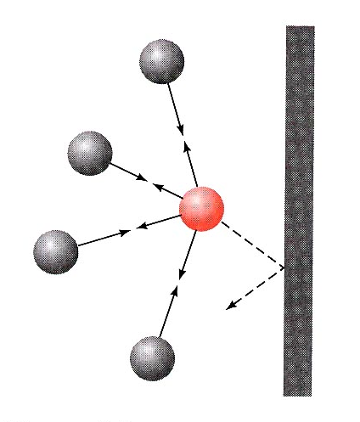
Pressure Correction
Because the molecules are attracted to each other, the pressure on the container will be less than ideal.
Pressure depends on the number of molecules per liter.
Since two molecules interact, the effect must be squared.

Slide 20
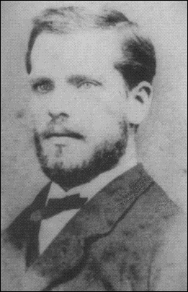
Van der Waal’s equation
Corrected Pressure
Corrected Volume
“a” and “b” are determined
by experiment
“a” and “b” are different for each gas
bigger molecules have larger “b”
“a” depends on both size and polarity
Johannes Diderik van der Waals
Mathematician & Physicist
Leyden, The Netherlands
November 23, 1837 – March 8, 1923

Slide 21
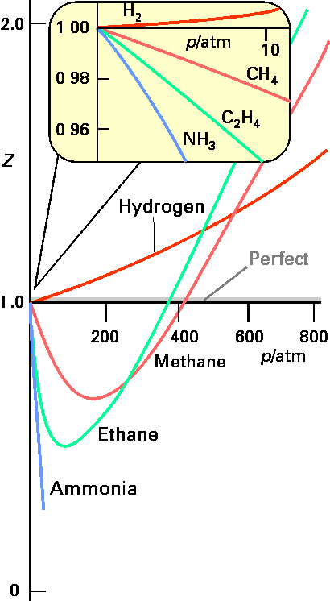
Compressibility Factor The most useful way of displaying this new law for real molecules is to plot the compressibility factor, Z :
For n = 1
Z = PV / RT
Ideal Gases have Z = 1

Slide 22
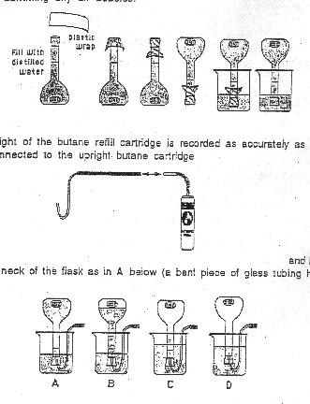
Part 1: Molar Volume of Butane
Page 72-73
in your
Green Book

Slide 23
Molar mass of butane (C₄H₁₀) = __________ g/mole
Mass of butane: __________
n or n_{B}= _______

Slide 24
Molar mass of butane (C₄H₁₀) = __________ g/mole
(12.011 × 4) + (1.008 × 10) = 58.124
Mass of butane: __________
Initial weight of cartridge – final weight of cartridge
n or n_{B}= _______

Slide 25
Ask your TA for the
Lab temperature and Pressure*
T = ____ ºC P = _____torr V = _____L
T = ____ K P = _____atm
0.500 L
Note: K = ºC + 273.15 & 1 atm = 760 torr
Apparent molar volume, (V_{m} = V / n) of butane
at experimental T & P: V_{m} = ________ L / mole
0.500 L
V/n
n → Calculated earlier
*These will be posted on the chalkboard.
Verify the values are for your session before posting in your book.

Slide 26
Apparent molar volume of butane at STP; V_{m} = _____L/mole
0.500 L
Lab pressure
1 atm or 760 torr
calculate
Lab temperature
(K)
273.15 K
V₂
calculate
Already calculated

Slide 27
Partial pressure of water vapor in flask: P_{w} = ______torr
calculate
Lab temperature
(K)

Slide 28
Partial pressure of butane in flask: _________ torr
_________atm
calculate
P_{B} = P_{total} -P_{w}
calculated
in previous step (torr)
Lab pressure
(torr)

Slide 29
Partial pressure of butane: P_{vdw} = ________ atm
0.08206 L.atm/mole. K
Lab temp.
Already calculated
14.47 atm .L²/mole²
calculate
0.500 L
0.1226 L/mole
0.500 L

Slide 30
Compressibility factor for butane : Z_{B} = ________
Partial pressure of butane in flask (atm)
Calculated earlier
0.500 L
calculate
Lab temperature
(K)
same as “n”
already calculated
0.08206 L.atm/mole. K

Slide 31
Estimated second Virial Coefficient for Butane at room temperature:
B_{B} = ___________L/mole
0.500 L
calculate
already calculated
Calculated in previous step
Compressibility factor for butane

Slide 32
Part 2: Buoyancy Effect
Filling Ziplok bag with butane gas
Page 75
in your
Green Book

Slide 33
Initial mass cartridge________g bag _________ g
Final mass ________g __________g
Change in mass ________g __________g
Discrepancy is the difference between these two masses
Discrepancy: _________g
Moles of Butane in bag: n = _____ moles
Change in cartridge mass
calculate
58.124 g/mole

Slide 34
Calculated volume of Butane in bag: ____L
Calculated in previous step
Estimated second Virial Coefficient
for Butane at room temperature
Calculated in Part 1 (p 73).
calculate
Compressibility factor for Butane
Calculated in Part 1 (p 73).

Slide 35
Estimated density of air at experimental T and P: d= ____g / L
Buoyancy effect of displaced volume of air
(the mass discrepancy)
calculate
Calculated volume of Butane in bag
(calculated in previous step)

Slide 36
Estimated Molar mass of air: _____g/mole
Estimated density of air
(calculated in previous step)
0.08206 L.atm/mole. K
Lab temperature
(K)
calculate
Lab pressure
(atm)

Slide 37
Part 3: Conservation of Mass
Gas generating reaction in a closed system
Page 77
in your
Green Book

Slide 38
Part 3: Conservation of Mass
Gas generating reaction in a closed system
Molar mass of NaHCO₃ : _____g/mole
Moles of NaHCO₃: _______ mole

Slide 39
Part 3: Conservation of Mass
Gas generating reaction in a closed system
Molar mass of NaHCO₃ : _____g/mole
(22.990) + (1.008) + (12.011) + (3 × 15.999) = 84.006 g/mole
Moles of NaHCO₃: _______ mole

Slide 40
Weight of bag and reaction components:
Before reaction: _____ g after reaction : ______ g
Discrepancy is the difference between these two weights.
Discrepancy: _____g
Estimated volume of expansion: _______ L
calculate
Determined in Part 2 (p 75).

Slide 41
Reaction:
1 NaHCO₃(aq) + CH₃CO₂H(aq) → _____ + 1 CO₂(g) + ______
Expected moles of CO₂(gas) : ___________ moles
Expected volume of gas at laboratory T & P: _____L
0.08206 L.atm/mole.K
Expected moles of CO₂
(from previous step)
Lab temp. (K)
Lab pressure (atm)
calculate
Lab pressure (atm)
Partial pressure of water vapor. (Note: Convert your Pw to atm.)
(You calculated Pw in torr in Part 1 – p 73.)

Slide 42
Check Out from the Stockroom
1000 ml beaker
500 ml volumetric flask
Tygon tubing with Hook
Butane cylinder
1 piece of plastic wrap
1 quart Ziploc Bag
5 dram vial with lid*
In The Hood:
50% Acetic Acid in a
500 ml plastic dispenser
By Balances:
Sodium bicarbonate, NaHCO₃
Clean Up:
*Dispose of liquid waste in appropriate container. Rinse vial and lid with water
and return them to the stockroom.
Hazards:
50% Acetic acid (corrosive, sharp, irritating odor)
Butane (flammable)
Waste:
5 gallon liquid waste for NaHCO₃ and acetic acid

Slide 43
For Next Week – March 5-8
Read:
Thermochemistry (Heat of Neutralization & Heat of Fusion)
pp 1-17 – Chapter 1 in the Green Book
Turn In:
Gas Laws Experiment pp. 73-77 + calculations page.
Calculations must be shown on a separate piece of paper,
with units to the correct number of significant figures.
Datasheets need to be in ink, but calculations may
be done with pen or pencil.
Calculations scribbled in the margins of the lab pages
are NOT ACCEPTABLE.

