Slide 1
Separating the Components
of a Ternary Mixture
Purpose of the Experiment
To separate the components of a mixture
of sand, sodium chloride, and calcium
carbonate and to calculate both the
percentage of each component in the mixture
and the percent recovery of each component.
Notes:
By Dr. Zahra Afrasiabi Navan
updated 060129 bolonc
updated 080208 cbolon

Slide 2
Matter
Mixtures Pure substances
Compounds Elements
Homogeneous Heterogeneous

Slide 3
Physical Change
Chemical Change
Easily reversible
Not easily reversible
No new substances
are formed
New substances are always produced
Mass of the individual substances not changed
Mass of individual
substances changed
Small changes in thermal energy (i.e., the latent
heat of fusion and / or vaporization)
Considerable changes in thermal energy normally involved

Slide 4
Examples of Chemical Changes
from Today’s Experiment:
CaCO₃ + HCl → CaCl₂ + CO₂ +H₂O
CaCl₂ + (K₂CO₃) → ?

Slide 5
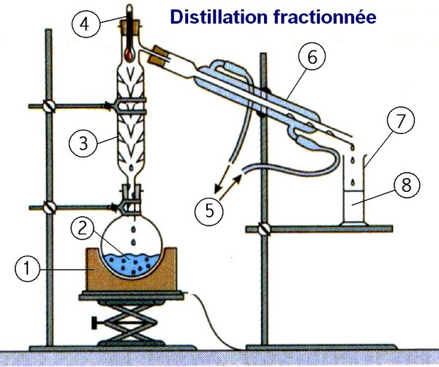
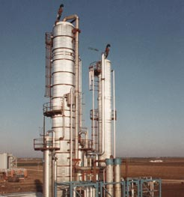
Various Methods for Separating
the Components of a Mixture
Distillation*: Separation through vaporization of a liquid from a solid, or another liquid, followed by vapor condensation.
Hebeler Corporation
Distillation is used in many different industries including chemical, brewery and pharmaceutical.

Slide 6
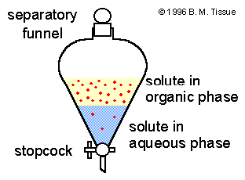
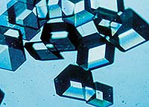
Extraction: removing a substance from a solid or liquid mixture by adding a solvent in which the substance is more soluble.
Crystallization: forming a crystalline solid by decreasing its solubility as a result of cooling the solution, evaporating the solvent, or adding a solvent in which the solid is less soluble such that solid crystals form.
Crystals of insulin grown in space let scientists determine the vital enzyme's structure and linkages with much higher resolution than Earth-grown crystals.
mineral aquamarine

Slide 7
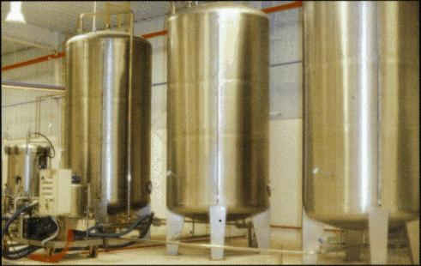
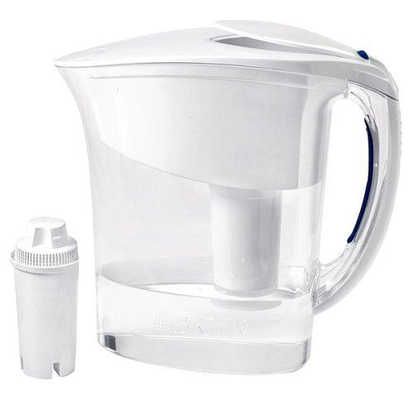
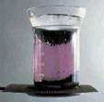
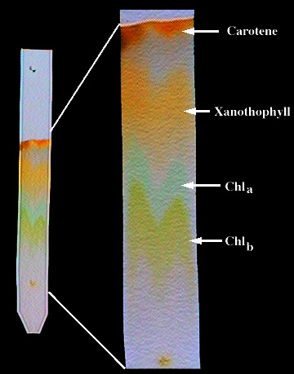
Filtration: removing a solid substance from a liquid by passing the suspension through a filter.
Sublimation: vaporizing a solid and subsequently condensing its vapor.
Chromatography: separating components of a mixture that have differing adsorptive tendencies on a stationary phase as the mixture is passed over or through the stationary phase .
Gravity
Filtration
Crude oil filtration
(vacuum filtration)
Sublimation
of
Iodine
Chromatography of plant pigments
Notes:
Carotene
Xanthophyll
Chlorophyll B
Chlorophyll A

Slide 8
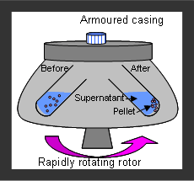
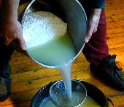
Centrifugation: removing a substance from a solution by means of a centrifuge.
Decantation: a process for separating the liquid component of a solid—liquid mixture from the solid by pouring.
Decanting
a solvent
from a solute.
Decanting whey
from the curds
in cheese making.

Slide 9
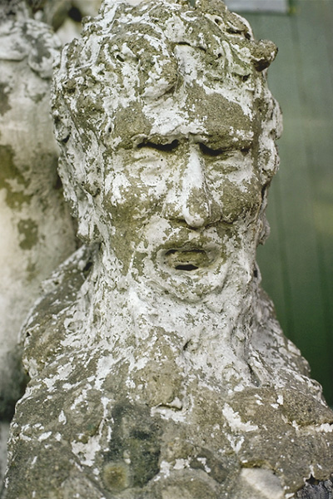
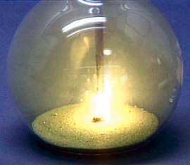
CHEMICAL CHANGES = REACTIONS
Reactants and Products
Formation of Sodium Chloride Salt.
http://www.youtube.com/watch?v=Ftw7a5ccubs
http://www.youtube.com/watch?v=Mx5JJWI2aaw
CaCO₃ Marble
eroded by acid rain.

Slide 10
Solubility Charts Are Useful for
Separating Components of a Mixture
 | Cold water | Hot water | 3M HCl | 3M NaOH
Benzoic acid | No | Yes | No | Yes
Mg(OH)₂ | No | No | Yes | No
Na₂SO₄ | Yes | Yes | Yes | Yes
Zn(OH)₂ | No | No | Yes | Yes
The differing solubility of a compound in various solvents can be used to separate the compounds.

Slide 11
The differing solubility of a compound in:
 | Cold water | Hot water | 3M HCl | 3M NaOH
Benzoic acid | No | Yes | No | Yes
Mg(OH)₂ | No | No | Yes | No
Na₂SO₄ | Yes | Yes | Yes | Yes
Zn(OH)₂ | No | No | Yes | Yes

Slide 12
The differing solubility of a compound in:
 | Cold water | Hot water | 3M HCl | 3M NaOH
Benzoic acid | No | Yes | No | Yes
Mg(OH)₂ | No | No | Yes | No
Na₂SO₄ | Yes | Yes | Yes | Yes
Zn(OH)₂ | No | No | Yes | Yes

Slide 13
The differing solubility of a compound in:
 | Cold water | Hot water | 3M HCl | 3M NaOH
Benzoic acid | No | Yes | No | Yes
Mg(OH)₂ | No | No | Yes | No
Na₂SO₄ | Yes | Yes | Yes | Yes
Zn(OH)₂ | No | No | Yes | Yes

Slide 14
The differing solubility of a compound in:
 | Cold water | Hot water | 3M HCl | 3M NaOH
Benzoic acid | No | Yes | No | Yes
Mg(OH)₂ | No | No | Yes | No
Na₂SO₄ | Yes | Yes | Yes | Yes
Zn(OH)₂ | No | No | Yes | Yes

Slide 15
 | Soluble in H₂O | Reacts with 3M HCl
SiO₂ | No | No
NaCl | Yes | No
CaCO₃ | No | Yes
*TODAY’S EXPERIMENT:
2.5 to 3.0 grams unknown only.
10.00 g* of
SiO₂ + NaCl + CaCO₃
Step 1?
Filtrate?
Residue?
2.

Slide 16
 | Soluble in H₂O | Reacts with 3M HCl
SiO₂ | No | No
NaCl | Yes | No
CaCO₃ | No | Yes
*TODAY’S EXPERIMENT:
2.5 to 3.0 grams unknown only.
10.00 g* of
SiO₂ + NaCl + CaCO₃
1. Add Water
Filtrate
Residue
NaCl (aq)
1.80 g
SiO₂ (s) + CaCO₃ (s)
Step 2?
Filtrate?
Residue?

Slide 17
 | Soluble in H₂O | Reacts with 3M HCl
SiO₂ | No | No
NaCl | Yes | No
CaCO₃ | No | Yes
*TODAY’S EXPERIMENT:
2.5 to 3.0 grams unknown only.
10.00 g* of
SiO₂ + NaCl + CaCO₃
1. Add Water
Filtrate
Residue
NaCl (aq)
1.80 g
SiO₂ (s) + CaCO₃ (s)
2. React with HCl
Filtrate
Residue
CaCl₂ (aq)
SiO₂(s)
3.20 g
Step 3?
Filtrate?
Residue?

Slide 18
 | Soluble in H₂O | Reacts with 3M HCl
SiO₂ | No | No
NaCl | Yes | No
CaCO₃ | No | Yes
*TODAY’S EXPERIMENT:
2.5 to 3.0 grams unknown only.
10.00 g* of
SiO₂ + NaCl + CaCO₃
1. Add Water
Filtrate
Residue
NaCl (aq)
1.80 g
SiO₂ (s) + CaCO₃ (s)
2. React with HCl
Filtrate
Residue
CaCl₂ (aq)
SiO₂(s)
3.20 g
3. React with K₂CO₃
Filtrate
Residue
KCl (aq)
CaCO₃ (s)
4.10 g

Slide 19
 | Soluble in H₂O | Reacts with 3M HCl
SiO₂ | No | No
NaCl | Yes | No
CaCO₃ | No | Yes
*TODAY’S EXPERIMENT:
2.5 to 3.0 grams unknown only.
10.00 g* of
SiO₂ + NaCl + CaCO₃
1. Add Water
Filtrate
Residue
NaCl (aq)
1.80 g
SiO₂ (s) + CaCO₃ (s)
2. React with HCl
Filtrate
Residue
How many grams were recovered?
What is the Percent Recovery?
CaCl₂ (aq)
SiO₂(s)
3.20 g
3. React with K₂CO₃
Filtrate
Residue
KCl (aq)
CaCO₃ (s)
4.10 g

Slide 20
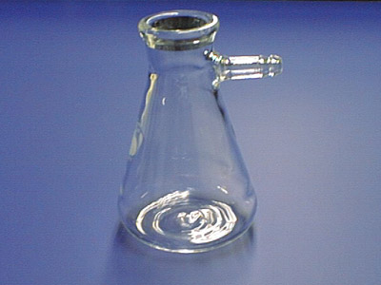
Side arm or filtration flask
A filtration flask looks like an Erlenmeyer flask with a short side arm.
The "arm" is designed to connect the flask to a vacuum source.
When sealed on the top with a stopper or a Büchner funnel, the vacuum flask will maintain a reduced pressure.

Slide 21
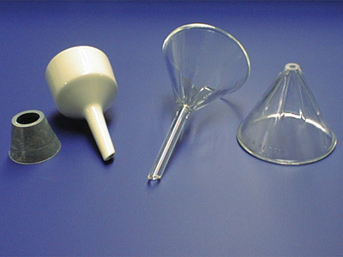
Stemmed Funnel
Büchner Funnel
Stemless Funnel
A Büchner funnel is the white porcelain funnel. It requires a gray or black adaptor or rubber stopper with a hole in it to connect it to the top of a filtration flask.
A Büchner funnel is used exclusively for vacuum filtrations.

Slide 22
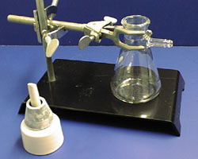
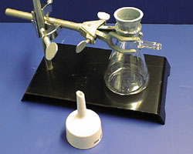
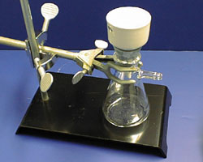
Procedure for Vacuum Filtration
1. Clamp a filtration
flask securely to a ring stand.
2. Place rubber*
stopper in the top of the filtration flask.
3. Place the Büchner funnel
on the adaptor.
*Note: Our Buchner funnels already have the rubber stoppers attached.

Slide 23
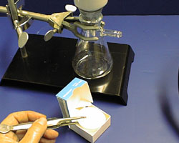
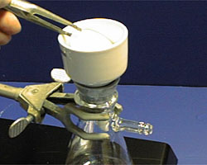
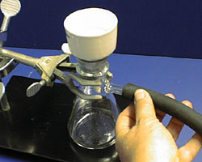
Procedure for Vacuum Filtration
4. Obtain a piece of filter paper.
5. If required weigh the filter paper.
6. Place the filter paper in the Büchner funnel.
7. Make sure all of the holes in the funnel are covered.
8. Connect the side arm to a vacuum source.
9. Make sure both ends are firmly connected.
Notes:
Make sure the paper covers the holes!!

Slide 24
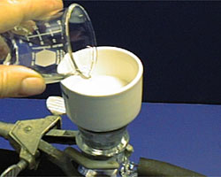
10. Wet the paper with a small amount of the solvent to be used in the filtration. We will using distilled water as our solvent. The distilled water may be sprayed directly from the bottle – i.e., it is not necessary to use a beaker to pour the distilled water.
11. Turn on the water aspirator or vacuum pump. Check to make sure the distilled water you placed on the filter paper is being sucked through the funnel. (Is it dripping into the flask?)
Notes:
Make sure the paper covers the holes!!

Slide 25
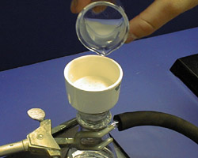
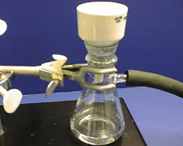
12. Carefully pour portions of the solution onto the center of the filter paper.
13. Notice that the vacuum will pull the solvent through the filter and into
the filtration flask.

Slide 26
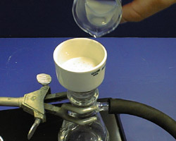
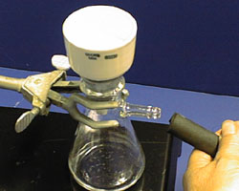
15. Disconnect the vacuum
at the flask
and
before turning off the water aspirator.
This prevents water from being sucked back into
the vacuum flask.
14. Make sure the entire contents is transferred to the funnel. If necessary use distilled water to wash contents into funnel.

Slide 27
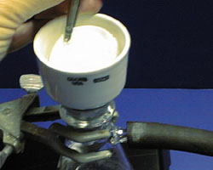
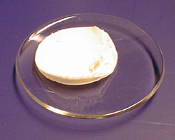
16. Using the forceps, carefully remove the filter paper and solid from the Büchner funnel.
Note: You may have to use your microspatula to pry up the corners before you use the forceps.
17. Place the filter paper and solid in a casserole or evaporating dish *.
(*A watch glass is shown here –
Do not use a watch glass.)
18. Transfer casserole to a hotplate using beaker tongs. Dry the product.

Slide 28
Checkout from Stockroom
Buchner funnel
Forceps
Beaker Tongs
Filter paper
Unknown Sample – it is very important that the unknown number be recorded on the data sheet.
(Note: The unknown number is not 375 – that is the experiment number!)
Reminders:
1. Check Bunsen burner tubing for cracks. Do not use if
cracked. Exchange in stockroom for new tubing.
2. Vacuum Filtration System:
a. Disconnect tubing before shutting off water.
b. The stopper on the funnel should fit about halfway.
b. Pour contents of beaker while swirling beaker to
keep solids suspended. Direct flow towards
center of filter paper.

Slide 29
Hazards:
3 M HCl is a corrosive strong acid
(neutralize spills with NaHCO₃)
Hot glass looks like cold glass,
but HOT glass burns.
Waste:
Liquid Waste should go in the carboy marked
“Ternary Mixture”.
Solid Waste should go in the bucket marked
“Used Solids.”

Slide 30
For Sept. 29-Oct. 2
Read: Mystery of the Thirteen Test Tubes (pp. 103-114).
Turn-In: Ternary Mixture Report
- Datasheet + Post-Lab Questions pages 95-98. - - Calculations Page for starred items on p. 95.
In 3 weeks (Oct. 13-16)
You will need the Green Book for the Heat of Neutralization Experiment.
It may be purchased for $10.00 in Room 142 Schrenk
starting in October.
Midterm Exam (Oct. 6-9)
Exam Review –
Thurs. Oct. 2, 7-9 pm in G3.

