Slide 1
Gravitational Waves and LIGO
2017 Nobel Prize in Physics: Rainer Weiss - Barry C. Barish -Kip S. Thorne "for decisive contributions to the LIGO detector and the observation of gravitational waves"
Since 2019, Missouri S&T has been part of the international LIGO consortium (the only institution in Missouri!)
https://www.ligo.caltech.edu/system/video_items/files/4/EinsteinsMessengerLIGO.mp4?1436490806

Slide 2
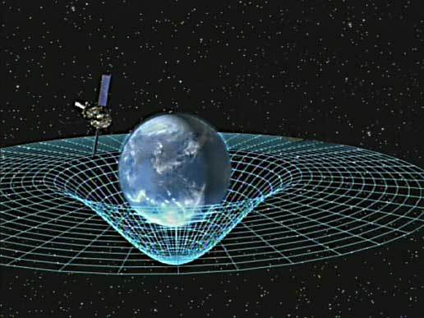
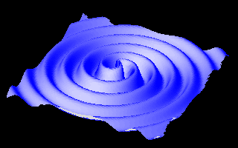
General Relativity (Einstein):
Gravity is related to the curvature of spacetime
caused by mass.
When massive objects accelerate,
they cause “ripples” in the fabric of spacetime.
These ripples propagate as gravitational waves
with the speed of light
https://www.ligo.caltech.edu/page/what-are-gw
Two-dimensional representation of gravitational waves generated by two neutron stars orbiting each other.

Slide 3
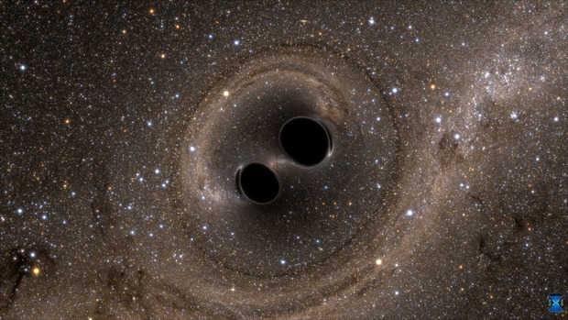
https://youtu.be/I_88S8DWbcU
Two Black Holes Merge into One
Image Credit: SXS, the Simulating eXtreme Spacetimes (SXS) project (http://www.black-holes.org)
Computer simulation.
Two merging black holes each roughly 30 times the mass of the sun
1.3 billion years ago.

Slide 4
https://youtu.be/owc7ZwVHHgg
A computer simulation of gravitational waves from merging black holes, based on data acquired Sept. 14, 2015 by the LIGO detectors. Our universe's three-dimensional space is shown as a two-dimensional surface, with one dimension removed. The black holes’ strong gravity curves the space near them into funnel shapes. As the black holes spiral together and merge into one, gravitational waves ripple outward. The movie is shown in slow motion, about 40 times slower than real time. This video is based on a computer simulation by the multi-university SXS (Simulating eXtreme Spacetimes) project. For more information, visit http://www.black-holes.org.

Slide 5
When gravitational waves pass an observer, they distort spacetime
Distances between objects change
⟶ Basis for detection

Slide 6
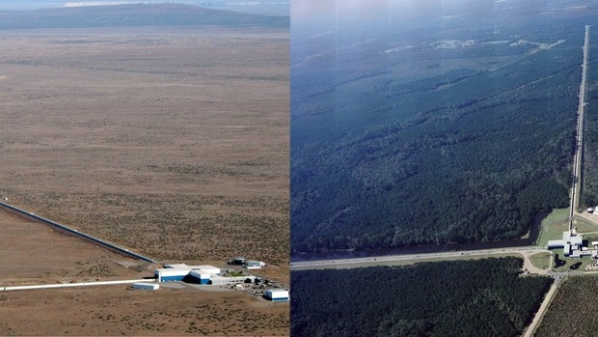
LIGO Laser Interferometer Gravitational Wave Observatory

Slide 7
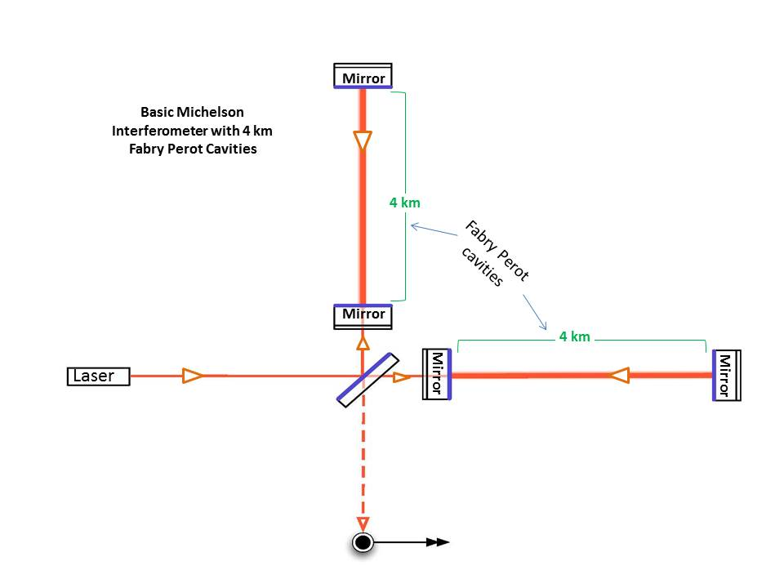
Mirrors placed near the beam splitter reflect each laser beam back and forth along this 4 km length about 280 times before it merges with the beam from the other arm.
1. It stores the laser light within the interferometer for a longer period of time, which increases LIGO's sensitivity
2. It increases the distance traveled by each laser from 4 km to 1120 km!
https://www.ligo.caltech.edu/page/ligos-ifo

Slide 8
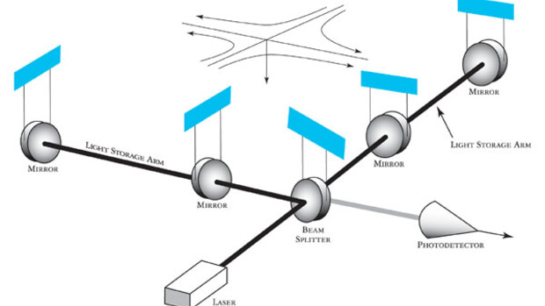
https://www.ligo.caltech.edu/page/what-is-interferometer

Slide 9
Gravitational waves cause space to stretch in one direction and get squeezed in a perpendicular direction.
One arm of an interferometer lengthens while the other shrinks, then vice versa. The arms will change lengths in this way for as long as it takes the wave to pass.
Distance traveled by each laser beam varies
Beams arrive at different times ⟹ destructive and constructive interference
Change in arm length only about 10⁻¹⁹ m ( 1/10,000th the width of a proton)!

Slide 10
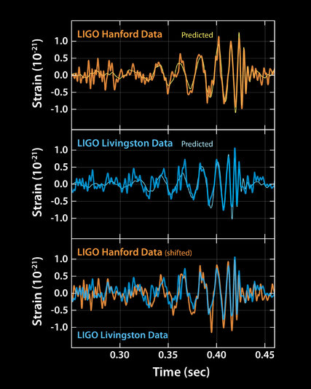

Slide 11
