Slide 1
Lecture 1: Course introduction
Motion in one dimension
Semester preview
Motion along a straight line
Position and displacement
Velocity and speed
Acceleration as derivative of velocity with respect to time
Interpret the sign of velocity and acceleration

Slide 2
What is physics?
Most fundamental of sciences
Behavior and structure of matter

Slide 3
Galaxy NGC 300, seven million lighters away, constellation Sculptor.
Courtesy of NASA.

Slide 4
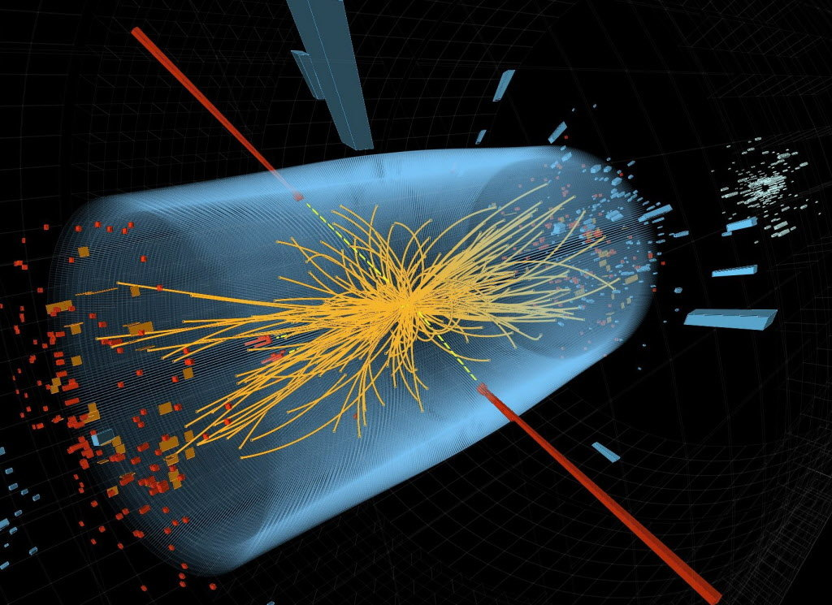
High energy proton collision in the LHC. © CERN

Slide 5
Why study physics?
Required for major
Find out how the world works
Because it is FUN
Demonstrations

Slide 6
Topic overview
Mechanics
Motion of macroscopic objects
Forces, friction, circular motion
Energy and momentum
Motion of planets
Rotational motion
Oscillations and waves
Fluids
Thermodynamics
Honda cog ad video

Slide 7
A few tools:
SI system of units, unit conversions
Scientific notation
Prefixes: micro, milli, centi, kilo…
Estimates
Please review on your own as needed.
See Ch. 1, Sec. 1.1-1.6

Slide 8
Basic math skills* required in this course
Linear equations, systems of linear equations
Quadratic equations
Basic trigonometry: SOHCAHTOA, Pythagoras
Calculus 1: derivatives/integrals
Note: Calc 1 is a prerequisite for this course. If you have not taken calc 1, you should drop the class.
*Homework # 1
will help you review
Vectors (will be covered in lecture 3)

Slide 9
Kinematics: Describing Motion
Consider object as point mass → only translation
Things to know about a moving object:
Where is it? ➔ Position
How fast is it moving and in which direction?
➔ Velocity
How do speed and direction of motion change?
➔ Acceleration

Slide 10
Position
In reference to some coordinate system
numerical value x
x(t) is location of particle as a function of time
Initial position: x₀ = x(t₀) *
* Does not mean x₀ = 0

Slide 11
Showing position
With respect to a coordinate system:
x-axis with origin and a positive direction (arrow)
Mark position at certain times:

Slide 12
Position versus Time Graphs

Slide 13
Position versus Time Graphs

Slide 14
Displacement
Displacement = Change in position: *
$Δx=x_{f}−x_{i}$
* Change (upper case delta Δ) is the final value of a quantity minus the initial value.
$Δx$can be positive or negative ⟶ direction
Displacement is not the same as distance traveled!

Slide 15
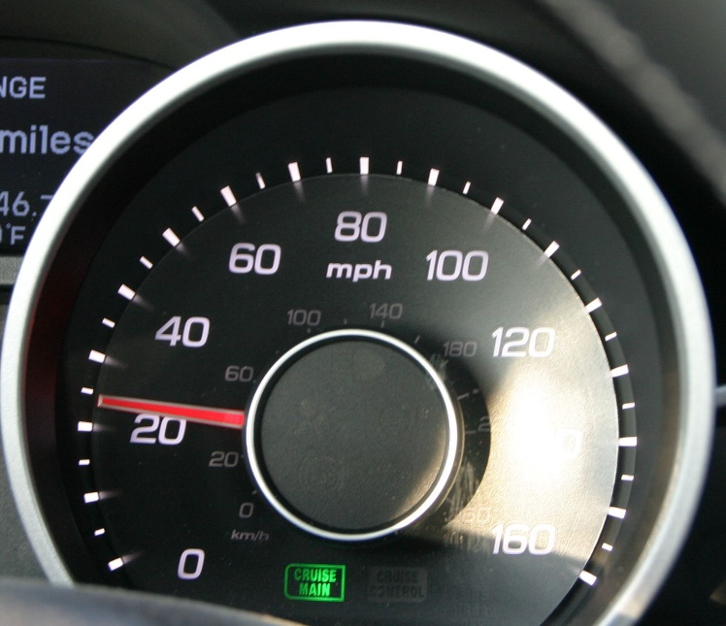
Speed and velocity
“I am currently going at 25 mph”
= instantaneous speed
Together with information about direction:
“I am currently going at 25 mph
North on Pine Street”
= instantaneous velocity
“I drove the 60 miles in one hour”
= average speed, distance per time

Slide 16
Average velocity
$$average {velocity}_{ }=\overline{v_{x}}=\frac{displacement}{time interval}=\frac{∆x}{∆t}$$
unit: $\frac{m}{s}$
* The subscript $x$ is
very important!
$\overline{v_{x}}>0$: object moves in the positive x-direction
$\overline{v_{x}}<0$ : object moves in the negative x-direction

Slide 17
Average velocity and x-t graph
Average velocity
between t₁ and t₃:
$$\overline{v_{x}}=v_{av−x}=\frac{x_{3}−x_{1}}{t_{3}−t_{1}}$$
In this example:
$\overline{v_{x}}$ is negative.
Object moves to smaller value of x.

Slide 18
Instantaneous velocity
$$v_{x}=\lim_{∆t→0}{\frac{∆x}{∆t}}=\frac{dx}{dt}$$

Slide 19
$$v_{x}=\frac{dx}{dt}$$
Speedometer shows
absolute value
of instantaneous velocity
${v=|v_{ x}|}_{ }$= speed
always positive

Slide 20
Direction of velocity
$v_{ x}$ >0: object moves in the positive x-direction
$v_{ x}$ <0: object moves in the negative x-direction

Slide 21
Acceleration
Acceleration: how fast velocity changes,
time rate of change of velocity
$$a_{x}=\frac{dv_{x}}{dt}=\frac{d^{2}x}{dt^{2}}$$
Slope of $v_{x}$vs $t$ graph
Unit: $\frac{m/s}{s}=\frac{m}{s^{2}}$
Acceleration produces change in velocity:${dv_{x}=a}_{x}dt$

Slide 22
Signs of acceleration and velocity
If $a_{ x}>0$ and thus ${dv}_{ x}=a_{ x}dt>0:$
if $v_{ x}$ >0 speed up if $v_{ x}$ <0 slow down

Slide 23
Signs of acceleration and velocity
If $a_{ x}<0$ and thus ${dv}_{ x}=a_{ x}dt<0:$
if $v_{ x}$ >0: slow down if $v_{ x}$ <0: speed up

Slide 24
Motion diagrams
http://phet.colorado.edu/en/simulation/moving-man
$$x_{0}=0, v_{0x}=+4\frac{m}{s}, a_{x}=−2 m/s^{2}$$

