Slide 1
Lecture 3: Vectors
Definition
Graphical addition and subtraction of vectors
Unit vector notation
Vector components, magnitude and direction
Addition and subtraction of vectors in unit vector notation

Slide 2
Vectors
A vector is a quantity that has size (magnitude) and direction. It can be symbolized by an arrow.
Length of the arrow represents magnitude
Notation convention:
$\vec{A}$denotes vector of magnitude $A=|\vec{A}|$
*Sometimes bold-face type also indicates a vector – hard to do in handwriting

Slide 3
Vector addition - graphically

Slide 4
Vector subtraction - graphically

Slide 5
Unit vectors

Slide 6
Unit vector notation

Slide 7
Vector components
$$A_{x}=+Acosθ$$
$$A_{y}=+Asinθ$$

Slide 8
Vector components

Slide 9
Unit vector notation

Slide 10
Magnitude and direction

Slide 11
Example
A displacement of 5 km is directed θ = 53° East of South. What is the displacement vector in unit-vector notation?

Slide 12
Example

Slide 13
Example

Slide 14
Vector addition in components
$$\vec{A}=A_{x}\hat{i}+A_{y}\hat{j}$$
$$\vec{B}=B_{x}\hat{i}+B_{y}\hat{j}$$
$\vec{C}=\left(A_{x}\hat{i}+A_{y}\hat{j}\right)+(B_{x}\hat{i}+B_{y}\hat{j}$)
$$\vec{C}={(A}_{x}+B_{x})\hat{i}+({A_{y}+B}_{y})\hat{j}$$
$$C_{x}=A_{x}+B_{x}$$
$$C_{y}=A_{y}+B_{y}$$

Slide 15
Vector subtraction in components
$$\vec{A}=A_{x}\hat{i}+A_{y}\hat{j}$$
$$\vec{B}=B_{x}\hat{i}+B_{y}\hat{j}$$
$$\vec{D}=\vec{A}−\vec{B}$$
$\vec{D}=\left(A_{x}\hat{i}+A_{y}\hat{j}\right)−(B_{x}\hat{i}+B_{y}\hat{j}$)
$$\vec{D}={(A}_{x}−B_{x})\hat{i}+({A_{y}−B}_{y})\hat{j}$$
$$D_{x}=A_{x}−B_{x}$$
$$D_{y}=A_{y}−B_{y}$$

Slide 16
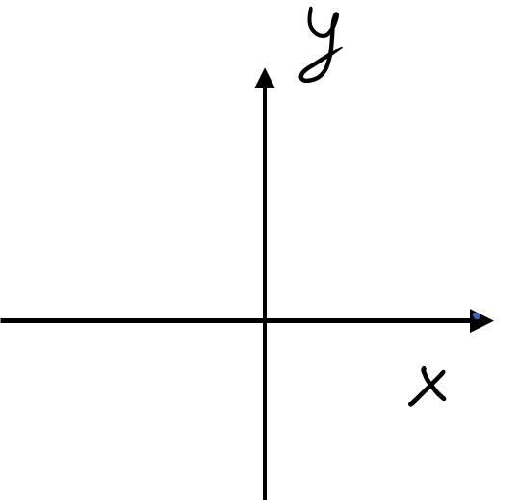
Example
Express the vectors$\vec{C}=\vec{A}+\vec{B}$ and $\vec{D}=\vec{B}−\vec{A}$ in unit vector notation in terms of $A, B,$ and θ.

Slide 17
Example with tilted coordinate system
N
y
P
x
W
θ

Slide 18
$$N_{x}=0$$
$$N_{y}=N$$
N
y
$$P_{x}=−P\cos{θ}$$
$$P_{y}=−P\sin{θ}$$
P
θ
x
θ
W
θ
$$W_{x}=W\sin{θ}$$
$$W_{y}=−W\cos{θ}$$

