Slide 1
Lecture 4: Motion in two dimensions
Position, velocity, and acceleration in 2-d
Separation of motion in x-and y-direction
Equations for 2-d kinematics at constant acceleration
Projectile motion

Slide 2
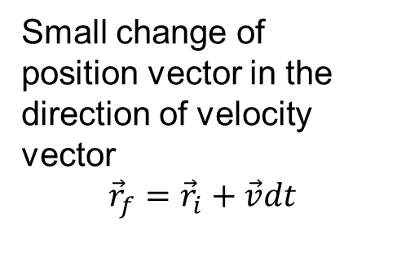
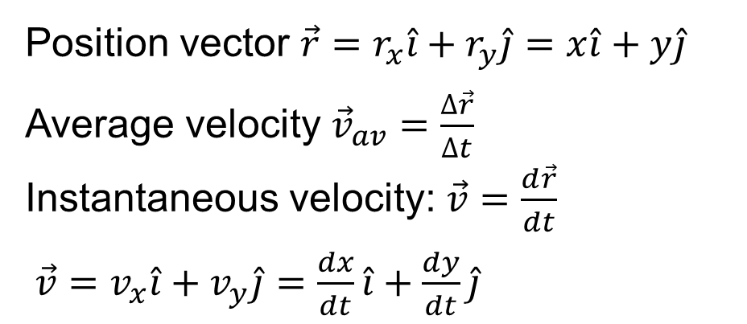
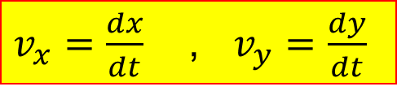
Velocity
Position vector $\vec{r}=r_{x}\hat{i}+r_{y}\hat{j}=x\hat{i}+y\hat{j}$
Average velocity ${\vec{v}}_{av}=\frac{∆\vec{r}}{∆t}$ Instantaneous velocity: $\vec{v}=\frac{d\vec{r}}{dt}$
$\vec{v}=v_{x}\hat{i}+v_{y}\hat{j}=\frac{dx}{dt}\hat{i}+\frac{dy}{dt}\hat{j}$
$v_{x}=\frac{dx}{dt}$ , $v_{y}=\frac{dy}{dt}$
Small change of position vector in the direction of velocity vector
$${\vec{r}}_{f}={\vec{r}}_{i}+\vec{v}dt$$

Slide 3
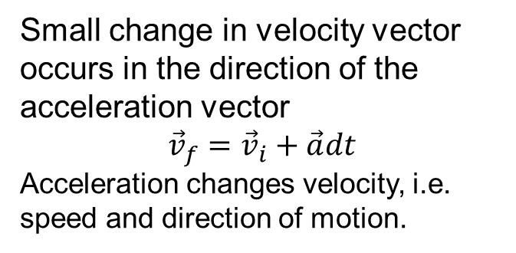
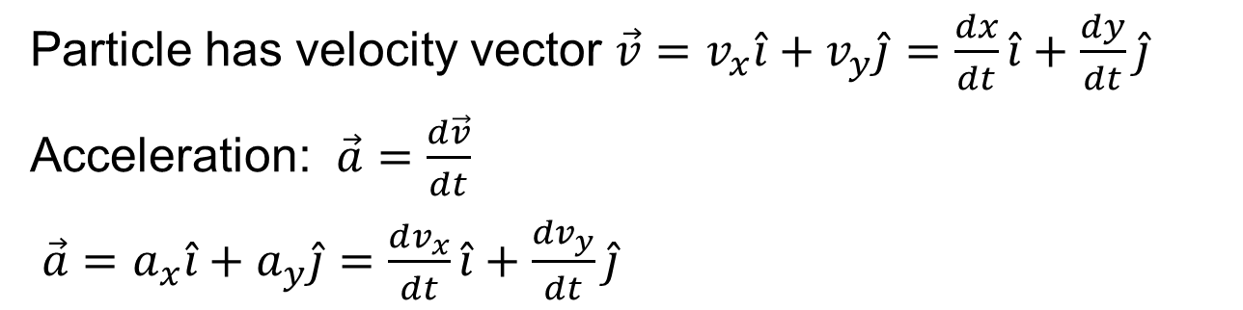
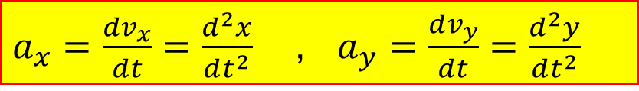
Acceleration
Particle has velocity vector $\vec{v}=v_{x}\hat{i}+v_{y}\hat{j}=\frac{dx}{dt}\hat{i}+\frac{dy}{dt}\hat{j}$
Acceleration: $\vec{a}=\frac{d\vec{v}}{dt}$
$\vec{a}=a_{x}\hat{i}+a_{y}\hat{j}=\frac{dv_{x}}{dt}\hat{i}+\frac{dv_{y}}{dt}\hat{j}$
$a_{x}=\frac{dv_{x}}{dt}=\frac{d^{2}x}{dt^{2}}$ , $a_{y}=\frac{dv_{y}}{dt}=\frac{d^{2}y}{dt^{2}}$
Small change in velocity vector occurs in the direction of the acceleration vector
$${\vec{v}}_{f}={\vec{v}}_{i}+\vec{a}dt$$
Acceleration changes velocity, i.e. speed and direction of motion.

Slide 4
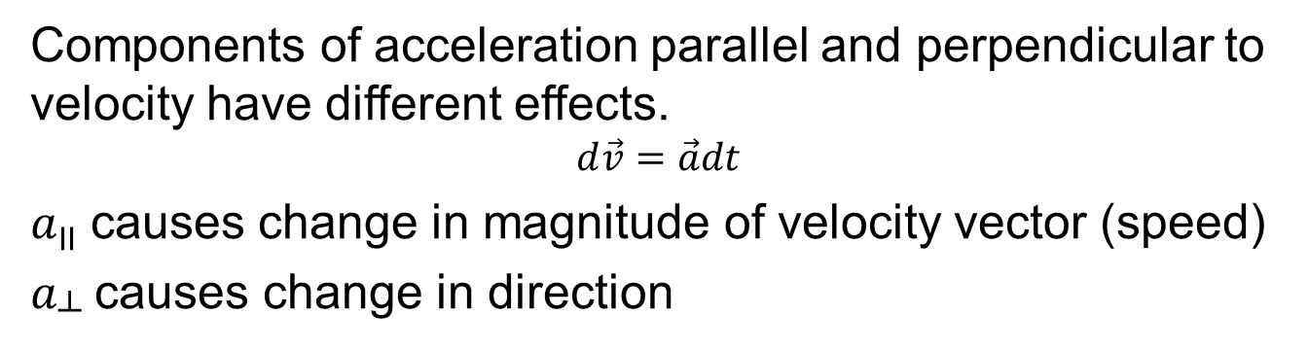
Effect of acceleration components
Components of acceleration parallel and perpendicular to velocity have different effects.
$$d\vec{v}=\vec{a}dt$$
$a$_{II} causes change in magnitude of velocity vector (speed)
$a$┴ causes change in direction

Slide 5
Demonstrations
Vertical launch of ball from traveling car
Simultaneously dropped and horizontally launched balls

Slide 7
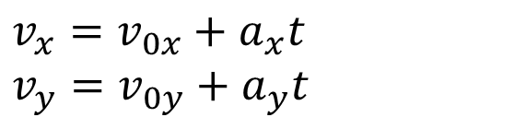
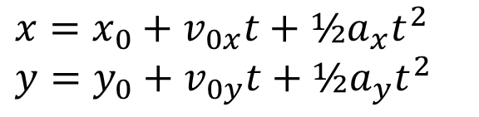
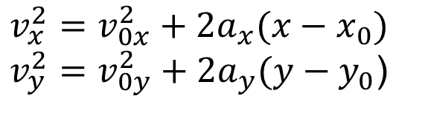
Kinematics equations
For constant acceleration:
$$x=x_{0}+v_{0x}t+½a_{x}t^{2}$$
$$y=y_{0}+v_{0y}t+½a_{y}t^{2}$$
$$v_{x}=v_{0x}+a_{x}t$$
$$v_{y}=v_{0y}+a_{y}t$$
$$v_{x}^{2}=v_{0x}^{2}+{2a}_{x}(x−x_{0})$$
$v_{y}^{2}=v_{0y}^{2}+{2a}_{y}(y−y_{0}$)

Slide 8
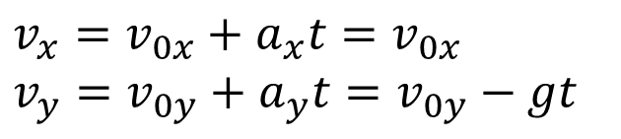
Projectile Motion
If only gravity acts on an object (free fall), then acceleration is a constant vector of magnitude g, directed down.
Effect on velocity:
$$v_{x}=v_{0x}+a_{x}t=v_{0x}$$
$$v_{y}=v_{0y}+a_{y}t=v_{0y}−gt$$

Slide 9
Projectile motion: Simulation
http://www.walter-fendt.de/ph14e/projectile.htm

Slide 10


Free-fall trajectory
$$x=x_{0}+v_{0x}t+½a_{x}t^{2}$$
$$y=y_{0}+v_{0y}t+½a_{y}t^{2}$$
Worked out on the board…

Slide 11
Example
A person is stranded between a river and a high vertical cliff. To get help, they want to throw a bottle containing a message over the river. If they throw the bottle with an initial velocity V₀ and at a positive angle θ with respect to the horizontal, what is the minimum height H they need to climb up the cliff to ensure that the bottle just barely reaches the opposite river bank, a distance D away?

Slide 13
Demo: The hunter and the monkey
*You will work this out in the Special Homework.
Hint: the angle θ between initial velocity and horizontal is not given, but knowing D and H will enable you to find sin θ and cos θ.

