Slide 1
Lecture 8: Circular motion
Uniform and non-uniform circular motion
Centripetal acceleration
Problem solving with Newton’s 2nd Law for circular motion

Slide 2
Effect of force components
Components of force parallel and perpendicular to velocity have different effects.
$$d\vec{v}=\vec{a}dt=\frac{\vec{F}}{m}dt$$
F_{II} causes change in magnitude of velocity vector (speed)
F ┴ causes change in direction

Slide 3
Uniform circular motion
Motion in a circle with constant speed
Caution:
velocity is a vector and has magnitude and direction
⟹ constant speed does not mean constant velocity. There will be acceleration!
$$a_{c}=\frac{v^{2}}{R}$$
Centripetal acceleration
Directed towards center of the circle

Slide 4
Non-uniform circular motion
Motion in a circle with non- constant speed
Centripetal acceleration
Towards the center
changes direction
Tangential acceleration
tangential to circle,
changes speed
$$a_{c}=\frac{v^{2}}{R}$$
$v$ is speed at that
instant, does not have
to be constant
$$a_{tan}=\frac{dv}{dt}$$

Slide 5
Forces create centripetal acceleration
The acceleration towards the center must be created by a force that is acting towards the center.
$$ΣF_{r}=ma_{c}=m\frac{v^{2}}{R}$$
Example: http://www.walter-fendt.de/ph1i1e/carousel.htm

Slide 6
Example: ball in vertical circle
A Ball of mass m at the end of a string of length L is moving in a vertical circle. When it is at its lowest point, it has speed V. What is the tension in the string at that instant?

Slide 7
Example: ball in vertical circle-
Minimum speed?
A Ball of mass m at the end of a string of length L is moving in a vertical circle. What must be its minimum speed at the highest point?

Slide 8
Demo: An instructor gets wet…
… or maybe not?
Twirling a bucket full of water in a vertical circle

Slide 9
Pseudoforces
In non-inertial rotating reference frame: Pseudoforces
Centrifugal force
Coriolis force

Slide 10
Coriolis force
Due to Earth's rotation
Relevant for very large masses (air masses, ocean currents) that are moving
Responsible for formation of hurricanes
Northern hemisphere: Deflection to the right
as seen in direction of motion

Slide 11
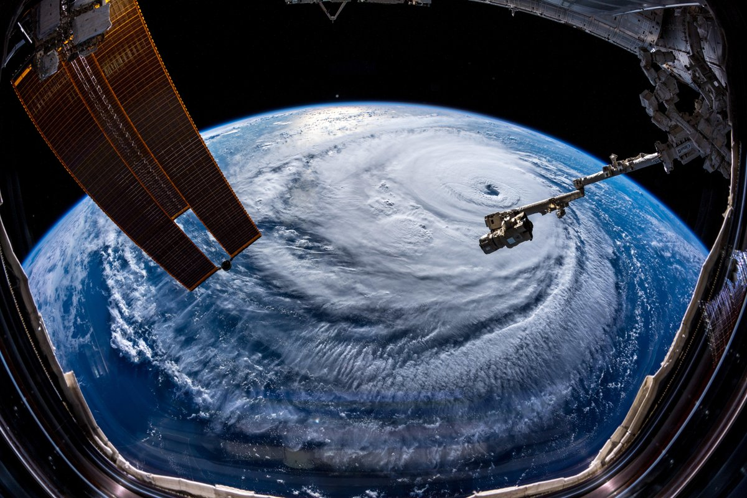
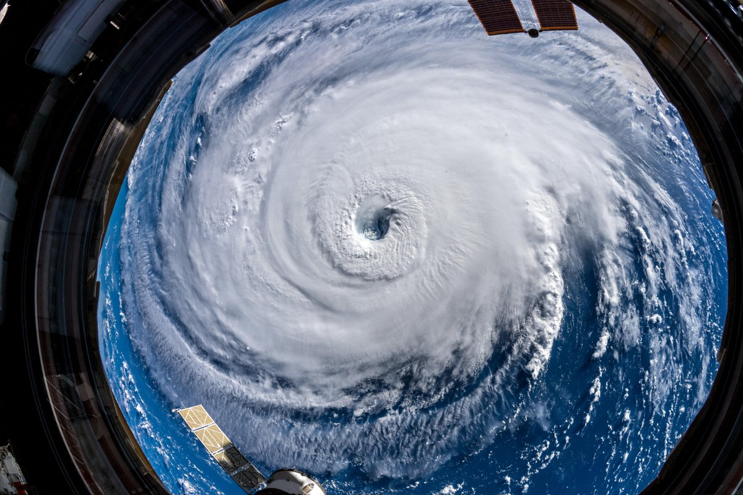
Hurricane Florence seen from the
International Space Station
September 12, 2018
(photo: Alexander Gerst @ISS)

Slide 12
In this course, we will never describe circular motion
in a rotating coordinate system.
Attach coordinate system to Earth,
treat Earth as inertial reference frame
No centrifugal force
In inertial reference frame: Inertia
Object continues motion in straight line at constant speed unless force acts

Slide 13
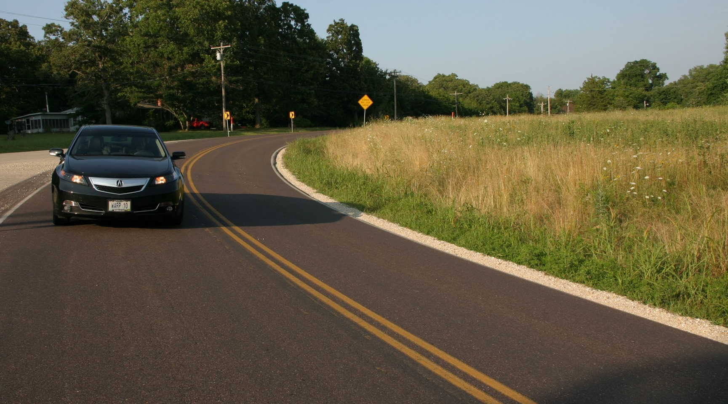
Car in flat curve

Slide 14
Car in flat curve

Slide 15
Car in flat curve worked out
$$ΣF_{x}=ma_{x}$$
$$f_{S}=m\frac{v^{2}}{R}$$
$$ΣF_{y}=ma_{y}$$
$$N+\left(−W\right)=0$$
$$N=mg$$
Maximum speed if: $f_{s}=f_{s max}=μN=μmg$
$$v_{max}=\sqrt{μgR}$$

Slide 16
Car in banked curve
Banking makes it possible to go around the curve even when the road is frictionless.

Slide 17
Car in banked curve: design speed

Slide 18
Car in banked curve with friction
Going slower than design speed
Find minimum speed in HW

Slide 19
Car in banked curve with friction
Going faster than design speed
Find maximum speed in HW

