Slide 1
Lecture 12: Potential energy diagrams
Problem with Work done by “other” forces
Relationship between force and potential energy
Potential energy diagrams

Slide 2
Example with other force
A block of mass M is at rest on an incline that makes an angle θ with the horizontal. It slides down a distance L and then flies of the edge a height H above the ground. Throughout its motion, a constant vertical blowing force of magnitude B is acting on the block.
Derive an expression for the speed with which the block hits the ground.

Slide 3
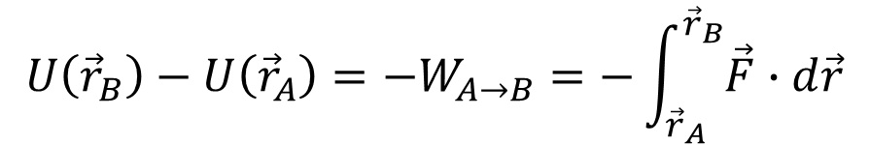
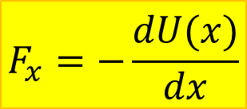
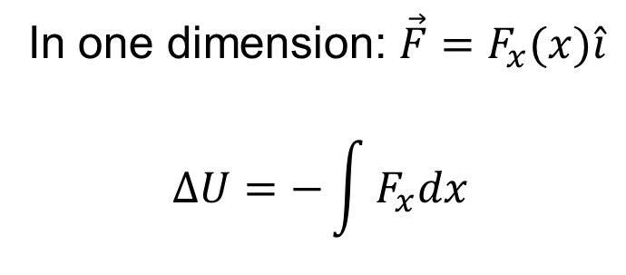
Relationship between force and potential energy
$$U\left({\vec{r}}_{B}\right)−U\left({\vec{r}}_{A}\right)=−W_{A→B}=−\int_{{\vec{r}}_{A}}^{{\vec{r}}_{B}}{\vec{F}∙d\vec{r}}$$
In one dimension: $\vec{F}=F_{x}(x)\hat{i}$
$$∆U=−\int{F_{x}dx}$$
$$F_{x}=−\frac{dU(x)}{dx}$$
$U_{grav}=mgy$ (y-axis up) $F_{grav,y}=−\frac{d}{dy}\left(mgy\right)=−mg$

Slide 4
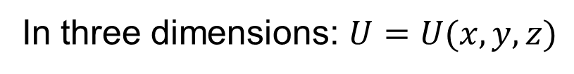
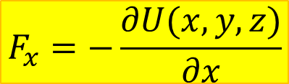

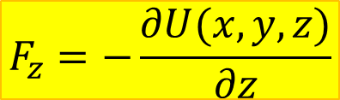
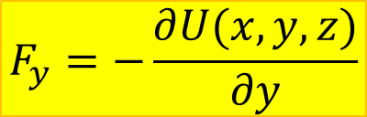
In three dimensions: $U=U(x,y,z)$
$$F_{x}=−\frac{∂U(x,y,z)}{∂x}$$
$$F_{y}=−\frac{∂U(x,y, z)}{∂y}$$
$$F_{z}=−\frac{∂U(x,y,z)}{∂z}$$
Partial derivative $\frac{∂}{∂x}$means: treat $y$ and $z$ like constants
and only x like a variable

Slide 5
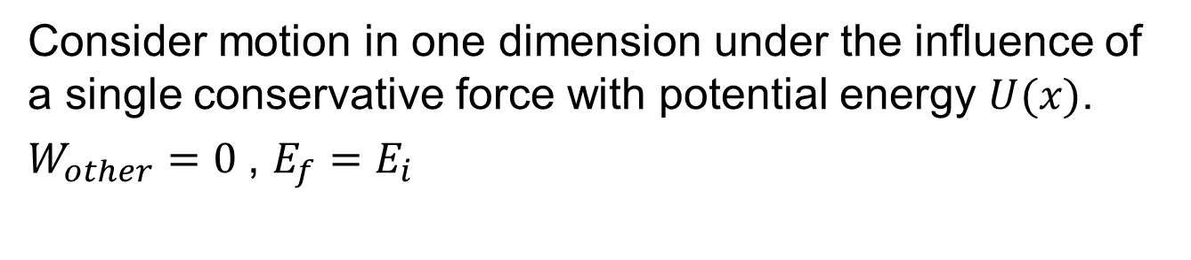
Motion in a potential energy well
Consider motion in one dimension under the influence of a single conservative force with potential energy $U(x)$.
$W_{other}=0$, $E_{f}=E_{i}$

Slide 6
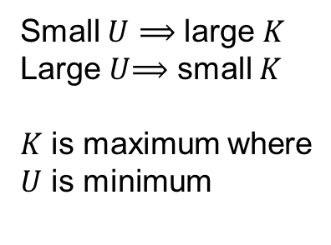
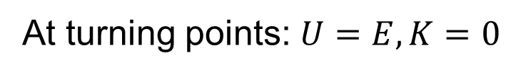
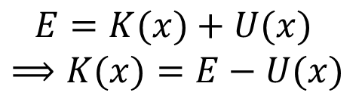
Kinetic and potential energy
$$E=K(x)+U(x)$$
$$⟹K(x)=E−U(x)$$
Small $U$ ⟹ large $K$
Large $U$⟹ small $K$
$K$ is maximum where
$U$ is minimum
At turning points: $U=E, K=0$

Slide 7
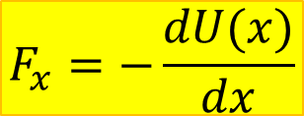
Force and potential energy
$$F_{x}=−\frac{dU(x)}{dx}$$
The force is the
negative slope
of potential energy
graph

Slide 8
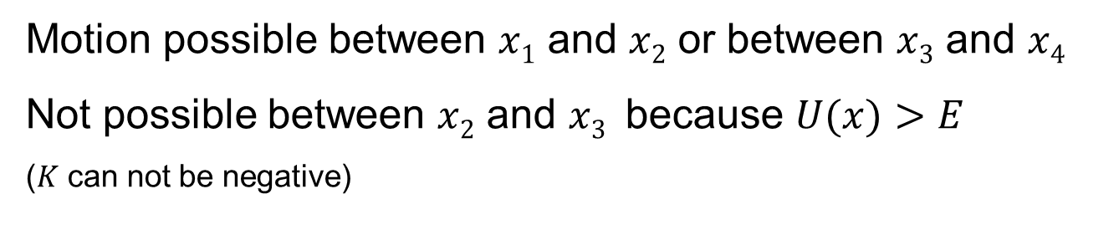
Different total mechanical energy
Motion possible between $x1$ and $x2$ or between $x3$ and $x4$
Not possible between $x2$ and $x3$ because $U(x)>E$
($K$ can not be negative)

Slide 9
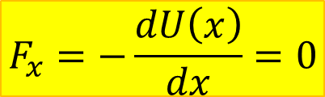
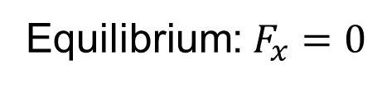
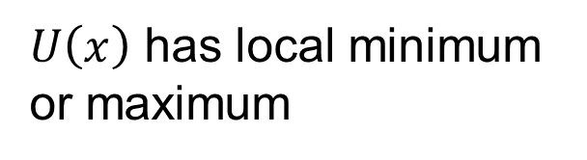
Equilibrium
Equilibrium:$F_{x}=0$
$$F_{x}=−\frac{dU\left(x\right)}{dx}=0$$
$U\left(x\right)$ has local minimum
or maximum
Minimum = stable
Maximum = unstable

Slide 10
Example: Diatomic Molecule
Diatomic molecule: two atoms separated a distance r
What should we expect about force between atoms?
Too close: repulsive force
The shorter the distance,
the greater the force
Too far: attractive force
Force decreases with distance,
goes to zero for r→∞
Distance just right: equilibrium

Slide 11
Example: Diatomic Molecule
Diatomic molecule: two atoms separated a distance r

