Slide 1
Lecture 23:
Angular momentum
Angular momentum of a point mass
Angular momentum of a rigid rotating object
Conservation of angular momentum

Slide 2
Translation vs rotation
Linear momentum $\vec{p}$ is fundamental quantity for translation.
Forces change linear momentum.
Angular momentum $\vec{l}$ is fundamental quantity for rotation.
Torques change angular momentum.
$$\vec{l}=\vec{r}×\vec{p}=\vec{r}×m\vec{v}$$

Slide 3
Angular momentum of a particle
$$\vec{l}=\vec{r}×\vec{p}=\vec{r}×m\vec{v}$$
$$l=r_{⊥}mv=rmv_{⊥}=rmv sinθ$$
Direction: right hand rule

Slide 4
Angular momentum of rigid object
$$\vec{L}=\sum_{n}{{\vec{l}}_{n}}$$
For system of particles:
$$\sum_{n}{l_{n}=\sum_{n}{r_{n⊥}m_{n}v_{n}=\sum_{n}{r_{n⊥}m_{n}{(ω_{n} r}_{n⊥})=}}}ω\sum_{n}{m_{n}{r_{n⊥}}^{2}}$$
$$\vec{L}=I\vec{ω}$$
$\vec{L}$ is in the same direction as angular velocity $\vec{ω}$ vector for rotations about a symmetry axis only.
This is not the case for rotation about other axes.

Slide 5
Angular momentum conservation
$$\sum{τ_{z}=\frac{dL_{z}}{dt}=\frac{d(Iω_{z})}{dt}=Iα_{z}}$$
$$\sum{\vec{τ}}=\sum{{\vec{τ}}_{ext}=\frac{d\vec{L}}{dt}}$$
For system:
$$\sum{{\vec{τ}}_{ext}=0⟹\frac{d\vec{L}}{dt}=0\text{, }{\vec{L}}_{i}={\vec{L}}_{f} }$$
If
Compare: $\sum{F_{x}=\frac{dP_{x}}{dt} }$ If $\sum{F_{ext, x}=0, P_{ix}=P_{fx} }$

Slide 6
Demonstrations

Slide 7
Demonstrations

Slide 8
Demonstrations

Slide 9
Example 1
A ball of mass $m$ and speed $V$ strikes a door at angle θ and bounces off at a right angle with ¼ its original speed. What is the final angular speed of the door after the collision?

Slide 10
Example 2
A ball from example 1 is made of putty and sticks to the door after the collision. What is the final angular speed of the door with the ball stuck on?

Slide 11
Example 3
A merry-go-round (solid disk of mass M and radius R) is rotating on frictionless bearings about a vertical axis through its center. It rotates in the clockwise direction with angular speed ω. A child of mass ½M is initially sitting at the outer edge of the merry-go-round. When the child jumps off tangentially to the circumference, the merry-go-round reverses its rotation and now rotates with the same angular speed ω in the opposite, i.e. counterclockwise, direction. Derive an expression for the speed relative to the ground with which the child jumps off.

Slide 12
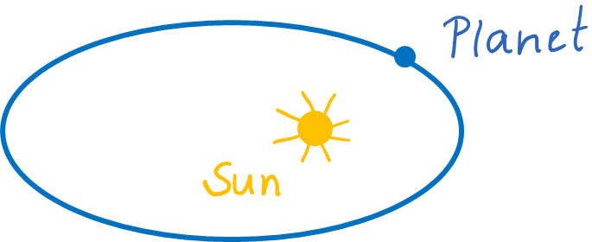
Kepler’s 2nd Law
A line drawn between the sun and a planet sweeps out equal areas in equal intervals of time

