Slide 1
Lecture 24: Periodic Motion
Motion of a mass at the end of a spring
Differential equation for simple harmonic oscillation
Amplitude, period, frequency and angular frequency
Energetics
Simple pendulum
Physical pendulum

Slide 2
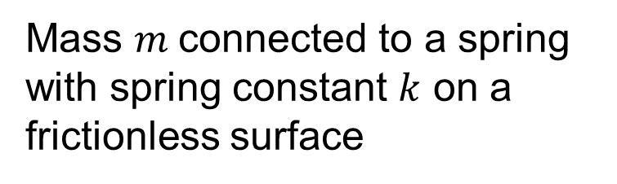

Mass at the end of a spring
Mass $m$connected to a spring with spring constant $k$ on a frictionless surface
$$F_{x}=−kx$$
Linear restoring spring force

Slide 3
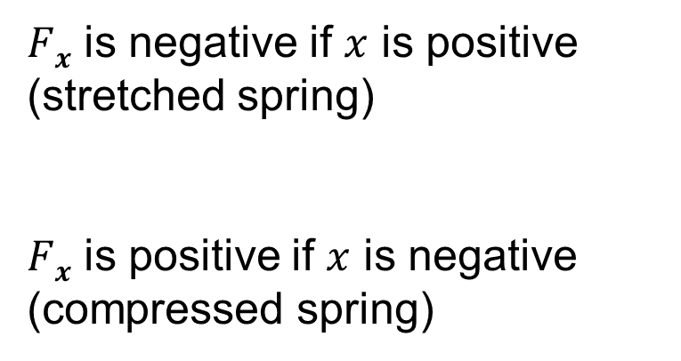
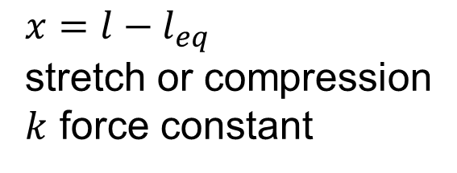

Spring force
Spring force: $F_{S x}=−kx$
$x=l−l_{eq}$
stretch or compression
$k$ force constant
$Fx$ is negative if $x$ is positive
(stretched spring)
$Fx$ is positive if $x$ is negative
(compressed spring)

Slide 4
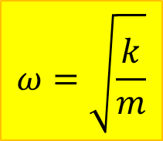
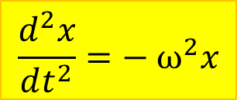
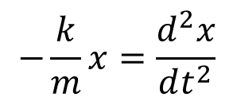
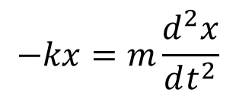

Differential equation of a SHO
$\text{Newton}\text{’}\text{s}\text{ 2}\text{nd} \text{Law}$: $\sum{F_{x}}=ma_{x}$
$$−kx=m\frac{d^{2}x}{dt^{2}}$$
$$−\frac{k}{m}x=\frac{d^{2}x}{dt^{2}}$$
$$\frac{d^{2}x}{dt^{2}}=− ω^{2}x$$
$$ω=\sqrt{\frac{k}{m}}$$
*
Angular frequency
Differential equation of a
Simple Harmonic Oscillator
*We can always write it like this because m and k are positive

Slide 5
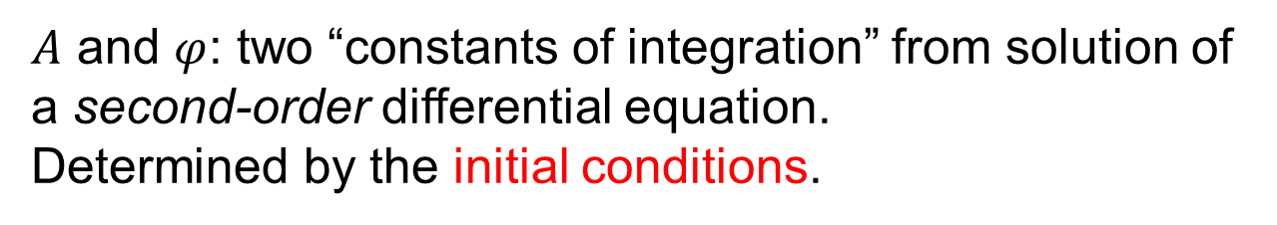

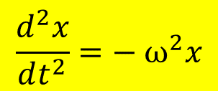
Solution
$$\frac{d^{2}x}{dt^{2}}=− ω^{2}x$$
Equation for SHO
General solution:
$x=A cos(ωt+φ)$
$A$ and $φ$: two “constants of integration” from solution of a second-order differential equation.
Determined by the initial conditions.

Slide 6

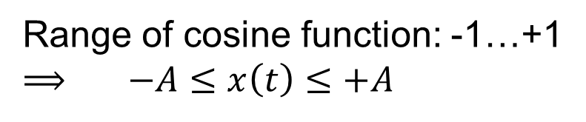
Amplitude
$x=A cos(ωt+φ)$
Range of cosine function: -1…+1
⟹ $−A≤x\left(t\right)≤+A$
A = Amplitude of the oscillation

Slide 7
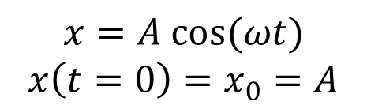

Phase Constant
$x=A cos(ωt+φ)$
If φ=0:
$$x=A cos(ωt)$$
$x\left(t=0\right)=x_{0}=A$
To describe motion with different starting points:
Add phase constant to shift the cosine function

Slide 8

$x=A cos(ωt+φ)$

Slide 9
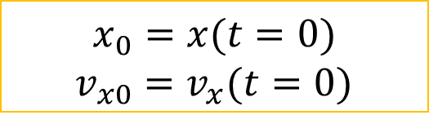
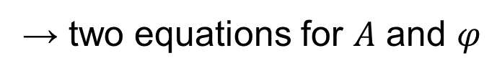
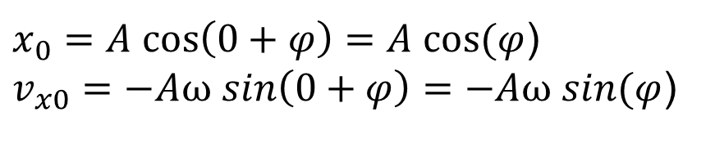
Initial conditions
$$x_{0}=x(t=0)$$
$v_{x0}=v_{x}(t=0)$
$x_{0}=A cos\left(0+φ\right)=A cos⁡(φ$)
$v_{x0}=−Aω sin\left(0+φ\right)=−Aω sin⁡(φ$)
→ two equations for $A$ and $φ$

Slide 10
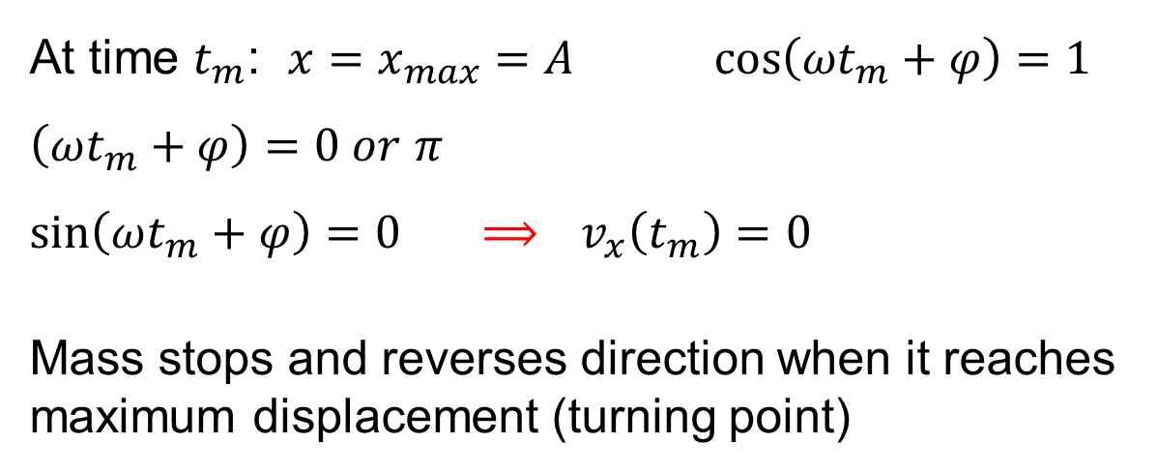
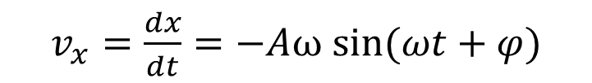

Position and velocity
$x=A cos(ωt+φ)$
$v_{x}=\frac{dx}{dt}=−Aω sin(ωt+φ)$
At time $t_{m}$: $x=x_{max}=A cos\left(ωt_{m}+φ\right)=1$
$\left(ωt_{m}+φ\right)=0 or$ $π$
$sin\left(ωt_{m}+φ\right)=0$ ⟹ $v_{x}\left(t_{m}\right)=0$
Mass stops and reverses direction when it reaches
maximum displacement (turning point)

Slide 11
Simulation
http://www.walter-fendt.de/ph14e/springpendulum.htm

Slide 12

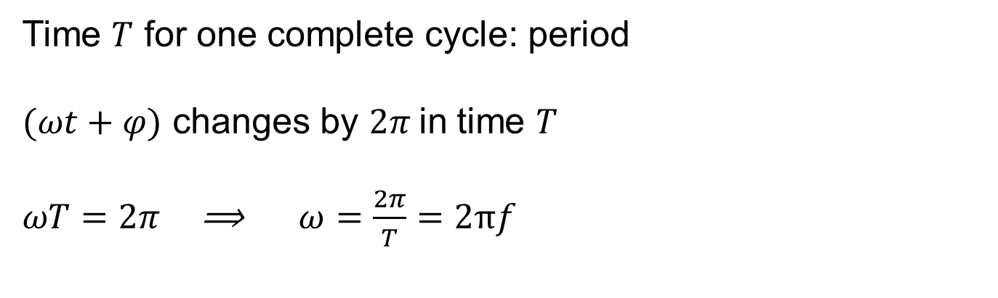
Period and angular frequency
$x=A cos(ωt+φ)$
Time $T$ for one complete cycle: period
$(ωt+φ)$ changes by $2π$ in time $T$
$ωT=2π$ ⟹ $ω=\frac{2π}{T}=2πf$

Slide 13
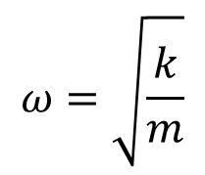
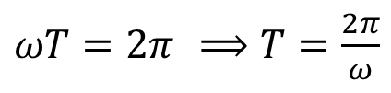
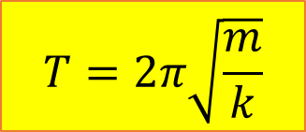
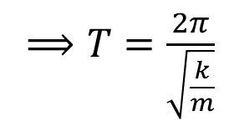
Effect of mass and amplitude on period
$ωT=2π$ ⟹ $T=\frac{2π}{ω}$
$$ω=\sqrt{\frac{k}{m}}$$
⟹ $T=\frac{2π}{\sqrt{\frac{k}{m}}}$
$$T=2π\sqrt{\frac{m}{k}}$$
Amplitude $A$ does not appear – no effect on period
Demo: Vertical springs showing effect of $m$ and $A$

Slide 14
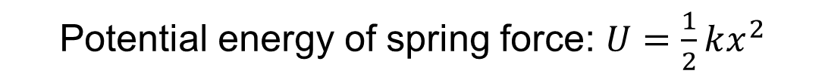

Energy in SHO
Potential energy of spring force: $U=\frac{1}{2}kx^{2}$
$$E=½kA^{2}$$

Slide 15
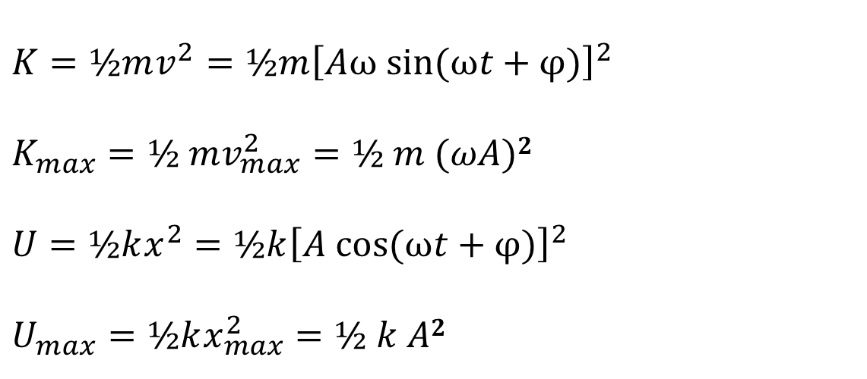
Kinetic and potential energy in SHO
$$K=½mv^{2}=½m{\left[Aω sin⁡(ωt+φ)\right]}^{2}$$
$$K_{max}=½ mv_{max}^{2}=½ m (ωA)2$$
$$U=½kx^{2}=½k{\left[A cos⁡(ωt+φ)\right]}^{2}$$
$$U_{max}=½kx_{max}^{2}=½ k A2$$
$$E=K_{max} sin2 (ωt+φ)+U_{max}cos2 (ωt+φ)$$
http://www.walter-fendt.de/ph14e/springpendulum.htm

Slide 16
Example
A block of mass M is attached to a spring and executes simple harmonic motion of amplitude A. At what displacement(s) x from equilibrium does its kinetic energy equal twice its potential energy?

Slide 17
SHO
$$\frac{d^{2}x}{dt^{2}}=− ω^{2}x$$
Equation for SHO
General solution:
$x=A cos(ωt+φ)$
$$T=\frac{2π}{ω}$$

Slide 18

Simple Pendulum
Point mass $m$ at the end of a massless string of length $L$
$θ$ = displacement coordinate (with sign) from vertical equilibrium position

Slide 19
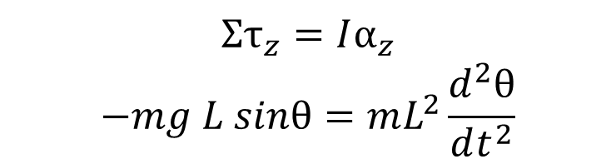
Simple Pendulum
$$Στ_{z}=Iα_{z}$$
$$−mg L sinθ=mL^{2}\frac{d^{2}θ}{dt^{2}}$$
T does not produce a torque, since the line of action goes through point P
Very complicated differential equation!
But for small oscillations:
$$sinθ≈θ$$
And
$$−\frac{g}{L}θ=\frac{d^{2}θ}{dt^{2}}$$
Differential equation of SHO

Slide 20
Simple pendulum oscillations
$$−\frac{g}{L}θ=\frac{d^{2}θ}{dt^{2}}$$
Differential equation of
simple harmonic oscillator
$$θ\left(t\right)=θ_{max}cos⁡(ωt+φ)$$
$$T=2π\sqrt{\frac{L}{g}}$$
With$ω=\sqrt{\frac{g}{L}}$ and
Demo: Simple pendulum with different masses, lengths and amplitudes

Slide 21
$$T=2π\sqrt{\frac{L}{g}}$$
Demo: Simple pendulum with different masses, lengths and amplitudes
Period independent of mass
Period independent of amplitude

Slide 22
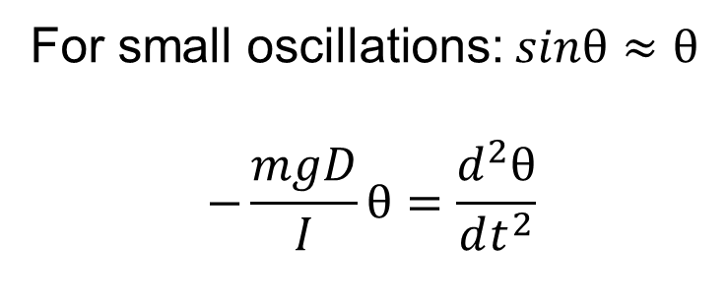
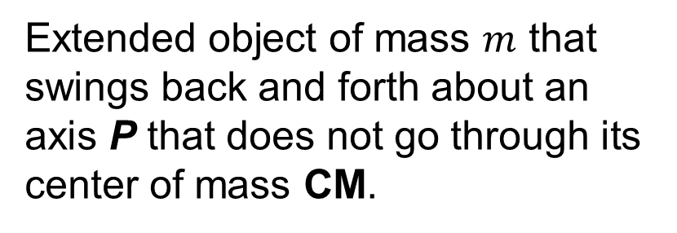
Physical Pendulum
Extended object of mass $m$ that swings back and forth about an axis P that does not go through its center of mass CM.
$$Στ_{z}=Iα_{z}$$
$$−mg D sinθ=I\frac{d^{2}θ}{dt^{2}}$$
For small oscillations: $sinθ≈θ$
$$−\frac{mgD}{I}θ=\frac{d^{2}θ}{dt^{2}}$$
SHO

Slide 23
Motion of the Physical Pendulum
$$−\frac{mgD}{I}θ=\frac{d^{2}θ}{dt^{2}}$$
SHO
$$T=2π\sqrt{\frac{I}{mgD}}$$
I is moment of inertia about axis P
D is distance between P and CM
Parallel axis theorem:
$$I_{P}=I_{CM}+mD^{2}$$
Demo: Meter stick pivoted at different positions

Slide 24
Example
A uniform disk of mass M and radius R is pivoted at a point at the rim. Find the period for small oscillations.
$$T=2π\sqrt{\frac{I}{mgD}}$$
$$I_{P}=I_{CM}+mD^{2}$$

