Slide 1
Lecture 26: Wave motion
longitudinal and transverse waves
traveling waves
wave length, frequency, and speed
distinction between wave speed and speed of a particle
speed of a wave on a string
Doppler effect

Slide 2
The Physlet simulations presented in this lecture have been developed by, and are used with permission from, Davidson College.
http://webphysics.davidson.edu/Applets/Applets.html

Slide 3
What is a wave?
A wave is a self-propagating disturbance in a medium.
The material of the medium is not moved along the wave. Particles of the medium are momentarily displaced from their equilibrium.
Demonstrations

Slide 4
Transverse and longitudinal waves
Transverse wave:
displacement perpendicular to propagation direction (ex: wave on string, water wave)
Longitudinal wave:
displacement parallel to propagation direction
(ex: sound)
Simulation:
http://webphysics.davidson.edu/physlet_resources/bu_semester1/c20_trans_long.html

Slide 5
Periodic waves
We will only study sine-shaped waves, because all periodic functions can be expressed as a superposition of different sine functions.
Simulation: Fourier Analysis- building square wave
http://webphysics.davidson.edu/physlet_resources/bu_semester1/c22_squarewave_sim.html

Slide 6


Sinusoidal waves
Snapshot at fixed time:
wave length
$$y\left(x\right)=A sin⁡(kx+φ)$$
$k$ wave number

Slide 7
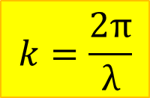
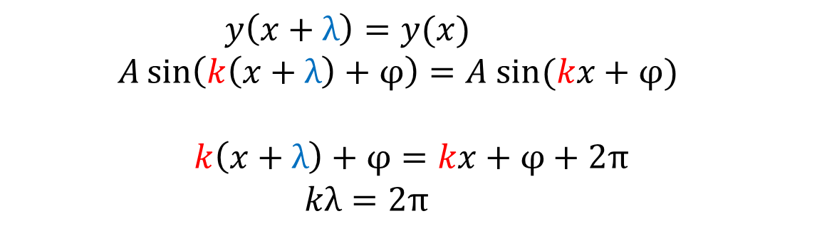
Wave length and wave number
$y\left(x+λ\right)=y(x)$
$A\sin\left(k\left(x+λ\right)+φ\right)=$ $A sin⁡(kx+φ)$
$$k\left(x+λ\right)+φ=kx+φ+2π$$
$kλ=2π$
$$k=\frac{2π}{λ}$$

Slide 8
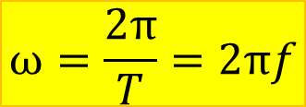

Time dependence at fixed position
Particle located at x=0:
$$y\left(t\right)=A sin⁡(ωt+φ)$$
$$ω=\frac{2π}{T}=2πf$$
http://webphysics.davidson.edu/physlet_resources/bu_semester1/c20_wavelength_period.html

Slide 9
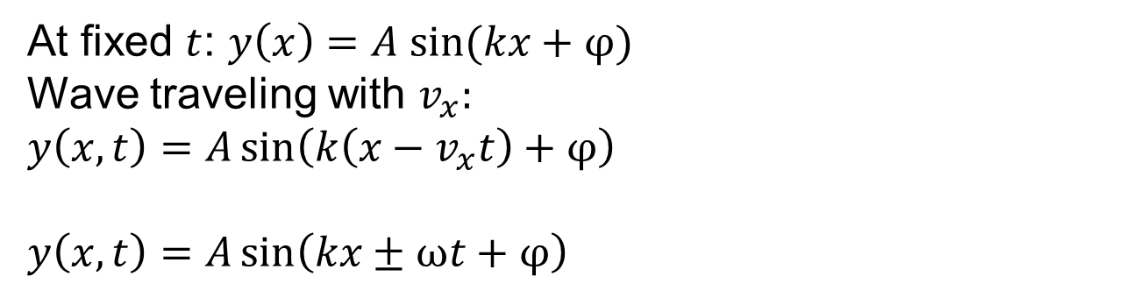
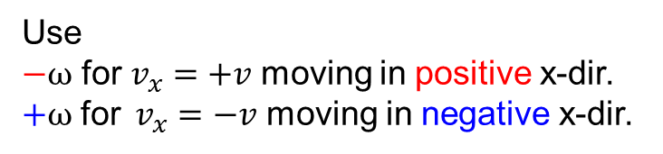
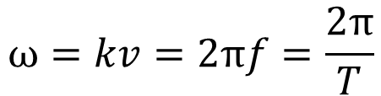
Traveling wave
At fixed $t$: $y\left(x\right)=A sin⁡(kx+φ)$
Wave traveling with $v_{x}:$
$$y\left(x,t\right)=A\sin\left(k\left(x−v_{x}t\right)+φ\right)$$
$$y\left(x,t\right)=A\sin\left(kx±ωt+φ\right)$$
Use
$−ω$ for$v_{x}=+v$ moving in positive x-dir.
$+ω {\text{for} v}_{x}=−v$ moving in negative x-dir.
$$ω=kv=2πf=\frac{2π}{T}$$

Slide 10

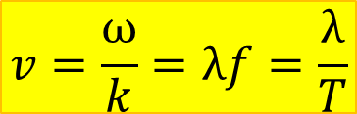
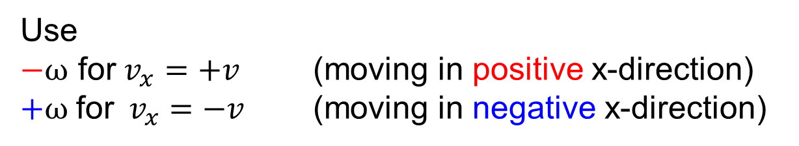
Wave speed and direction
$$y\left(x,t\right)=A\sin\left(kx±ωt+φ\right)$$
Use
$−ω$ for$v_{x}=+v$ (moving in positive x-direction)
$+ω {\text{for} v}_{x}=−v$ (moving in negative x-direction)
$$v=\frac{ω}{k}=λf=\frac{λ}{T}$$
The wave travels one wavelength during one period.

Slide 11

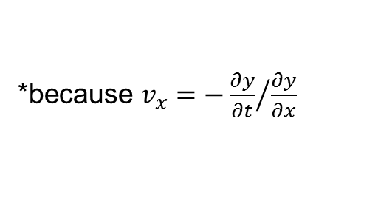

$$y\left(x,t\right)=A\sin\left(kx±ωt+φ\right)$$
Use
$−ω$ for$v_{x}=+v$ (moving in positive x-direction)
$+ω {\text{for} v}_{x}=−v$ (moving in negative x-direction)*
*because $v_{x}=−{\frac{∂y}{∂t}}/{\frac{∂y}{∂x}}$

Slide 12
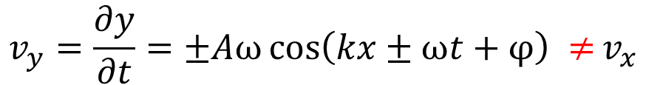
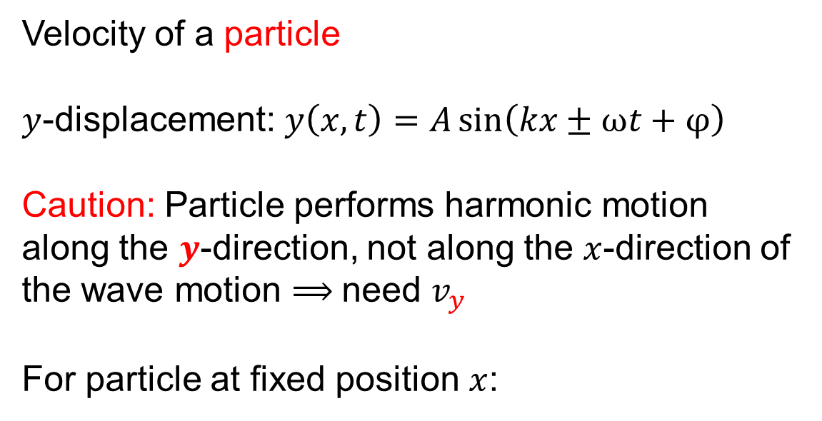
Transverse velocity
Velocity of a particle
$y$-displacement: $y\left(x,t\right)=A\sin\left(kx±ωt+φ\right)$
Caution: Particle performs harmonic motion along the $y$-direction, not along the $x$-direction of the wave motion ⟹ need $v_{y}$
For particle at fixed position $x$:
$$v_{y}=\frac{∂y}{∂t}=±Aω\cos\left(kx±ωt+φ\right) ≠v_{x}$$

Slide 13
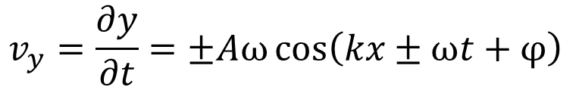
Maximum transverse speed
$$v_{y}=\frac{∂y}{∂t}=±Aω\cos\left(kx±ωt+φ\right)$$

Slide 14
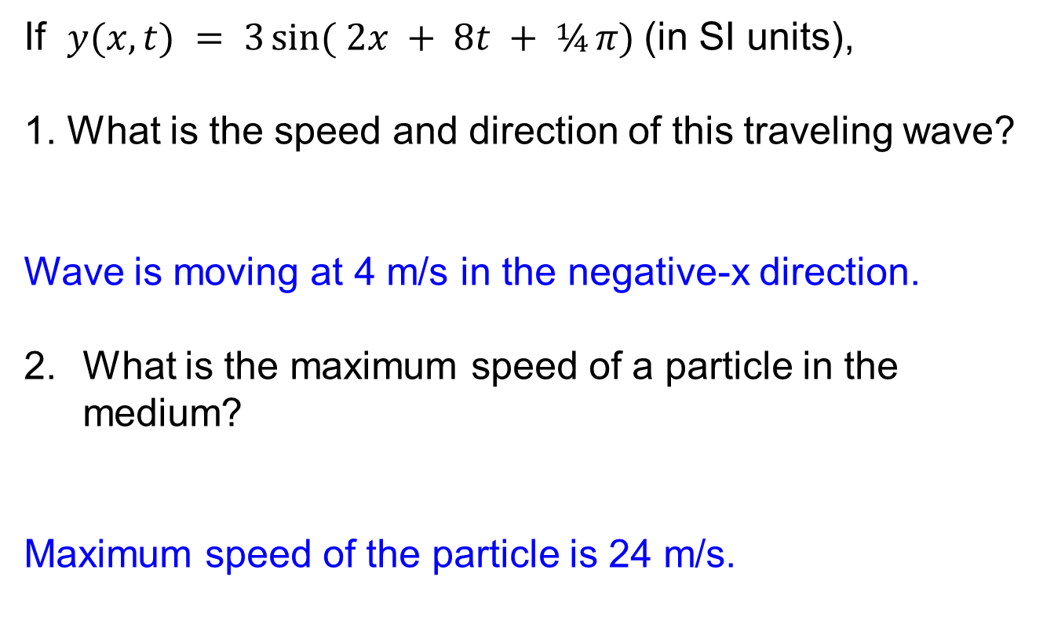
Example
If $y(x,t) = 3 sin⁡( 2x + 8t + ¼ π)$(in SI units),
1. What is the speed and direction of this traveling wave?
Wave is moving at 4 m/s in the negative-x direction.
What is the maximum speed of a particle in the medium?
Maximum speed of the particle is 24 m/s.

Slide 15
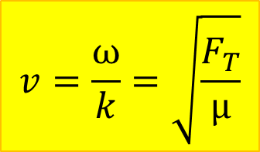
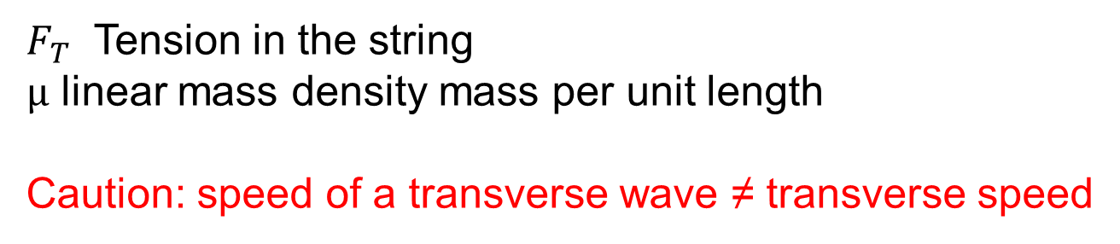
Speed of transverse wave on string
$$v=\frac{ω}{k}=\sqrt{\frac{F_{T}}{μ}}$$
$F_{T}$ Tension in the string
$μ$ linear mass density mass per unit length
Caution: speed of a transverse wave ≠ transverse speed

Slide 16
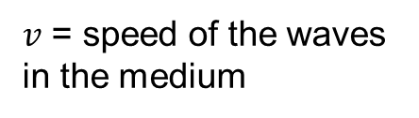
Doppler Effect
$v$ = speed of the waves
in the medium
http://webphysics.davidson.edu/physlet_resources/bu_semester1/c21_doppler.html

Slide 17
Example for Doppler Effect
You are exploring a planet in a very fast ground vehicle. The speed of sound in the planet's atmosphere is 250 m/s. You are driving straight toward a cliff wall at 50 m/s. In panic, you blow your emergency horn to warn the cliff wall to get out of your way.
If the frequency of your horn is 1000 Hz, what is the frequency your helpless friend who is standing by the cliff wall will hear?
What is the frequency of the sound you hear reflected off the cliff before you crash into it?

Slide 18
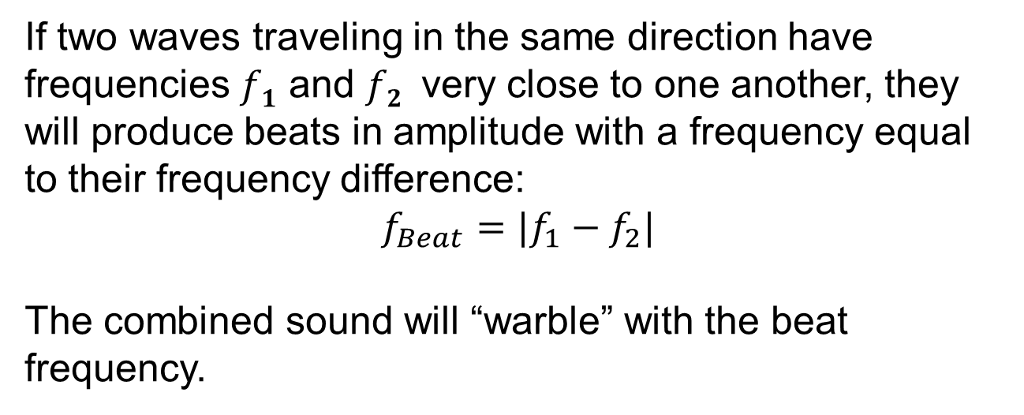
Beats
If two waves traveling in the same direction have frequencies $f1$ and $f2$ very close to one another, they will produce beats in amplitude with a frequency equal to their frequency difference:
$$f_{Beat}=|f_{1}−f_{2}|$$
The combined sound will “warble” with the beat frequency.
http://webphysics.davidson.edu/physlet_resources/bu_semester1/c22_beats.html
Set frequency difference to “large”
Demo: 440Hz and 441 Hz

