Slide 1
Lecture 30: 2nd Law of Thermodynamics
Thermodynamic cycles
2nd law of Thermodynamics
Carnot Cycle

Slide 2
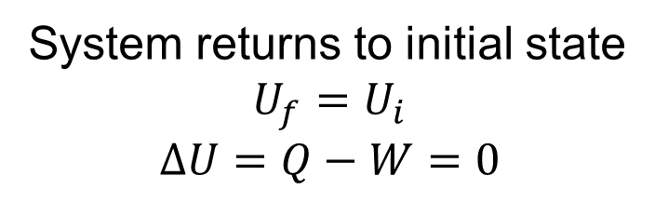

Thermodynamic Cycles
System returns to initial state
$$U_{f}=U_{i}$$
$$∆U=Q−W=0$$
$$Q=W$$

Slide 3
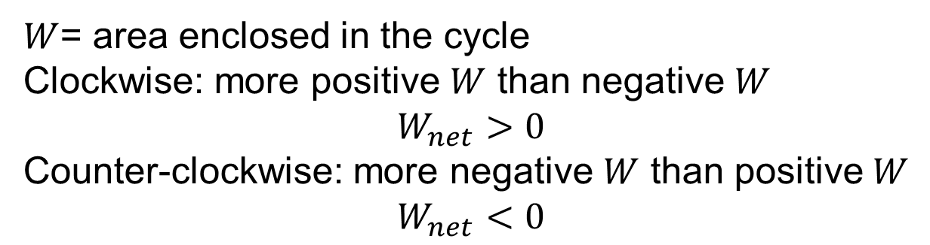
Work in cycles
$W$= area enclosed in the cycle
Clockwise: more positive $W$ than negative $W$
$$W_{net}>0$$
Counter-clockwise: more negative $W$ than positive $W$
$$W_{net}<0$$

Slide 4
Heat engine

Slide 5
Efficiency

Slide 6
2nd Law of Thermodynamics
Clausius:
Heat flows naturally from a hot object to a cold object; heat will not flow spontaneously from a cold object to a hot object.
Kelvin-Planck:
No device is possible whose sole effect is to transform a given amount of heat completely into work.
impossible to construct perpetual motion machine
of 2nd kind

Slide 8
Carnot Cycle
1-2 isothermal expansion
2-3 adiabatic expansion
3-4 isothermal compression
4-1 adiabatic compression

Slide 9
Carnot Cycle
1-2 isothermal expansion
2-3 adiabatic expansion
3-4 isothermal compression
4-1 adiabatic compression

Slide 10
Efficiency of Carnot Cycle
1-2 isothermal expansion
2-3 adiabatic expansion
3-4 isothermal compression
4-1 adiabatic compression

Slide 11
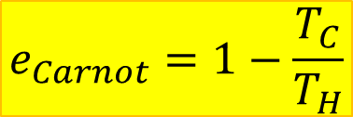
Carnot Cycle has maximum efficiency
Heat transfer during isothermal process reversible
No heat transfer during process that involves temperature change
Carnot cycle is reversible
If more efficient engine existed:
Couple hypothetical engine with reverse Carnot engine
Transforms amount of heat completely into work
Violates 2nd Law
More efficient engine can not exist
$$e_{Carnot}=1−\frac{T_{C}}{T_{H}}$$
Maximum efficiency of any cycle
operating between T_{C} and T_{H}

