Slide 1
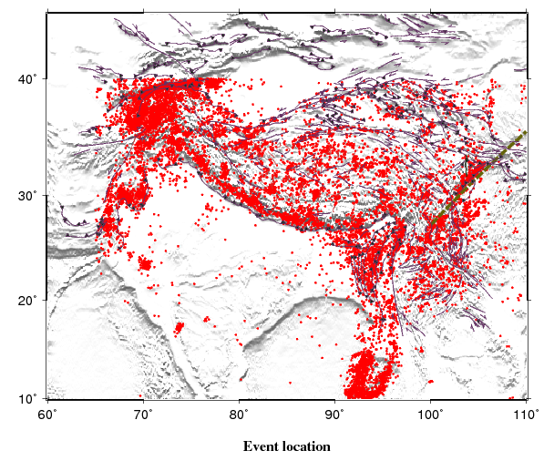
Figure 1. A topographic relief map of Tibetan Plateau showing seismic events with magnitude greater than 4 (red dots), Longmenshan strike (dashed olive green lines) and major faults (solid purple lines) .

Slide 2
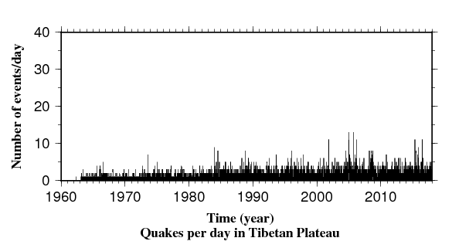
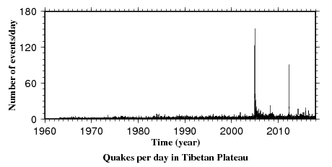
Figure 2. Number of earthquakes per day computed using the declustered catalog.

Slide 3
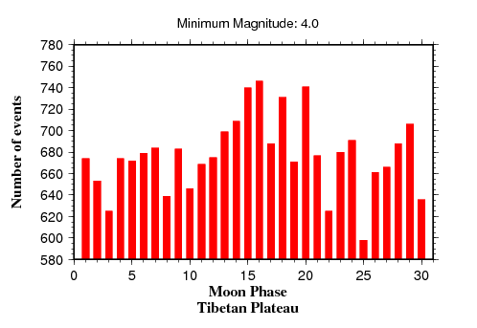
Figure 3. Number of quakes in each moonphase from 1962 to 2018.

Slide 4
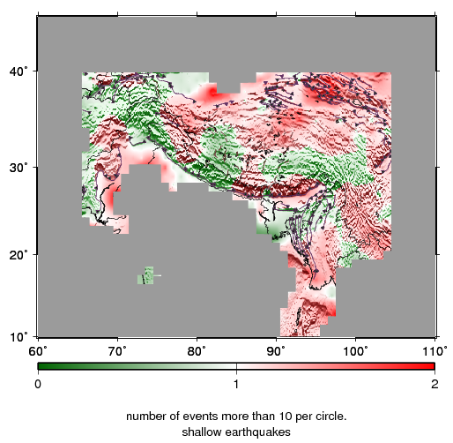
Figure 4. Ratio distribution of events occur on moonphase 12 to 17 and other days. Number of events are more than 10 per circle.

Slide 5
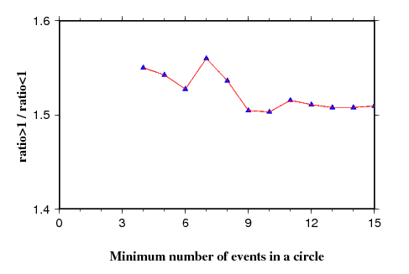
Figure 5. Results of ratio greater than 1 over less than 1 in figure 4.

Slide 6
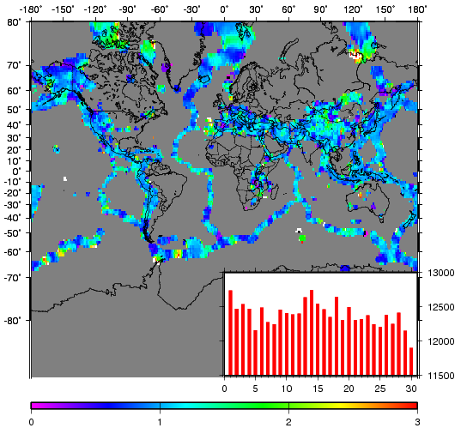
Figure 6. Global ratio distribution of events occur on moonphase 12 to 17 and other days. Number of events are more than 10 per circle. The inset histogram is number of events in each moonphase from 1900 to 2018.

