Slide 1
File I/O

Slide 2
Objectives
Learn input and output streams to work with files

Slide 3
Stream Connections
Can you use cin or cout to work with files?
Input stream (type: iStream): cin
Output stream (type: oStream): cout
We must use some “file streams” to work with files
Data file extension: .dat

Slide 4
Stream Connections
File Stream Basics:
#include <fstream> // short for file stream
Input File Stream type: ifstream
Output File Stream type: ofstream

Slide 5
General Usage Flow
1
Declare and connect a file stream object
2
Use it
3
Close it

Slide 6
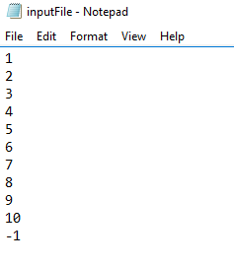
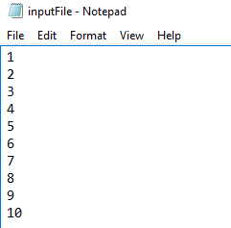
Reading in Data from a File
When would you know to stop reading from a file?
Utilize an end-of-file ‘marker’
Utilize the ‘state’ of the file stream objects (both ifstream & ofstream)
http://www.cplusplus.com/reference/fstream/ifstream/
End-of-file marker

Slide 7
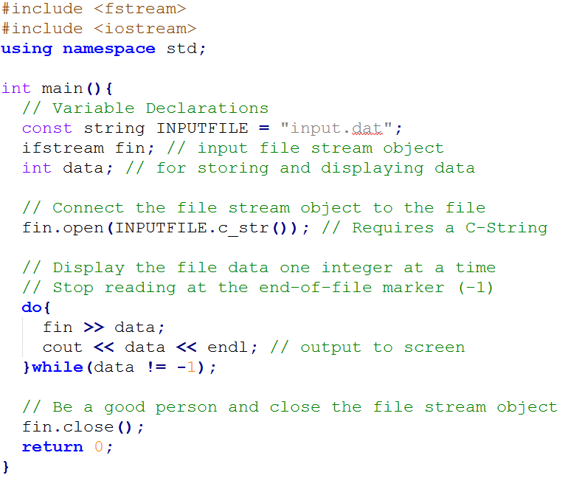
Reading in Data from a File
1) Utilize an end-of-file ‘marker’
Input:

Slide 8
Reading in Data from a File
1) Utilize an end-of-file ‘marker’
Input:
Other string manipulations for data input can be used too, e.g. getline()

Slide 9
Reading in Data from a File
1) Utilize an end-of-file ‘marker’
Output:

Slide 10
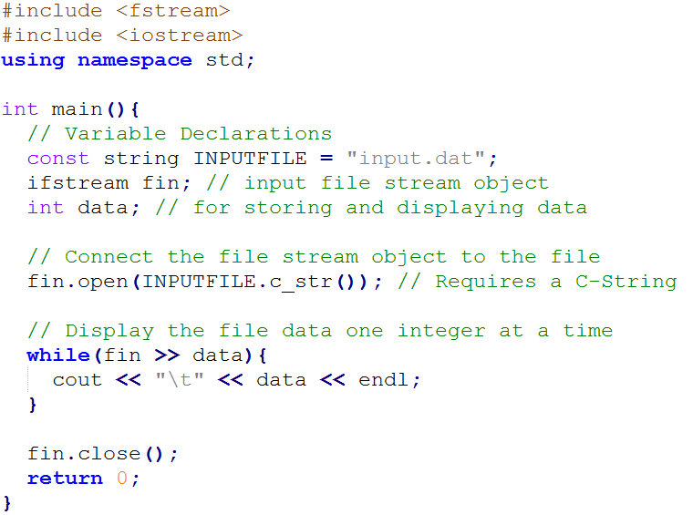
Reading in Data from a File
2) Utilize the state of a file stream object
Input:

Slide 11
Reading in Data from a File
2) Utilize the state of a file stream object
Input:
The return value of (fin >> data) is fin (recall the overload of <<)
When there is no more data to read from the file (or if some errors occurred), the state of fin will be evaluated as false

Slide 12
Review of operator << overload
Reference:
LHS
RHS
return the LHS

Slide 13
Reading in Data from a File
2) Utilize the state of a file stream object
Input:
The return value of (fin >> data) is fin (recall the overload of <<)
When there is no more data to read from the file (or if some errors occurred), the state of fin will be evaluated as false
After reading in 10, there will be no more data to read in, so the state of fin becomes false

Slide 14
Reading in Data from a File
2) Utilize the state of a file stream object
Output:

Slide 15
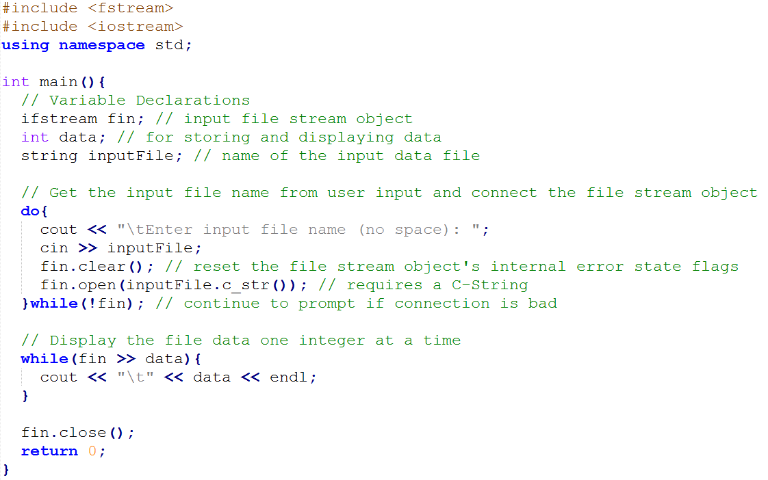
Reading in Data from a File

Slide 16
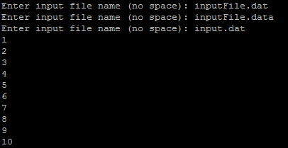
Reading in Data from a File

Slide 17
Using File Stream Objects as Function Parameter
When used as a function argument, a file stream object (actually any stream object) must be pass-by-reference.

Slide 18
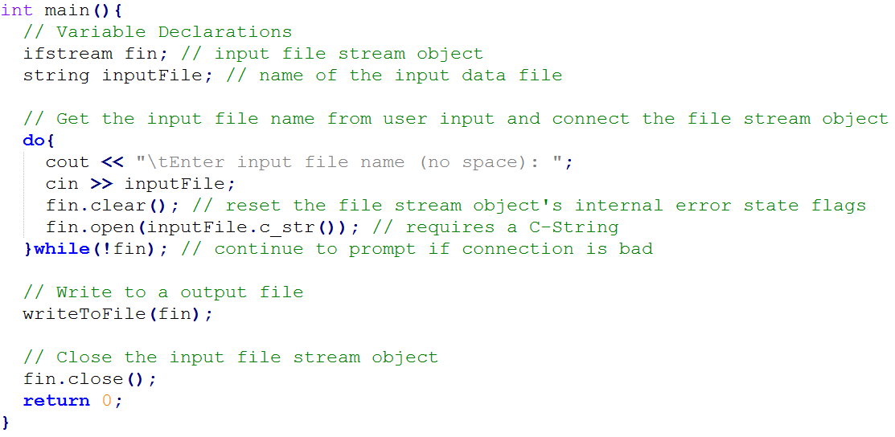
Using File Stream Objects as Function Parameter
Making the function call after fin is successfully connected

Slide 19
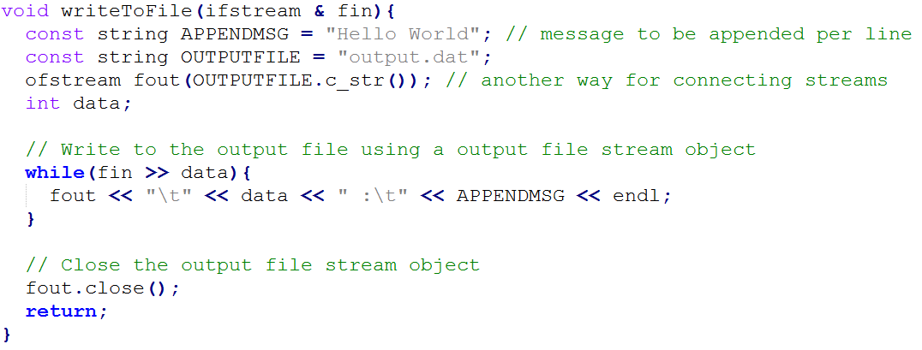
Writing Data to a File
output.dat will be created if it does not exist
If output.dat exists, then new data will overwrite the old data

Slide 20
Writing Data to a File
How would the output file looks like?

Slide 21
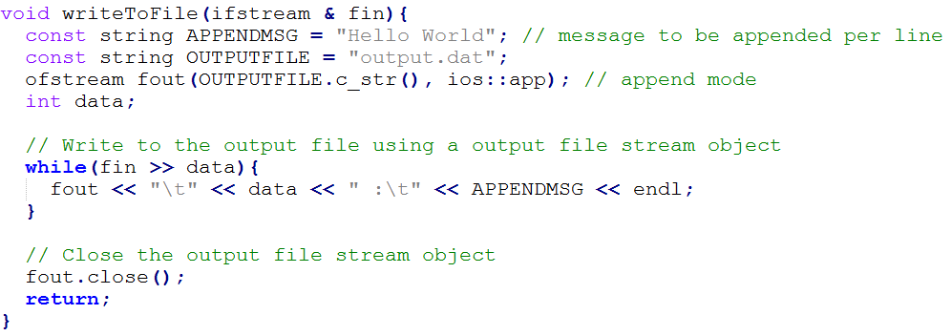
Writing (append) Data to a File
Append the data written out to the end of an existing file
http://www.cplusplus.com/reference/fstream/ofstream/ofstream/

Slide 22
Writing (append) Data to a File
Append the data written out to the end of an existing file
http://www.cplusplus.com/reference/fstream/ofstream/ofstream/
How would the output file looks like?

Slide 23
One More Note on the Operator << Overload

Slide 24
One More Note on the Operator << Overload
This insertion operator overload will work for cout
It will also works for the output file stream, so you can use it to write to a file

